Slide 1
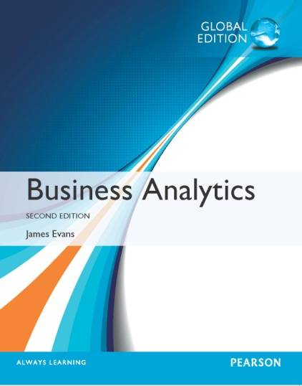

Chapter 5 Probability Distributions and Data Modeling

Slide 2
Basic Concepts of Probability
Probability is the likelihood that an outcome occurs. Probabilities are expressed as values between 0 and 1.
An experiment is the process that results in an outcome.
The outcome of an experiment is a result that we observe.
The sample space is the collection of all possible outcomes of an experiment.

Slide 3
Definitions of Probability
Probabilities may be defined from one of three perspectives:
Classical definition: probabilities can be deduced from theoretical arguments
Relative frequency definition: probabilities are based on empirical data
Subjective definition: probabilities are based on judgment and experience

Slide 4
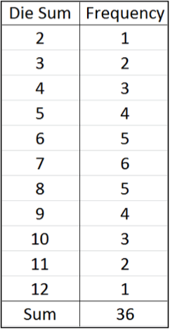
Example 5.1 Classical Definition of Probability
Roll 2 dice
36 possible rolls (1,1), (1,2),…(6,5), (6,6)
Probability = number of ways of rolling a number divided by 35; e.g., probability of a 3 is 2/36
Suppose two consumers try a new product.
Four outcomes:
1. like, like
2. like, dislike
3. dislike, like
4. dislike, dislike
Probability at least one dislikes product = 3/4

Slide 5
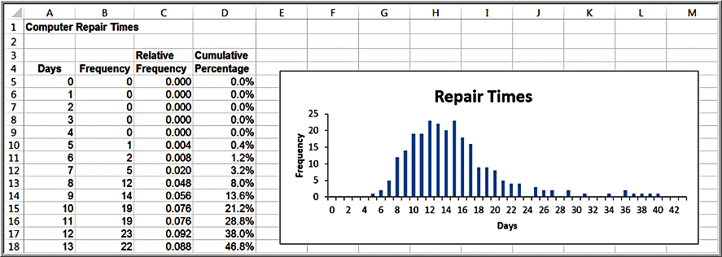
Example 5.2: Relative Frequency Definition of Probability
Use relative frequencies as probabilities
Probability a computer is repaired in 10 days = 0.076

Slide 6
Probability Rules and Formulas
Label the n outcomes in a sample space as O₁, O₂, …, O_{n}, where O_{i} represents the i^{th} outcome in the sample space. Let P(O_{i}) be the probability associated with the outcome O_{i}.
The probability associated with any outcome must be between 0 and 1.
0 ≤ P(O_{i}) ≤ 1 for each outcome O_{i} (5.1)
The sum of the probabilities over all possible outcomes must be equal to 1.
P(O₁) + P(O₂) + … + P(O_{n}) = 1 (5.2)

Slide 7
Probabilities Associated with Events
An event is a collection of one or more outcomes from a sample space.
Rule 1. The probability of any event is the sum of the probabilities of the outcomes that comprise that event.

Slide 8
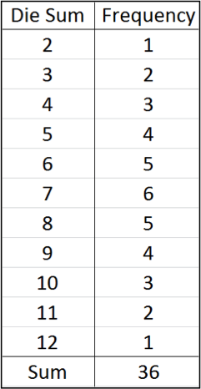
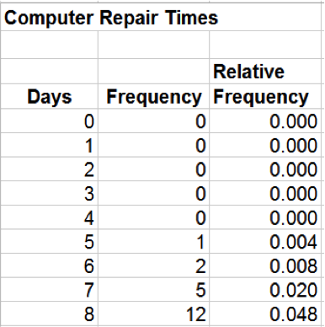
Example 5.3: Computing the Probability of an Event
Consider the events:
Rolling 7 or 11 on two dice
Probability = 6/36 + 2/36 = 8/36.
Repair a computer in 7 days or less
Probability =
= O₁ + O₂ + O₃ + O₄ + O₅ + O₆ + O₇
= 0 + 0 + 0 + 0 + .004 + .008 + .020
= 0.032

Slide 9
Complement of an Event
If A is any event, the complement of A, denoted A^{c}, consists of all outcomes in the sample space not in A.
Rule 2. The probability of the complement of any event A is P(A^{c}) = 1 – P(A).

Slide 10
Example 5.4: Computing the Probability of the Complement of an Event
Dice example:
A = {7, 11}
P(A) = 8/36
A^{c} = {2, 3, 4, 5, 6, 8, 9, 10, 12}
Using Rule 2:
P(A^{c}) = 1 − 8/36 = 28/36

Slide 11
Union of Events
The union of two events contains all outcomes that belong to either of the two events.
If A and B are two events, the probability that some outcome in either A or B (that is, the union of A and B) occurs is denoted as P(A or B).
Two events are mutually exclusive if they have no outcomes in common.
Rule 3. If events A and B are mutually exclusive, then P(A or B) = P(A) + P(B).

Slide 12
Example 5.5: Computing the Probability of Mutually Exclusive Events
Dice Example:
A = {7, 11}: P(A) = 8/36
B = {2, 3, 12}: P(B) = 4/36
P(A or B) = Union of events A and B
= P(A) + P(B)
= 8/36 + 4/36 = 12/36

Slide 13
Non-Mutually Exclusive Events
The notation (A and B) represents the intersection of events A and B – that is, all outcomes belonging to both A and B .
Rule 4. If two events A and B are not mutually exclusive, then P(A or B) = P(A)+ P(B) - P(A and B).

Slide 14
Example 5.6: Computing the Probability of Non-Mutually Exclusive Events
Dice Example:
A = {2, 3, 12}: P(A) = 4/36
B = {even number} : P(B) = 18/36
(A and B) = {2, 12}: P(A and B) = 2/36
P(A or B) = P(A) + P(B)− P(A and B)
= 4/36 + 18/36− 2/36
= 20/36

Slide 15
Joint and Marginal Probability
The probability of the intersection of two events is called a joint probability.
The probability of an event, irrespective of the outcome of the other joint event, is called a marginal probability.

Slide 16
Application of Joint and Marginal Probability
A sample of 100 individuals were asked to evaluate their preference for three new proposed energy drinks in a blind taste test.
The sample space consists of two types of outcomes corresponding to each individual: gender (F = female or M = male) and brand preference (B₁, B₂, or B₃).
Define a new sample space consisting of the outcomes that reflect the different combinations of outcomes from these two sample spaces.
O₁ = the respondent is female and prefers brand 1
O₂ = the respondent is female and prefers brand 2
O₃ = the respondent is female and prefers brand 3
O₄ = the respondent is male and prefers brand 1
O₅ = the respondent is male and prefers brand 2
O₆ = the respondent is male and prefers brand 3
The probability of each of these events is the intersection of the gender and brand preference event. For example, P(O₁) = P(F and B₁)

Slide 17
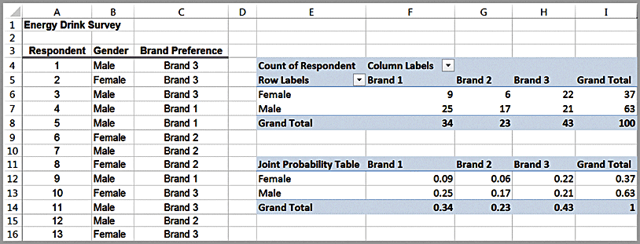
Example 5.7: Applying Probability Rules to Joint Events
Energy Drink Survey
The joint probabilities of gender and brand preference are calculated by dividing the number of respondents corresponding to each of the six outcomes listed above by the total number of respondents, 100.
E.g., P(F and B₁) = P(O₁) = 9/100 = 0.09
Joint probabilities

Slide 18
Example 5.7: Continued
The marginal probabilities for gender and brand preference are calculated by adding the joint probabilities across the rows and columns
E.g., the event F, (respondent is female) is comprised of the outcomes O₁, O₂, and O₃, and therefore P(F) = P(F and B₁) + P(F and B₂) + P(F and B₃) = 0.37
Marginal probabilities

Slide 19
Joint/Marginal Probability Rule
Calculations of marginal probabilities leads to the following probability rule:
Rule 5. If event A is comprised of the outcomes {A₁, A₂, …, A_{n}} and event B is comprised of the outcomes {B₁, B₂, …, B_{n}}, then
P(A_{i}) = P(A_{i} and B₁) + P(A_{i} and B₂) + … + P(A_{i} and B_{n})

Slide 20
Example 5.7 Continued
Events F and M are mutually exclusive, as are events B₁, B₂, and B₃ since a respondent may be only male or female and prefer exactly one of the three brands. We can use Rule 3 to find, for example, P(B₁ or B₂) = 0.34 + 0.23 = 0.57.
Events F and B₁, however, are not mutually exclusive because a respondent can be both female and prefer brand 1. Therefore, using Rule 4, we have P(F or B₁) = P(F) + P(B₁) – P(F and B₁) = 0.37 + 0.34 – 0.09 = 0.62.

Slide 21
Conditional Probability
Conditional probability is the probability of occurrence of one event A, given that another event B is known to be true or has already occurred.

Slide 22
Example 5.8 Computing a Conditional Probability in a Cross-Tabulation
Suppose we know a respondent is male. What is the probability that he prefers Brand 1?
Using cross-tabulation: Of 63 males, 25 prefer Brand 1, so the probability of preferring Brand 1 given that a respondent is male = 25/63
Using joint probability table: divide the joint probability 0.25 (the probability that the respondent is male and prefers brand 1) by the marginal probability 0.63 (the probability that the respondent is male).

Slide 23
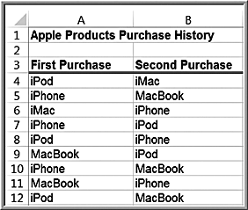
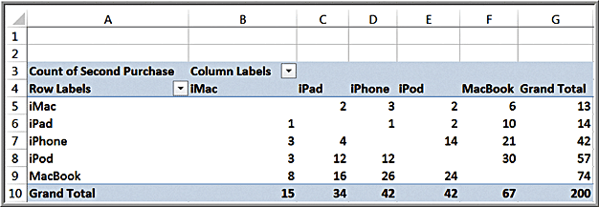
Example 5.9: Conditional Probability in Marketing
Apple Purchase History
The PivotTable shows the count of the type of second purchase given that each product was purchased first.
Probability of purchasing an
iPad given that a customer already purchased an iMac = 2/13

Slide 24
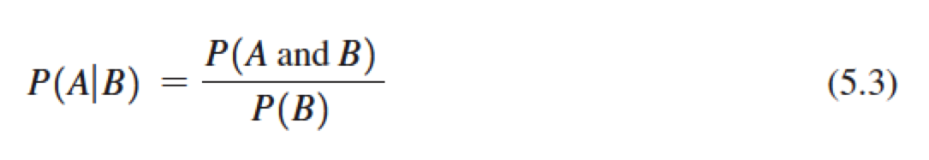
Conditional Probability Formula
The conditional probability of an event A given that event B is known to have occurred is
We read the notation P(A|B) as “the probability of A given B.”

Slide 25
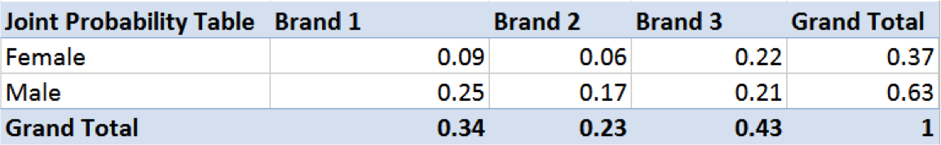
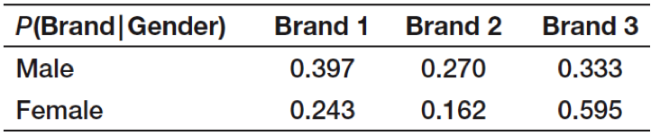
Example 5.10: Using the Conditional Probability Formula
P(B₁|M) = P(B₁ and M)/ P(M) = (0.25)/(0.63) = 0.397
P(B₁|F) = P(B₁ and F)/ P(F) = (0.09)/(0.37) = 0.243
Summary of conditional probabilities:
Applications in marketing and advertising.

Slide 26
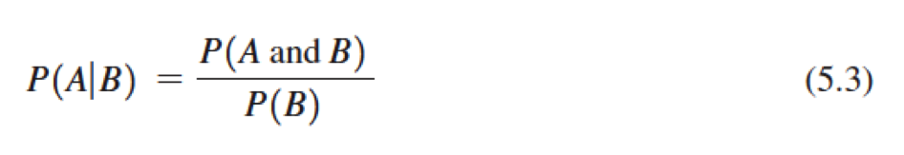
Variations of the Conditional Probability Formula
P(A and B) = P(A | B) P(B)
P(B and A) = P(B | A) P(A)
Note: P(A and B) = P(B and A)
Multiplication law of probability:

Slide 27
Extension of the Multiplication Law
Suppose B₁, B₂, . . . , B_{n} are mutually exclusive events whose union comprises the entire sample space. Then

Slide 28
Example 5.11: Using the Multiplication Law of Probability
“Texas Hold ‘Em” Poker
Probability of pocket aces (two aces in hand)
A₁ = Ace on first card; A₂ = Ace on second card
P(A₁ and A₂) = P(A₂|A₁) P(A₁)
= (3/51) (4/52)
= 0.004525

Slide 29
Independent Events
Two events A and B are independent if
P(A | B) = P(A).
Energy Drink Survey example: the probability of preferring a brand depends on gender.
Thus, we may say that brand preference and gender are not independent.

Slide 30
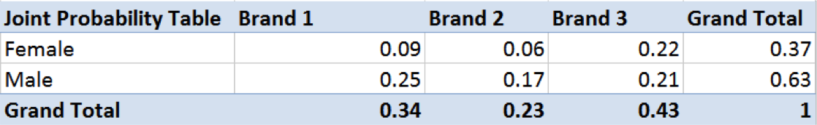
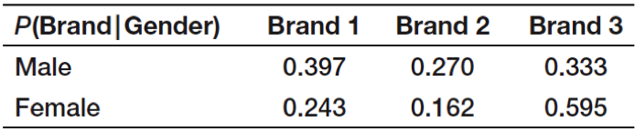
Example 5.12: Determining if Two Events are Independent
Are Gender and Brand Preference Independent?
P(B₁) = 0.34
P(B₁|M) = 0.397
Because 0.397 ≠ 0.34, Gender and Brand Preference are not independent.

Slide 31
Multiplication Law for Independent Events
If two events are independent, then we can simplify the multiplication law of probability in equation (5.4)
by substituting P(A) for P(A | B):

Slide 32
Example 5.13: Using the Multiplication Law for Independent Events
Dice Rolls:
Rolling pairs of dice are independent events since they do not depend on the previous rolls.
A = {roll a sum of 6 on first roll}
B = {roll a sum of 2, 3, or 12 on second roll}
Using formula (5.5): P(A and B) = P(A) P(B)
= (5/36) (4/36) = 0.0154

Slide 33
Random Variables
A random variable is a numerical description of the outcome of an experiment.
A discrete random variable is one for which the number of possible outcomes can be counted.
A continuous random variable has outcomes over one or more continuous intervals of real numbers.

Slide 34
Example 5.14: Discrete and Continuous Random Variables
Examples of discrete random variables:
outcomes of dice rolls
whether a customer likes or dislikes a product
number of hits on a Web site link today
Examples of continuous random variables:
weekly change in DJIA
daily temperature
time between machine failures

Slide 35
Probability Distributions
A probability distribution is a characterization of the possible values that a random variable may assume along with the probability of assuming these values.
We may develop a probability distribution using any one of the three perspectives of probability: classical, relative frequency, and subjective.

Slide 36
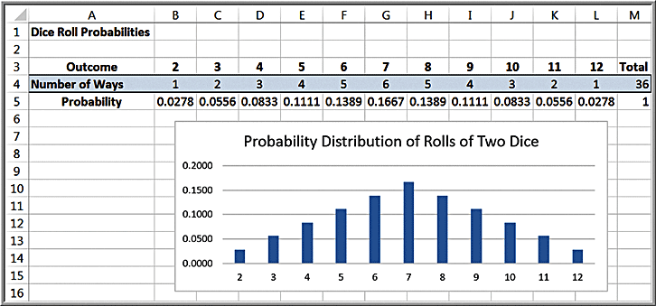
Example 5.14 Probability Distribution of Dice Rolls

Slide 37
Empirical Probability Distributions
We can calculate the relative frequencies from a sample of empirical data to develop a probability distribution. Because this is based on sample data, we usually call this an empirical probability distribution.
An empirical probability distribution is an approximation of the probability distribution of the associated random variable, whereas the probability distribution of a random variable, such as one derived from counting arguments, is a theoretical model of the random variable.

Slide 38
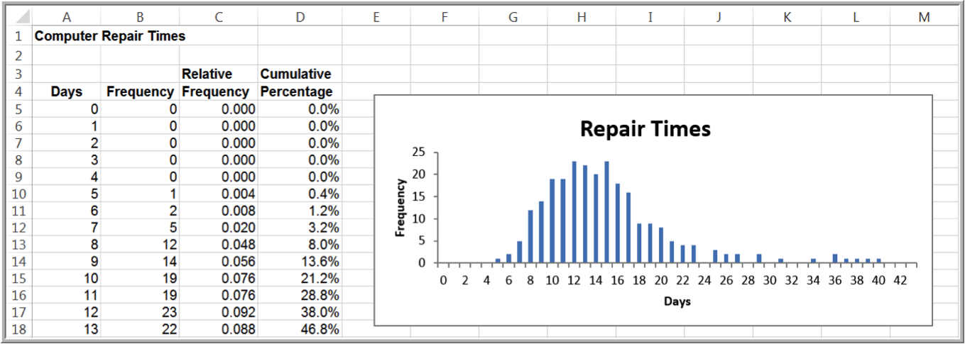
Empirical Probability Distribution Example

Slide 39
Subjective Probability Distributions
We could simply specify a probability distribution using subjective values and expert judgment.
This is often done in creating decision models for phenomena for which we have no historical data.

Slide 40
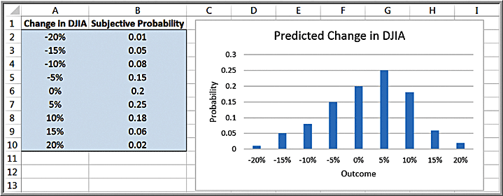
Example 5.16: A Subjective Probability Distribution
Distribution of an expert’s assessment of how the DJIA might change next year.

Slide 41
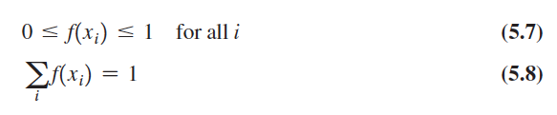
Discrete Probability Distributions
For a discrete random variable X, the probability distribution of the discrete outcomes is called a probability mass function and is denoted by a mathematical function, f(x).
The symbol x_{i} represents the i^{th} value of the random variable X and f(x_{i}) is the probability.
Properties:
the probability of each outcome must be between 0 and 1
the sum of all probabilities must add to 1

Slide 42
Example 5.17: Probability Mass Function for Rolling Two Dice
x_{i} = values of the random variable X, which represents sum of the rolls of two dice
x₁ = 2, x₂ = 3, …, x₁₀ = 11, x₁₁ = 12
f(x₁) = 1/36 = 0.0278; f(x₂) = 2/36 = 0.0556, etc.

Slide 43
Cumulative Distribution Function
A cumulative distribution function, F(x), specifies the probability that the random variable X assumes a value less than or equal to a specified value, x; that is,
F(x) = P(X ≤ x)

Slide 44
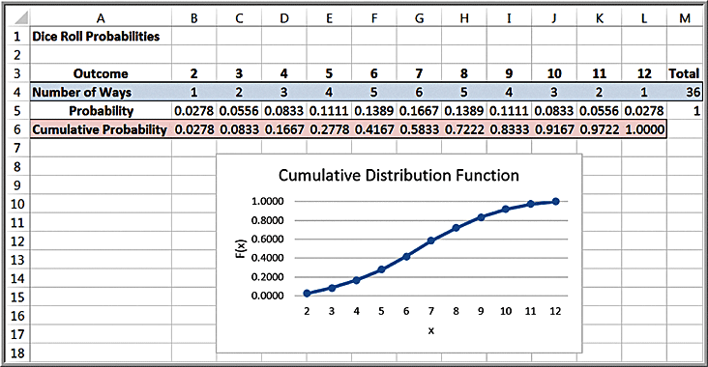
Example 5.18: Using the Cumulative Distribution Function
Probability of rolling a 6 or less = F(6) = 0.1667
Probability of rolling between 4 and 8:
= P(4 ≤ X ≤ 8) = P(3 < X ≤ 8) = P(X ≤ 8) – P(X ≤ 3)
= 0.7222 – 0.0833 = 0.6389

Slide 45

Expected Value of a Discrete Random Variable
The expected value of a random variable corresponds to the notion of the mean, or average, for a sample.
For a discrete random variable X, the expected value, denoted E[X], is the weighted average of all possible outcomes, where the weights are the probabilities:

Slide 46
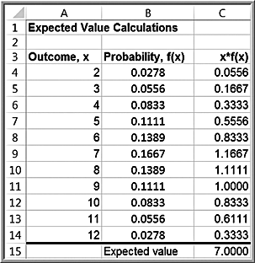
Example 5.19: Computing the Expected Value
Rolling two dice
E[X] = 2(0.0278) + 3(0.0556) + 4(0.0833) + 5(0.1111) + 6(0.1389) + 7(0.1667) + 8(0.1389) + 9(0.1111) + 10(0.0833) + 11(0.0556) + 12(0.0278) = 7

Slide 47
Example 5.20: Expected Value on Television
The Apprentice
Teams were required to select an artist (mainstream or avant-garde) and sell their art for the most money possible. A back-of-the-envelope expected value calculation would have easily predicted the winner.
Deal or No Deal
Contestant had 5 briefcases left with $100, $400, $1000, $50,000 or $300,000 in them.
Expected value of briefcases is $70,300.
Banker offered contestant $80,000 to quit, which was higher than the expected value. The probability of choosing the $300,000 briefcase was only 0.2, so the decision should have been easy to make.

Slide 48
Expected Value and Decision Making
The expected value is a “long-run average” and is appropriate for decisions that occur on a repeated basis.
For one-time decisions, however, you need to consider the downside risk and the upside potential of the decision.

Slide 49
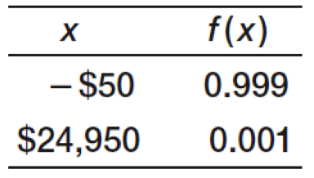
Example 5.21: Expected Value of a Charitable Raffle
Cost of raffle ticket is $50
1000 raffle tickets are sold.
Winning prize is $25,000
E[X] = −$25
If you played this game repeatedly over the long run, you would lose an average of $25.00 each time you play.
For any one game, you would either lose $50 or win $24,950.
Is the risk of losing $50 worth the potential of winning $24,950?

Slide 50
Example 5.22: Airline Revenue Management
Full and discount airfares are available for a flight.
Full-fare ticket costs $560
Discount ticket costs $400
X = ticket price paid
p = 0.75 (the probability of selling a full-fare ticket)
E[X] = 0.75($560) + 0.25(0) = $420
The airline should not discount full-fare tickets because the expected value of a full-fare ticket is greater than the cost of a discount ticket.
Break-even point: $400 = p($560) or p = 0.714

Slide 51

Variance of a Discrete Random Variable
The variance, Var[X ], of a discrete random variable X is a weighted average of the squared deviations from the expected value:

Slide 52
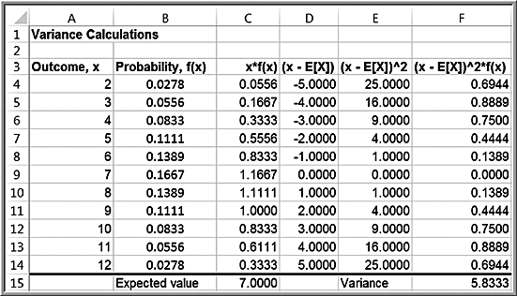
Example 5.23: Computing the Variance of a Random Variable
Rolling two dice

Slide 53

Bernoulli Distribution
Two possible outcomes, “success” and “failure,” each with a constant probability of occurrence; p is the probability of a success and 1 – p is the probability of a failure
Typically, x = 1 represents “success” and x = 0 represents “failure”
Probability mass function:
E[X] = p
Var[X] = p(1 − p)

Slide 54
Example 24: Using the Bernoulli Distribution
The Bernoulli distribution can be used to model whether an individual responds positively (x = 1), or negatively (x = 0) to a telemarketing promotion.
For example, if you estimate that 20% of customers contacted will make a purchase, the probability distribution that describes whether or not a particular individual makes a purchase is Bernoulli with p = 0.2

Slide 55
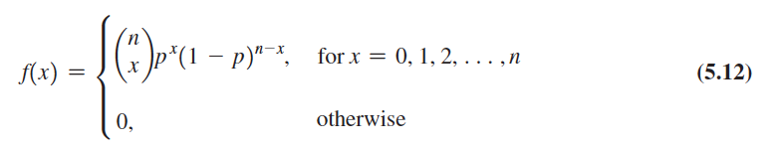

Binomial Distribution
Models n independent replications of a Bernoulli experiment, each with a probability p of success.
X represents the number of successes in these n experiments
Probability mass function:
The number of ways of choosing x distinct items from a group of n items and is
where n! (n factorial) = n(n - 1)(n - 2) . . . (2)(1), and 0! is defined as 1.
Expected value = np; variance = np(1 – p)

Slide 56
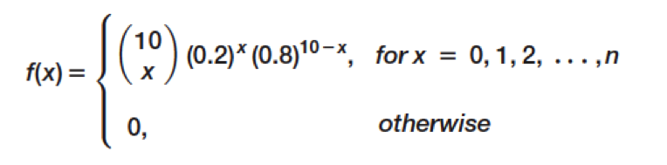
Example 5.25: Computing Binomial Probabilities
Suppose 10 individuals receive a telemarking promotion. Each individual has a 0.2 probability of making a purchase. Find the probability that exactly 3 of the 10 individuals make a purchase.
The probability distribution that x individuals out of 10 calls will make a purchase is:
Excel function:
=BINOM.DIST(number_s, trials, probability_s, cumulative)
If cumulative is set to TRUE, then this function will provide cumulative probabilities; otherwise the default is FALSE, and it provides values of the probability mass function, f(x).

Slide 57
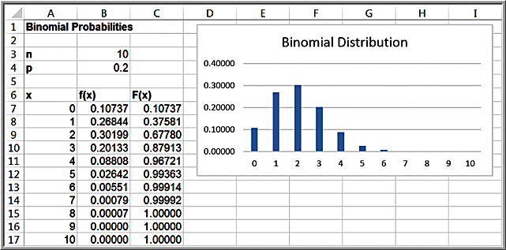
Example 5.26: Using Excel’s Binomial Distribution Function
The probability that exactly 3 of 10 individuals will make a purchase is P(x = 3): =BINOM.DIST(3,10,0.2,TRUE) = 0.20133
The probability that 3 or fewer of 10 individuals will make a purchase is P(x ≤ 3): =BINOM.DIST(3,10,0.2,FALSE) = 0.87913

Slide 58
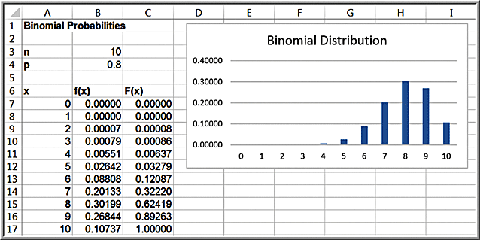
Shapes and Skewness of the Binomial Distribution
The binomial distribution is symmetric when p = 0.5; positively skewed when p < 0.5, and negatively skewed when p > 0.5.
Example of negatively-skewed distribution

Slide 59
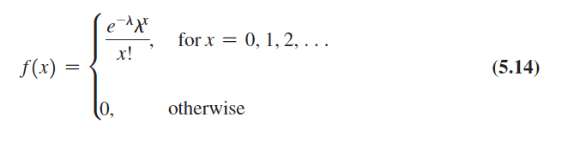
Poisson Distribution
Models the number of occurrences in some unit of measure (often time or distance).
There is no limit on the number of occurrences.
The average number of occurrence per unit is a constant denoted as λ.
Probability mass function:
Expected value = λ; variance = λ

Slide 60
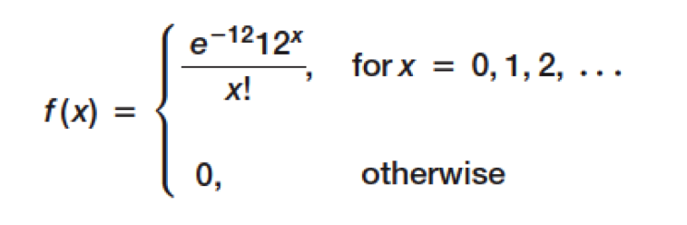
Example 5.27: Computing Poisson Probabilities
Suppose the average number of customers arriving at a Subway restaurant during lunch hour is λ =12 per hour.
The probability that exactly x customers arrive during the hour is given by the Poisson distribution with a mean of 12.
Excel function: =POISSON.DIST(x, mean, cumulative)

Slide 61
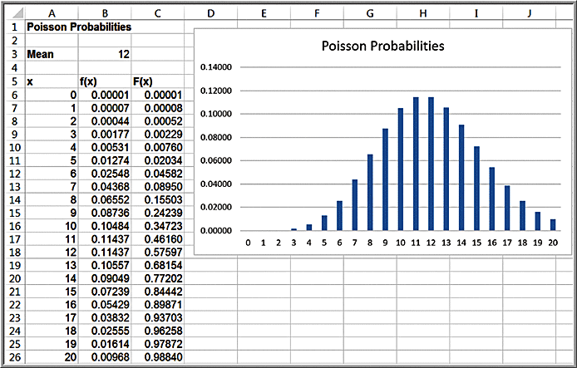
Example 5.28: Using Excel’s Poisson Distribution Function
With λ = 12, the probability that X = 1 is
=POISSON.DIST(A7,$B$3,FALSE) = 0.00007
The probability that X ≤ 4 is
=POISSON.DIST(A10,$B$3,TRUE) = 0.00760

Slide 62
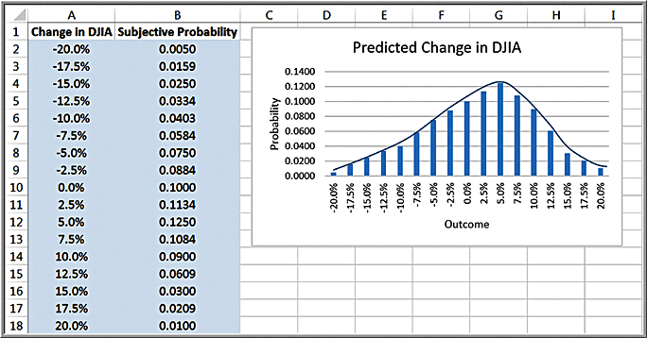
Continuous Probability Distributions
A probability density function is a mathematical function that characterizes a continuous random variable

Slide 63
Continuous Probability Distributions
Properties
f(x) ≥ 0 for all values of x
Total area under the density function equals 1.
P(X = x) = 0
Probabilities are only defined over intervals.
P(a ≤ X ≤ b) is the area under the density function between a and b.

Slide 64
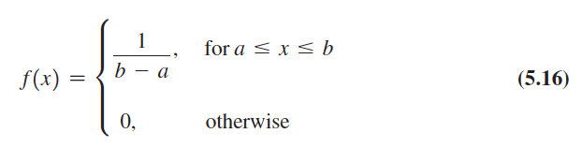
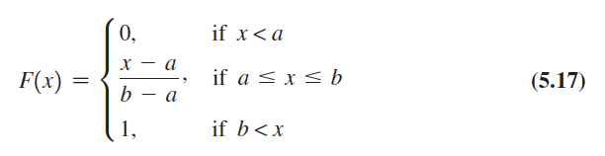
Uniform Distribution
The uniform distribution characterizes a continuous random variable for which all outcomes between a minimum (a) and a maximum (b) are equally likely.
Density function:
Cumulative distribution function:
Expected value = (a + b)/2; variance = (b – a)²/12

Slide 65
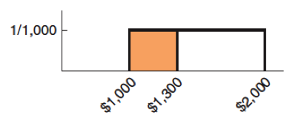
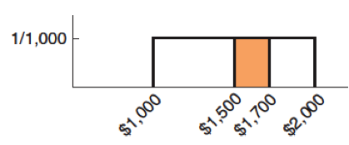
Example 5.29: Computing Uniform Probabilities
Sales revenue for a product varies uniformly each week between $1000 and $2000.
Probability that sales revenue will be less than x = $1,300.
F(1,300) = (1,300 - 1,000) / (2,000 - 1,000) = 0.30
Probability that revenue will be between $1,500 and $1,700.
P(1,500 ≤ X ≤ 1,700) = P(X ≤ 1,700) - P(X ≤ 1,500) = F(1,700) - F(1,500) = F(1,700) - F(1,500) = 0.7 – 0.5 = 0.2

Slide 66
Discrete Uniform Distribution
A variation of the uniform distribution is one for which the random variable is restricted to integer values between a and b (also integers); this is called a discrete uniform distribution.
Example: roll of a single die. Each of the numbers 1 through 6 have a 1/6 probability of occurrence.

Slide 67
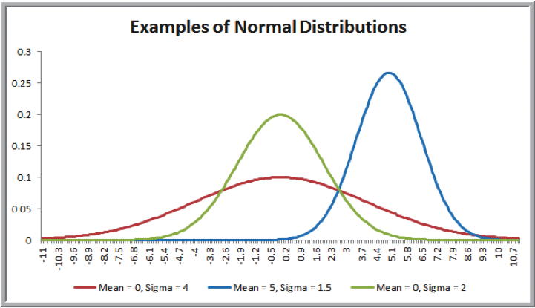
Normal Distribution
f(x) is a bell-shaped curve
Characterized by 2 parameters:
μ (mean)
σ (standard deviation)
Properties
Symmetric
Mean = Median = Mode
Range of X is unbounded
Empirical rules apply

Slide 68
Computing Normal Probabilities
Excel function:
=NORM.DIST(x, mean, standard_deviation, cumulative).
NORM.DIST(x, mean, standard_deviation, TRUE) calculates the cumulative probability
If cumulative is set to FALSE, the function simply calculates the value of the density function f(x), which has little practical application.

Slide 69
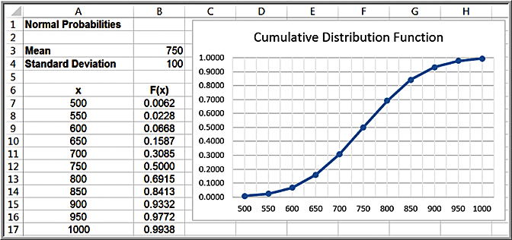
Example 5.30 Using the NORM.DIST Function to Compute Normal Probabilities
The distribution for customer demand (units per month) is normal with mean = 750 and standard deviation = 100
Find the probability that demand will be:
1. at most 900 units/month
2. exceed 700 units/month
3. be between 700 and 900 units/month

Slide 70
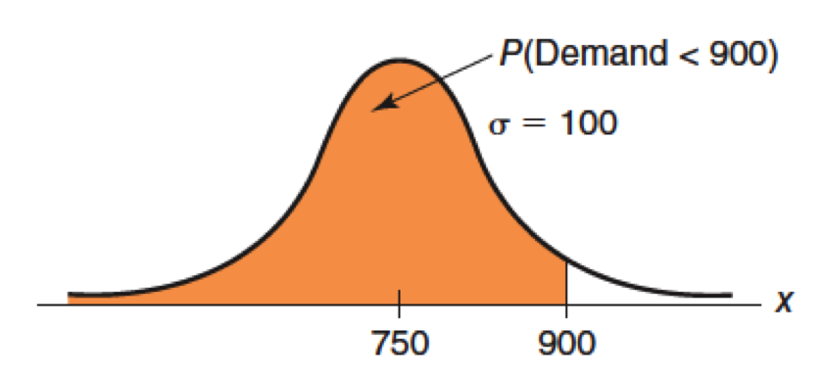
Example 5.30: Question 1
Probability that demand will be at most 900 units, or P(X ≤ 900):
=NORM.DIST(900,750,100,TRUE) = 0.9332.

Slide 71
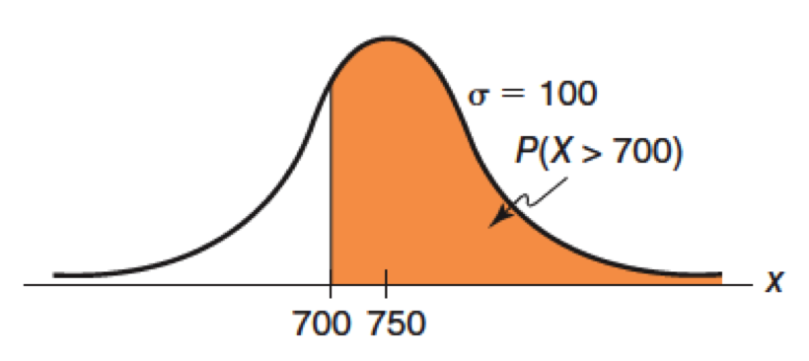
Example 5.30: Question 2
Probability that demand will exceed 700 units, or P(X > 700).
=1-NORM.DIST(700,750,100,TRUE) = 1 - 0.3085 = 0.6915

Slide 72
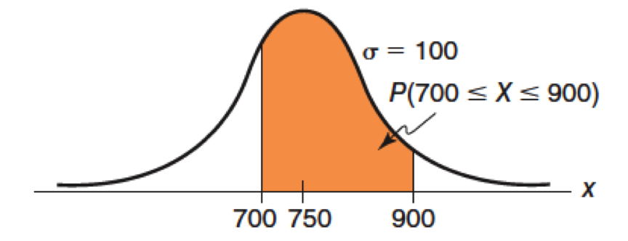
Example 5.30: Question 3
Probability that demand will be between 700 and 900, or P(700 < X < 900):
=NORM.DIST(900,750,100,TRUE) - NORM.DIST(700,750,100,TRUE) =0.9332 - 0.3085 = 0.6247

Slide 73
The NORM.INV Function
Normal Inverse function:
=NORM.INV(probability, mean, stdev)
provides the x value with F(x) = probability

Slide 74
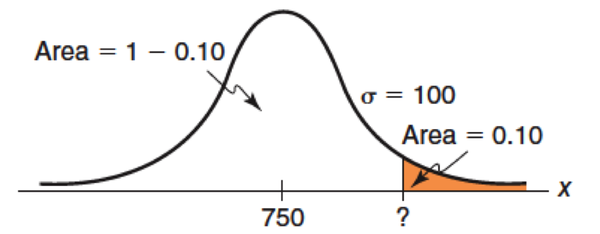
Example 5.31: Using the NORM.INV Function
What level of demand would be exceeded at most 10% of the time?
Find x such that F(x) = 0.90:
= NORM.INV(0.90, 750, 100) = 878.155

Slide 75
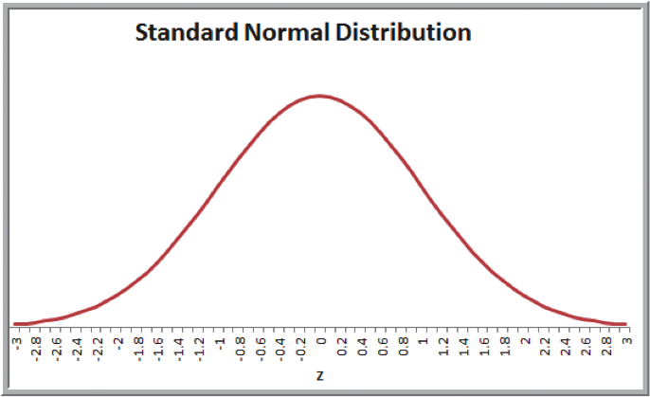
Standard Normal Distribution
A standard normal distribution is a normal distribution with a mean of 0 and standard deviation of 1.
A standard normal random variable is denoted by Z.
The scale along the z-axis represents the number of standard deviations from the mean of zero.
The Excel function =NORM.S.DIST(z) finds probabilities for the standard normal distribution.

Slide 76
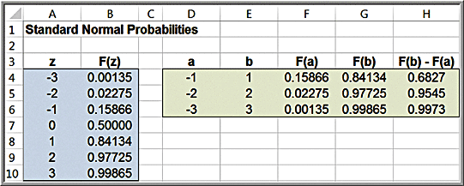
Example 5.32: Computing Probabilities with the Standard Normal Distribution
Verify the empirical rules using Excel.
Example: The probability within one standard deviation of the mean is P(-1 < Z < 1)
= NORMS.DIST(1) – NORMS.DIST(-1)
= 0.84134 – 0.15866
= 0.6827
~ 68%

Slide 77
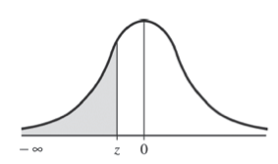
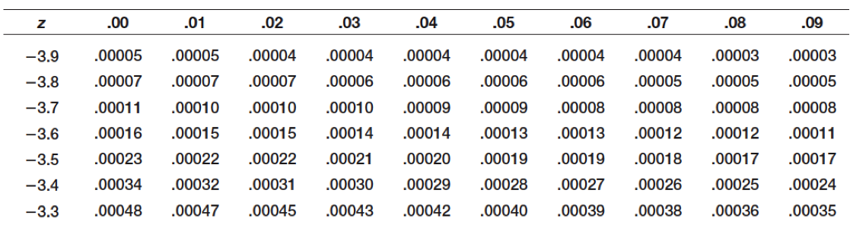

Using Standard Normal Distribution Tables
Table 1 of Appendix A
We may compute probabilities for any normal random variable X having a mean μ and standard deviation σ by converting it to a standard normal random variable Z:

Slide 78
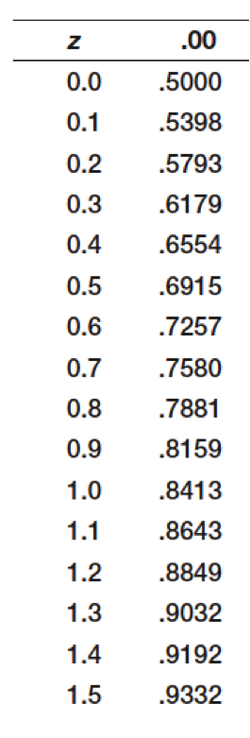
Example 5.33: Computing Probabilities with Standard Normal Tables
From Example 5.30, what is the probability that demand will be at least 900 units/month?
z = (900 − 750)/100 = 1.50
Using Table 1 in Appendix A, we find:
P(X < 900) = P(Z < 1.50) = 0.93319

Slide 79

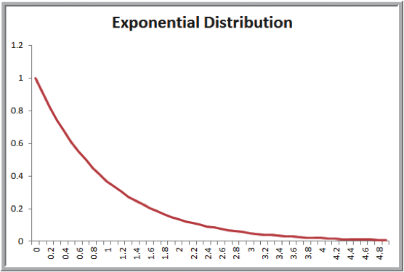
Exponential Distribution
Models the time between randomly occurring events
Density function:
Cumulative distribution function:
Mean = μ = 1/λ
Excel function:
=EXPON.DIST(x, lambda, cumulative)
If the number of events occurring during an interval of time has a Poisson distribution, then the time between events is exponentially distributed.

Slide 80
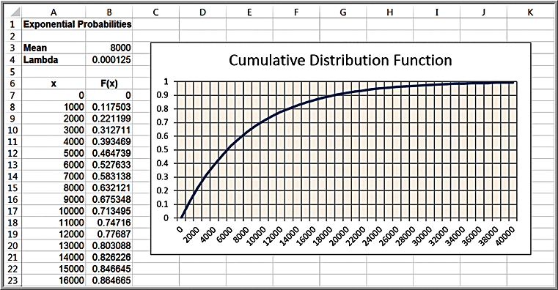
Example 5.34: Using the Exponential Distribution
The mean time to failure of a critical engine component is µ = 8,000 hours. What is the probability of failing before 5000 hours?
P(X < x) =EXPON.DIST(x, lambda, cumulative)
λ = 1/8000
P(X < 5000) =EXPON.DIST(5000, 1/8000, TRUE)
= 0.4647

Slide 81
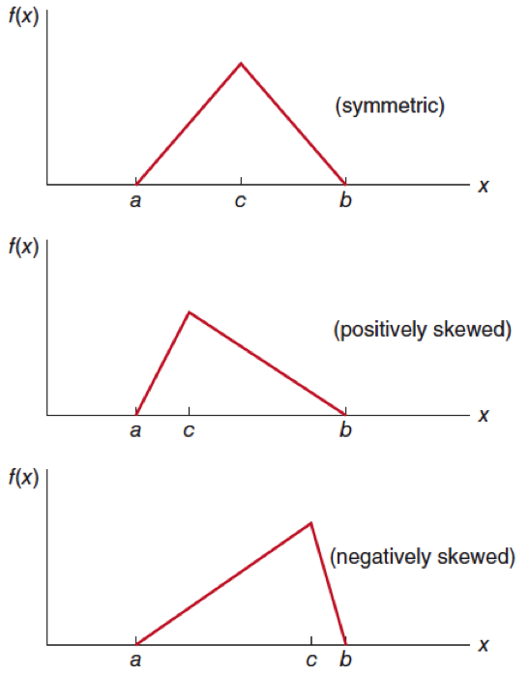
Other Useful Distributions
Triangular Distribution
Lognormal Distribution
Beta Distribution

Slide 82
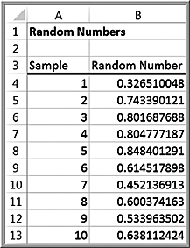
Random Sampling from Probability Distributions
A random number is one that is uniformly distributed between 0 to 1.
Excel function: =RAND( )

Slide 83
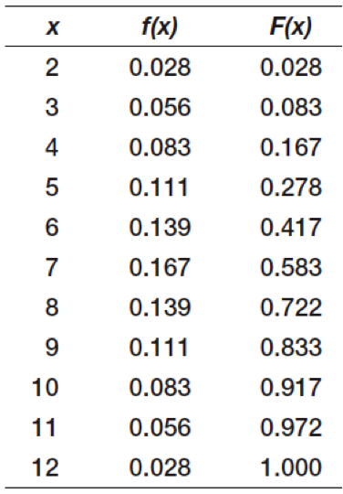

Example 5.35: Sampling from the Distribution of Dice Outcomes
Probability distribution
Intervals for random sampling
Generate a random number
Find the interval in which it falls
Use the associated outcome as the sample

Slide 84

Example 5.36: Using the VLOOKUP Function
Sample from the probability distribution of predicted change in the Dow Jones Industrial Average index
Compute F(x) and assign intervals to outcomes
Generate random numbers using the Excel function =RAND( )
E.g. Cell J2: =VLOOKUP(I2,$E2:$G$10,3)

Slide 85
Sampling from Common Probability Distributions
A value randomly generated from a specified probability distribution is called a random variate.
Example: Uniform distribution
Analysis Toolpak Random Number Generation Tool
Can sample from uniform, normal, Bernoulli, binomial, Poisson, patterned, and discrete distributions.
Can also specify a random number seed – a value from which a stream of random numbers is generated. By specifying the same seed, you can produce the same random numbers at a later time.

Slide 86

Example 5.37: Using Excel’s Random Number Generation Tool
Generate 100 outcomes from a Poisson distribution with a mean of 12
Number of Variables = 1.
Number of Random Numbers = 100
Distribution = Poisson
Dialog changes and prompts you to enter Lambda (mean of Poisson) = 12

Slide 87

Example 5.37 Results
(Histogram created manually)

Slide 88
Using Excel Functions to Generate Random Variates
Normal: =NORM.INV(RAND( ), mean, stdev)
Standard normal: =NORM.S.INV(RAND( ))

Slide 89
Example 5.38: A Sampling Experiment for Evaluating Capital Budgeting Projects
In finance, one way of evaluating capital budgeting projects is to compute a profitability index: PI = PV / I,
PV is the present value of future cash flows
I is the initial investment
What is the probability distribution of PI when PV is estimated to be normally distributed with a mean of $12 million and a standard deviation of $2.5 million, and the initial investment is also estimated to be normal with a mean of $3.0 million and standard deviation of $0.8 million.?

Slide 90


Example 5.38 Continued
Column F: =NORM.INV(RAND( ), 12, 2.5)
Column G: =NORM.INV(RAND( ), 3, 0.8)

Slide 91

Analytic Solver Platform Distribution Functions
Analytic Solver Platform provides Excel functions to generate random variates for many distributions

Slide 92

Example 5.39: Using Analytic Solver Platform Distribution Functions
An energy company was considering offering a new product and needed to estimate the growth in PC ownership.
Using the best data and information available, they determined that the minimum growth rate was 5.0%, the most likely value was 7.7%, and the maximum value was 10.0% (a triangular distribution).
A portion of 500 samples that were generated using the function PsiTriangular(5%, 7.7%, 10%):

Slide 93
Data Modeling and Distribution Fitting
Using sample data may limit our ability to predict uncertain events that may occur because potential values outside the range of the sample data are not included.
A better approach is to identify the underlying probability distribution from which sample data come by “fitting” a theoretical distribution to the data and verifying the goodness of fit statistically.
Examine a histogram for clues about the distribution’s shape
Look at summary statistics such as the mean, median, standard deviation, coefficient of variation, and skewness

Slide 94

Example 5.40: Analyzing Airline Passenger Data
Sample data on passenger demand for 25 flights
The histogram shows a relatively symmetric distribution. The mean, median, and mode are all similar, although there is moderate skewness. A normal distribution is not unreasonable.

Slide 95

Example 5.41: Analyzing Airport Service Times
Sample data on service times for 812 passengers at an airport’s ticketing counter
It is not clear what the distribution might be. It does not appear to be exponential, but it might be lognormal or another distribution.

Slide 96
Goodness of Fit
A better approach that simply visually examining a histogram and summary statistics is to analytically fit the data to the best type of probability distribution.
Three statistics measure goodness of fit:
Chi-square (need at least 50 data points)
Kolmogorov-Smirnov (works well for small samples)
Anderson-Darling (puts more weight on the differences between the tails of the distributions)
Analytic Solver Platform has the capability of fitting a probability distribution to data.

Slide 97

Example 5.42: Fitting a Distribution to Airport Service Times
1. Highlight the data
Analytic Solver Platform >
Tools > Fit
2. Fit Options dialog
Type: Continuous
Test: Kolmorgov-Smirnov
Click Fit button

Slide 98

Example 5.42 Continued
The best-fitting distribution is called an Erlang distribution.

