Slide 1
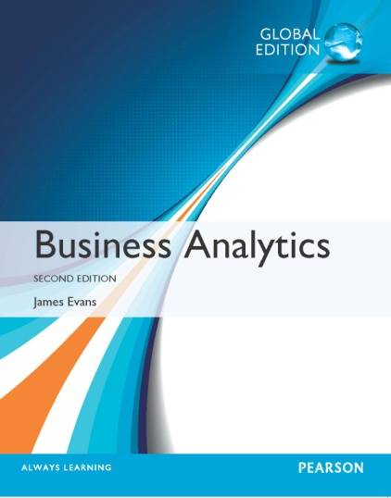
Chapter 4
Descriptive Statistical Measures

Slide 2
Populations and Samples
Population - all items of interest for a particular decision or investigation
- all married drivers over 25 years old
- all subscribers to Netflix
Sample - a subset of the population
- a list of individuals who rented a comedy from
Netflix in the past year
The purpose of sampling is to obtain sufficient information to draw a valid inference about a population.

Slide 3
Understanding Statistical Notation
We typically label the elements of a data set using subscripted variables, x₁, x₂ , … , and so on, where x_{i} represents the i^{th} observation.
It is common practice in statistics to use Greek letters, such as μ (mu), σ (sigma), and π (pi), to represent population measures and italic letters such as by x (called x-bar), s, and p to represent sample statistics.
N represents the number of items in a population and n represents the number of observations in a sample.
Σ represents summation: Σx_{i} = x₁ + x₂ + … x_{n}

Slide 4
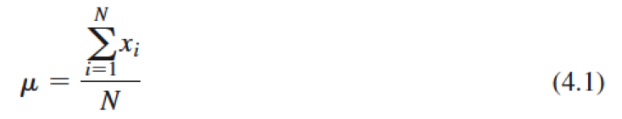
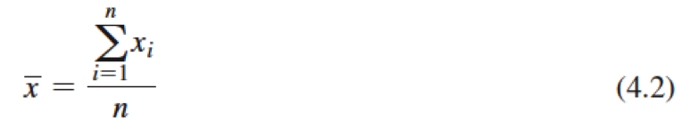
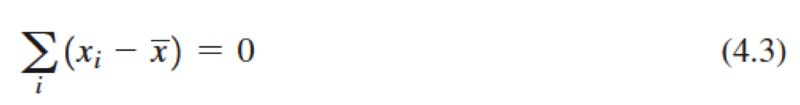
Measures of Location: Arithmetic Mean
Population mean:
Sample mean:
Excel function: =AVERAGE(data range)
Property of the mean:
Outliers can affect the value of the mean.

Slide 5
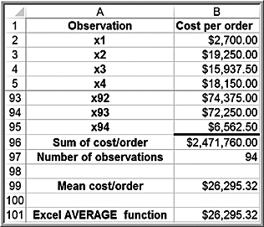
Example 4.1: Computing Mean Cost per Order
Purchase Orders database
Using formula:
=SUM(B2:B95)/COUNT(B2:B95)
Mean = $2,471,760/94
= $26,295.32
Using Excel AVERAGE Function
=AVERAGE(B2:B95)

Slide 6
Measures of Location: Median
The median specifies the middle value when the data are arranged from least to greatest.
  Half the data are below the median, and half the data are above it.
  For an odd number of observations, the median is the middle of the sorted numbers.
  For an even number of observations, the median is the mean of the two middle numbers.
We could use the Sort option in Excel to rank-order the data and then determine the median. The Excel function =MEDIAN(data range) could also be used.
The median is meaningful for ratio, interval, and ordinal data.
Not affected by outliers.

Slide 7
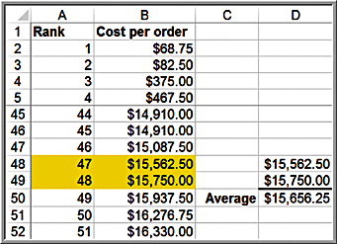
Example 4.2: Finding the Median Cost per Order
Sort the data from smallest to largest. Since we have 90 observations, the median is the average of the 47th and 48th observation.
Median =
($15,562.50 + $15,750.00)/2 = $15,656.25
=MEDIAN(B2:B94)

Slide 8
Measures of Location: Mode
The mode is the observation that occurs most frequently.
The mode is most useful for data sets that contain a relatively small number of unique values.
You can easily identify the mode from a frequency distribution by identifying the value or group having the largest frequency or from a histogram by identifying the highest bar.
Excel function: =MODE.SNGL(data range).
For multiple modes: =MODE.MULT(data range)

Slide 9
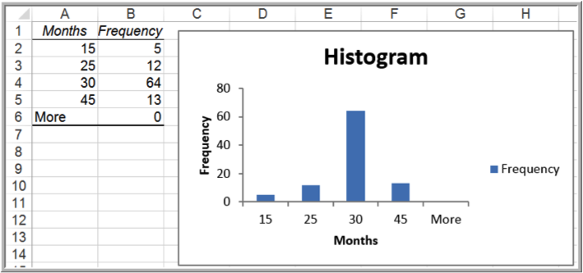
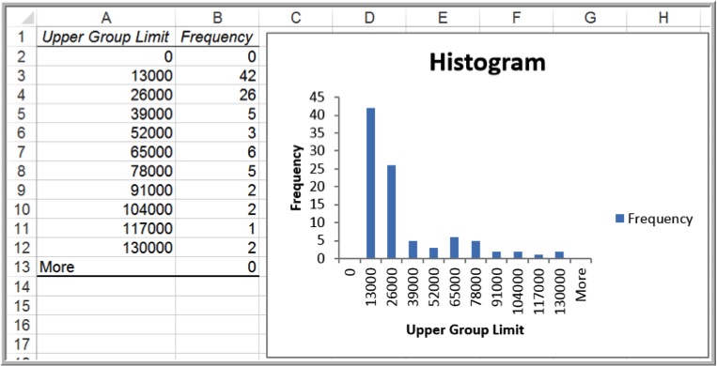
Example 4.3: Finding the Mode
Purchase Orders database: A/P Terms
  Mode = 30 months
Cost per order
  Mode is the group between $0 and $13,000

Slide 10
Measures of Location: Midrange
The midrange is the average of the greatest and least values in the data set.
Caution must be exercised when using the midrange because extreme values easily distort the result. This is because the midrange uses only two pieces of data, whereas the mean uses all the data; thus, it is usually a much rougher estimate than the mean and is often used for only small sample sizes.

Slide 11
Example 4.4: Computing the Midrange
Purchase Orders data
Use the Excel MIN and MAX functions or sort the data and find them easily.
Cost per order midrange:
= ($68.78 + $127,500)/2
= $63,784.89

Slide 12
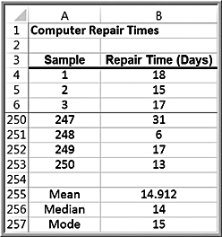
Using Measures of Location – Example 4.5: Quoting Computer Repair Times
The Excel file Computer Repair Times includes 250 repair times for customers.
What repair time would be reasonable to quote to a new customer?
Median repair time is 2 weeks; mean and mode are about 15 days.
Examine the histogram.

Slide 13
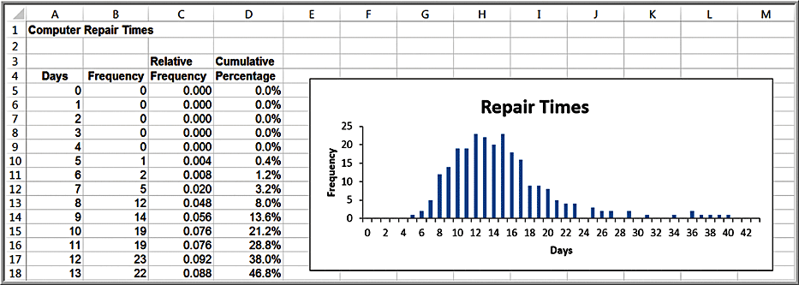
Example 4.5 (continued)
90% are completed within 3 weeks

Slide 14
Measures of Dispersion
Dispersion refers to the degree of variation in the data; that is, the numerical spread (or compactness) of the data.
Key measures:
  Range
  Interquartile range
  Variance
  Standard deviation

Slide 15
Measures of Dispersion: Range
The range is the simplest and is the difference between the maximum value and the minimum value in the data set.
In Excel, compute as =MAX(data range) - MIN(data range).
The range is affected by outliers, and is often used only for very small data sets.

Slide 16
Example 4.6: Computing the Range
Purchase Orders data
For the cost per order data:
  Maximum = $127,500
  Minimum = $68.78
Range = $127,500 - $68.78 = $127,431.22

Slide 17
Measures of Dispersion: Interquartile Range
The interquartile range (IQR), or the midspread is the difference between the first and third quartiles, Q3 – Q1.
This includes only the middle 50% of the data and, therefore, is not influenced by extreme values.

Slide 18
Example 4.7: Computing the Interquartile Range
Purchase Orders data
For the Cost per order data:
  Third Quartile = Q₃ = $27,593.75
  First Quartile = Q₁ = $6,757.81
Interquartile Range = $27,593.75 – $6,757.81 =$20,835.94

Slide 19
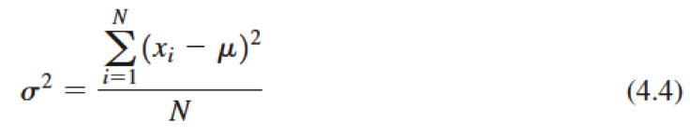
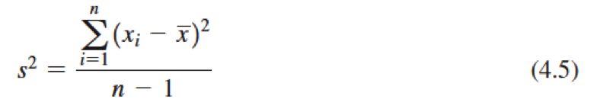
Measures of Dispersion: Variance
The variance is the “average” of the squared deviations from the mean.
For a population:
  In Excel: =VAR.P(data range)
For a sample:
  In Excel: =VAR.S(data range)
Note the difference in denominators!

Slide 20
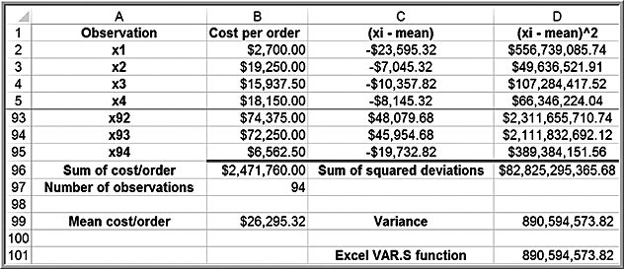
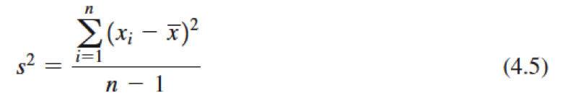
Example 4.8 Computing the Variance
Purchase Orders Cost per order data

Slide 21
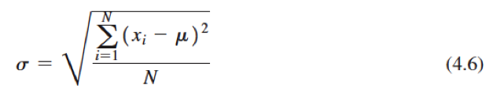
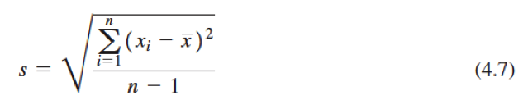
Measures of Dispersion: Standard Deviation
The standard deviation is the square root of the variance.
  Note that the dimension of the variance is the square of the dimension of the observations, whereas the dimension of the standard deviation is the same as the data. This makes the standard deviation more practical to use in applications.
For a population:
  In Excel: =STDEV.P(data range)
For a sample:
  In Excel: =STDEV.S(data range)

Slide 22

Example 4.9 Computing the Standard Deviation
Purchase Orders Cost per order data
Using the results of Example 4.8, take the square root of the variance:
Alternatively, use the STDEV.S function for the data range.

Slide 23
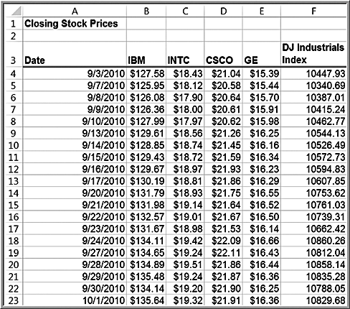
Standard Deviation as a Measure of Risk
Excel file: Closing Stock Prices
Intel (INTC):
Mean = $18.81
Standard deviation = $0.50
General Electric (GE):
Mean = $16.19
Standard deviation = $0.35
INTC is a higher risk
investment than GE.

Slide 24
Chebyshev’s Theorem
For any data set, the proportion of values that lie within k (k > 1) standard deviations of the mean is at least 1 – 1/k²
Examples:
  For k = 2: at least ¾ or 75% of the data lie within two standard deviations of the mean
  For k = 3: at least 8/9 or 89% of the data lie within three standard deviations of the mean

Slide 25



Empirical Rules
For many data sets encountered in practice:
  Approximately 68% of the observations fall within one standard deviation of the mean
  Approximately 95% fall within two standard deviations of the mean
  Approximately 99.7% fall within three standard deviations of the mean
These rules are commonly used to characterize the natural variation in manufacturing processes and other business phenomena.

Slide 26
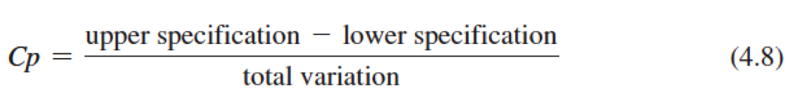
Process Capability Index
The process capability index (C_{p}) is a measure of how well a manufacturing process can achieve specifications.
Using a sample of output, measure the dimension of interest, and compute the total variation using the third empirical rule.
Compare results to specifications using:

Slide 27
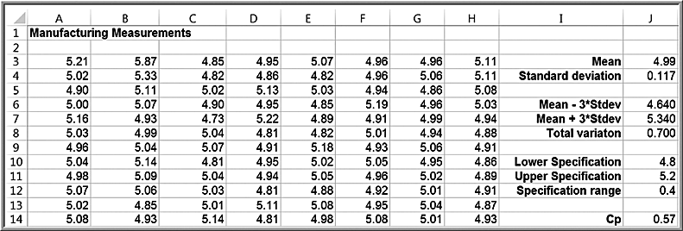
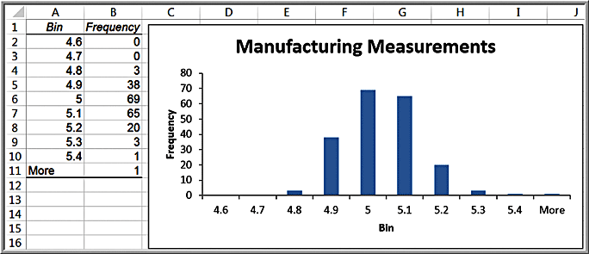
Example 4.11 Using Empirical Rules to Measure the Capability of a Manufacturing Process
Empirical rules

Slide 28
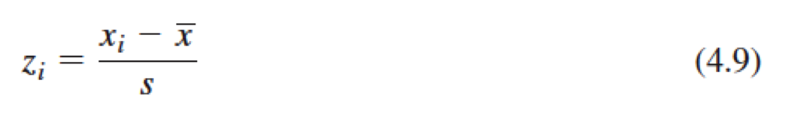
Standardized Values
A standardized value, commonly called a z-score, provides a relative measure of the distance an observation is from the mean, which is independent of the units of measurement.
The z-score for the i^{th} observation in a data set is calculated as follows:
  Excel function: =STANDARDIZE(x, mean, standard_dev).

Slide 29
Properties of z-Scores
The numerator represents the distance that x_{i} is from the sample mean; a negative value indicates that x_{i} lies to the left of the mean, and a positive value indicates that it lies to the right of the mean. By dividing by the standard deviation, s, we scale the distance from the mean to express it in units of standard deviations. Thus,
  a z-score of 1.0 means that the observation is one standard deviation to the right of the mean;
  a z-score of 2 1.5 means that the observation is 1.5 standard deviations to the left of the mean.

Slide 30
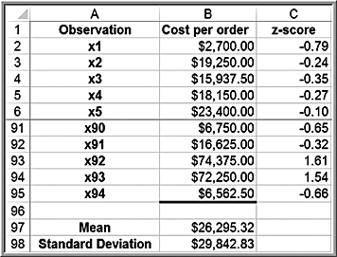
Example 4.12 Computing z-Scores
Purchase Orders Cost per order data
=(B2 - $B$97)/$B$98, or =STANDARDIZE(B2,$B$97,$B$98).

Slide 31
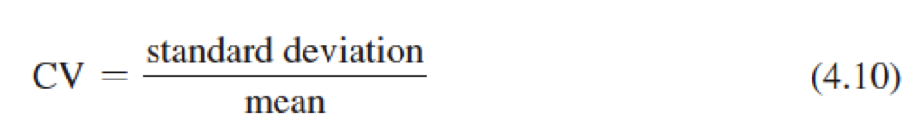
Coefficient of Variation
The coefficient of variation (CV) provides a relative measure of dispersion in data relative to the mean:
  Sometimes expressed as a percentage.
  Provides a relative measure of risk to return.
Return to risk = 1/CV, is often easier to interpret, especially in financial risk analysis.
  The Sharpe ratio is a related measure in finance.

Slide 32
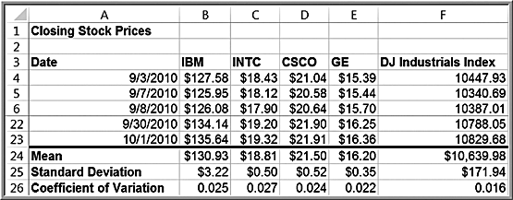
Example 4.13 Applying the Coefficient of Variation
Closing Stock Prices worksheet
Intel (INTC) is slightly riskier than the other stocks.
The Index fund has the least risk (lowest CV).

Slide 33
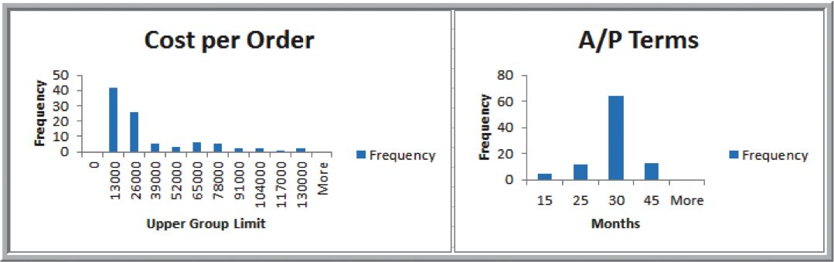
Measures of Shape: Skewness
Skewness describes the lack of symmetry of data.
  Distributions that tail off to the right are called positively skewed; those that tail off to the left are said to be negatively skewed.
Positively skewed Symmetrical

Slide 34
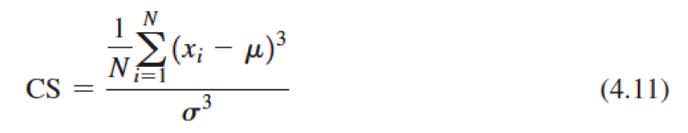
Coefficient of Skewness
Coefficient of Skewness (CS):
Excel function: =SKEW(data range)
  CS is negative for left-skewed data.
  CS is positive for right-skewed data.
  |CS| > 1 suggests high degree of skewness.
  0.5 ≤ |CS| ≤ 1 suggests moderate skewness.
  |CS| < 0.5 suggests relative symmetry.

Slide 35
Example 4.14: Measuring Skewness
Purchase Orders database
Cost per order data: CS = 1.66 (high positive skewness)
A/P terms data: CS = 0.60 (moderate positive skewness)

Slide 36
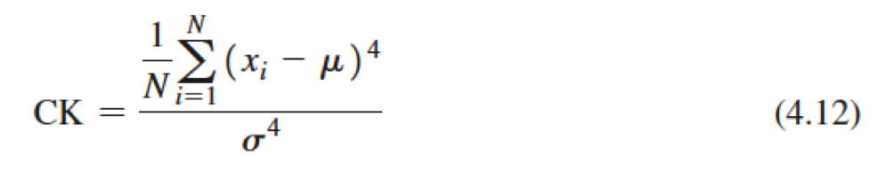
Measures of Shape: Kurtosis
Kurtosis refers to the peakedness (i.e., high, narrow) or flatness (i.e., short, flat-topped) of a histogram.
The coefficient of kurtosis (CK) measures the degree of kurtosis of a population
  CK < 3 indicates the data is somewhat flat with a wide degree of dispersion.
  CK > 3 indicates the data is somewhat peaked with less dispersion.
  Excel function: =KURT(data range).

Slide 37
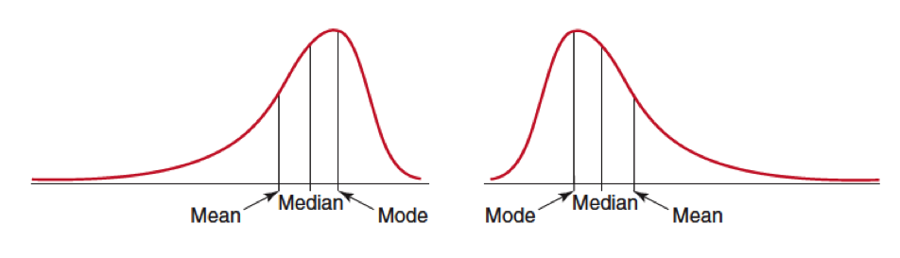
Shape and Measures of Location
Comparing measures of location can sometimes reveal information about the shape of the distribution of observations.
  For example, if the distribution were perfectly symmetrical and unimodal, the mean, median, and mode would all be the same.
  If it were negatively skewed, we would generally find that mean < median < mode
  Positive skewness would suggest that mode < median < mean

Slide 38
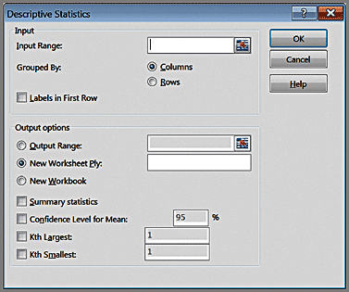
Excel Descriptive Statistics Tool
This tool provides a summary of numerical statistical measures for sample data.
Data >
Data Analysis >
Descriptive Statistics
Enter Input Range
Labels (optional)
Check Summary Statistics box
The data must be in a single row or column. If the data are in multiple columns, the tool treats each row or column as a separate data set

Slide 39
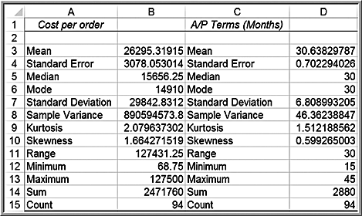
Example 4.15: Using the Descriptive Statistics Tool
Purchase Orders database
Note: Results of the Analysis Toolpak do not change when changes are made to the data.

Slide 40
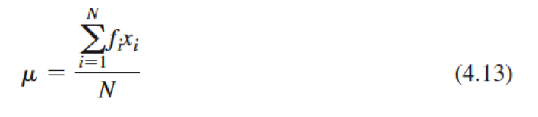
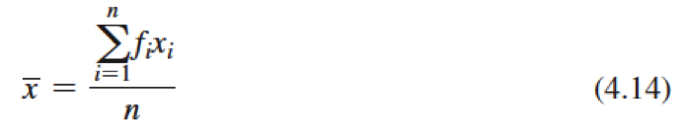
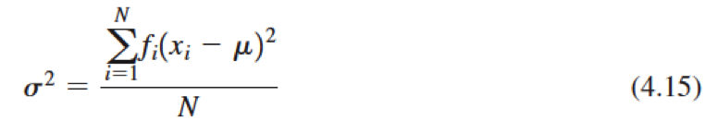
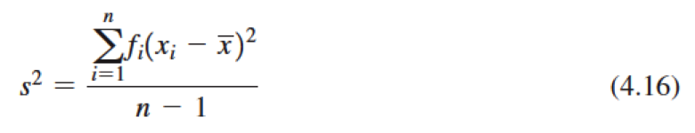
Descriptive Statistics for Grouped Data
Population mean:
Sample mean:
Population variance:
Sample variance:

Slide 41
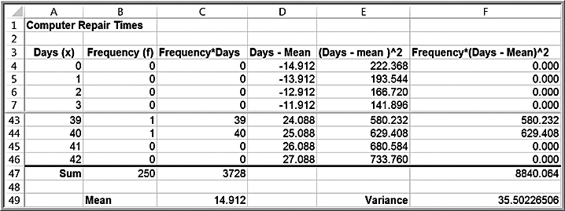
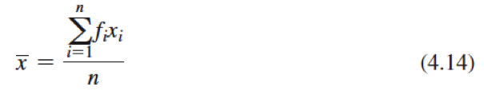
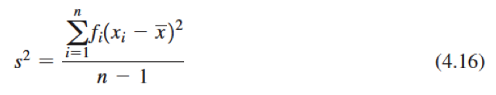
Example 4.16: Computing Statistical Measures from Frequency Distributions
Computer Repair Times

Slide 42
Grouped Data
If the data are grouped into k cells in a frequency distribution, we can use modified versions of the formulas to estimate the mean and variance by replacing x_{i} with a representative value (such as the midpoint) for all the observations in each cell.

Slide 43
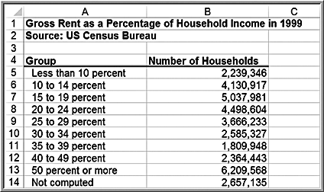
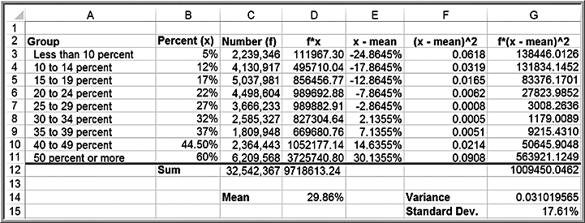
Example 4.17: Computing Descriptive Statistics for a Grouped Frequency Distribution
Representative group value

Slide 44
Descriptive Statistics for Categorical Data: The Proportion
The proportion, denoted by p, is the fraction of data that have a certain characteristic.
Proportions are key descriptive statistics for categorical data, such as defects or errors in quality control applications or consumer preferences in market research.

Slide 45
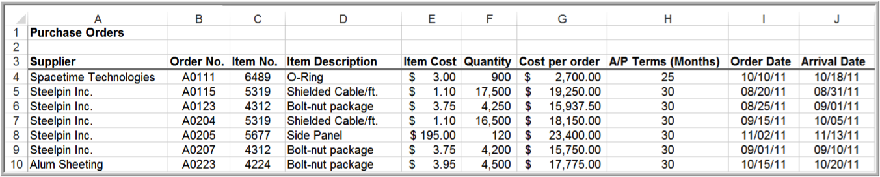
Example 4.18: Computing a Proportion
Proportion of orders placed by Spacetime Technologies
=COUNTIF(A4:A97, “Spacetime Technologies”)/94
= 12/94 = 0.128

Slide 46
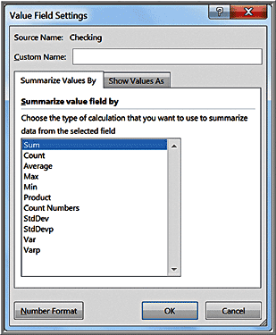
Statistics in PivotTables
Value Field Settings include several statistical measures:
Average
Max and Min
Product
Standard deviation
Variance

Slide 47
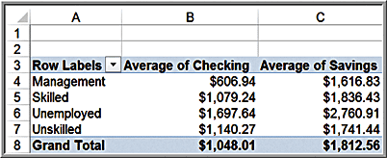
Example 4.19: Statistical Measures in PivotTables
Credit Risk Data
First, create a PivotTable.
In the PivotTable Field List, move Job to the Row Labels field and Checking and Savings to the Values field. Then change the field settings from “Sum of Checking” and “Sum of Savings” to the averages.

Slide 48
Measures of Association
Two variables have a strong statistical relationship with one another if they appear to move together.
When two variables appear to be related, you might suspect a cause-and-effect relationship.
Sometimes, however, statistical relationships exist even though a change in one variable is not caused by a change in the other.

Slide 49
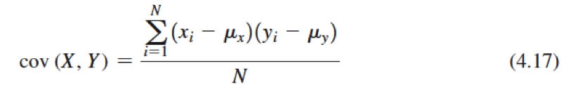
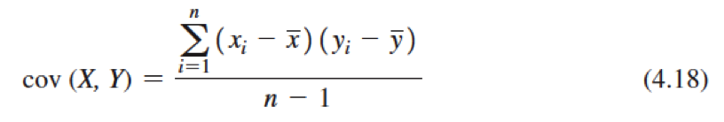
Measures of Association: Covariance
Covariance is a measure of the linear association between two variables, X and Y. Like the variance, different formulas are used for populations and samples.
Population covariance:
  Excel function: =COVARIANCE.P(array1,array2)
Sample covariance:
  Excel function: =COVARIANCE.S(array1,array2)
The covariance between X and Y is the average of the product of the deviations of each pair of observations from their respective means.

Slide 50
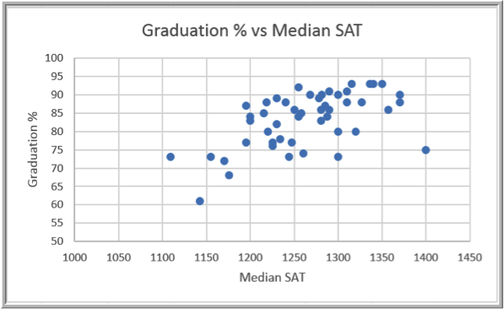
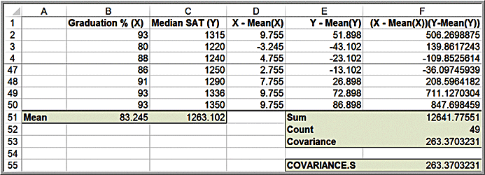
Example 4.20: Computing the Covariance
Colleges and Universities data

Slide 51
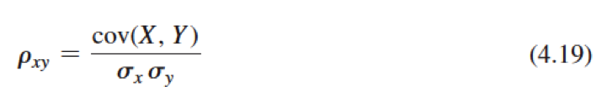
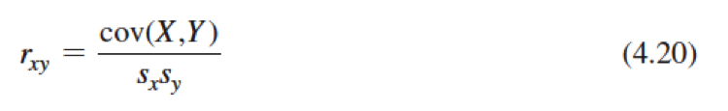
Measures of Association: Correlation
Correlation is a measure of the linear relationship between two variables, X and Y, which does not depend on the units of measurement.
Correlation is measured by the correlation coefficient, also known as the Pearson product moment correlation coefficient.
Correlation coefficient for a population:
Correlation coefficient for a sample:
The correlation coefficient is scaled between -1 and 1.
Excel function: =CORREL(array1,array2)

Slide 52
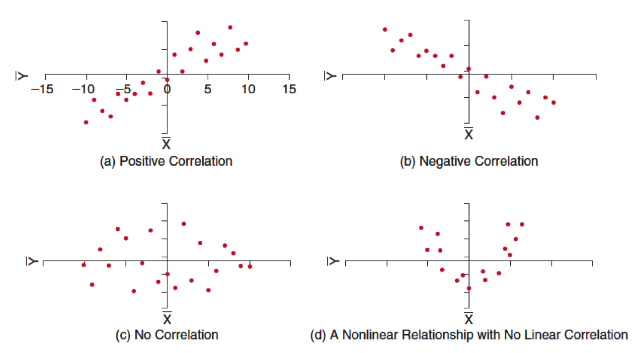
Examples of Correlation

Slide 53
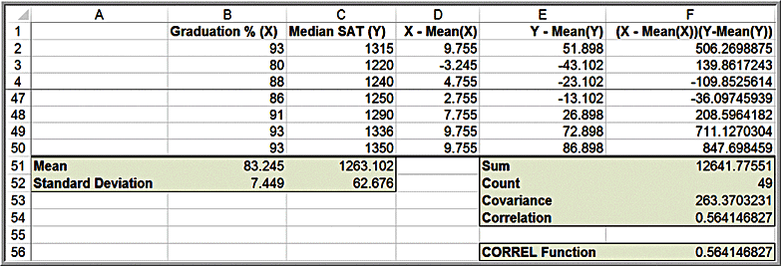

Example 4.21 Computing the Correlation Coefficient
Colleges and Universities data

Slide 54
Notes on the CORREL Function
When using the CORREL function, it does not matter if the data represent samples or populations. In other words,
CORREL(array1,array2) =
COVARIANCE.P(array1,array2) / STDEV.P(array1)*STDEV.P(array2)
and
CORREL(array1,array2) =
COVARIANCE.S(array1,array2) / STDEV.S(array1)*STDEV.S(array2)

Slide 55

Excel Correlation Tool
Data >
Data Analysis >
Correlation
Excel computes the correlation coefficient
between all pairs of variables in the Input Range. Input Range data must be in contiguous columns.

Slide 56

Example 4.22: Using the Correlation Tool
Colleges and Universities data
  Moderate negative correlation between acceptance rate and graduation rate, indicating that schools with lower acceptance rates have higher graduation rates.
  Acceptance rate is also negatively correlated with the median SAT and Top 10% HS, suggesting that schools with lower acceptance rates have higher student profiles.
  The correlations with Expenditures/Student suggest that schools with higher student profiles spend more money per student.

Slide 57
Identifying Outliers
There is no standard definition of what constitutes an outlier.
Some typical rules of thumb:
  z-scores greater than +3 or less than -3
  Extreme outliers are more than 3*IQR to the left of Q₁ or right of Q₃
  Mild outliers are between 1.5*IQR and 3*IQR to the left of Q₁ or right of Q₃

Slide 58


Example 4.23: Investigating Outliers
Home Market Value data
None of the z-scores exceed 3. However, while individual variables might not exhibit outliers, combinations of them might.
  The last observation has a high market value ($120,700) but a relatively small house size (1,581 square feet) and may be an outlier.

Slide 59
Statistical Thinking in Business Decisions
Statistical Thinking is a philosophy of learning and action for improvement, based on principles that:
  all work occurs in a system of interconnected processes
  variation exists in all processes
  better performance results from understanding and reducing variation
Work gets done in any organization through processes — systematic ways of doing things that achieve desired results.
Understanding business processes provides the context for determining the effects of variation and the proper type of action to be taken.

Slide 60

Example 4.24: Applying Statistical Thinking
Excel file Surgery Infections
  Is month 12 simply random variation or some explainable phenomenon?

Slide 61

Example 4.24 Continued
Three-standard deviation empirical rule:
This suggests that month 12 is statistically different from the rest of the data.

Slide 62
Variability in Samples
Different samples from any population will vary.
  They will have different means, standard deviations, and other statistical measures
  They will have differences in the shapes of histograms.
Samples are extremely sensitive to the sample size – the number of observations included in the samples.

Slide 63


Example 4.25: Variation in Sample Data
Samples from Computer Repair Times data
Population statistics: μ = 14.91 days, σ² = 35.5 days²
Two samples of size 50:
Two samples of size 25:

