Slide 1


Chapter 2
Analytics on Spreadsheets

Slide 2
Why Spreadsheets?
Many commercial software packages can be used for Business Analytics.
Spreadsheet software, such as Microsoft Excel, is widely available and used across all areas of business.
Spreadsheets provide a flexible modeling environment for manipulating data and developing and solving models.

Slide 3
Windows vs. Mac
Mac versions of Excel do not have the full functionality that Windows versions have – particularly statistical features which are important to this book.
The Excel add-in that we use in later chapters, Analytic Solver Platform, only runs on Windows. Thus, if you use a Mac, you should either run Bootcamp with Windows or use a third-party software product such as Parallels or VMWare.

Slide 4
Basic Excel Skills
Opening, saving, and printing files
Using workbooks and worksheets
Moving around a spreadsheet
Selecting cells and ranges
Inserting/deleting rows and columns
Entering and editing text, data, and formulas
Formatting data (number, currency, decimal)
Working with text strings
Formatting data and text
Modifying the appearance of a spreadsheet

Slide 5

Excel 2013 Ribbon
Tabs - Home, Insert, Page Layout, Formulas, …
Groups - Font, Alignment, Number, Styles, …
Buttons and Menus
- Buttons appear as small icons.
- Menus of additional choices are indicated by
small triangles.

Slide 6
Excel Formulas
Common mathematical operators are used.
For example:
a − bP⁵ + would be entered into Excel as:
=a− b*P^5 + c/d

Slide 7
Relative and Absolute References
Cell references can be relative or absolute. Using a dollar sign before a row and/or column label creates an absolute reference.
  Relative references: A2, C5, D10
  Absolute references: $A$2, $C5, D$10
Using a $ sign before a row label (for example, B$4) keeps the reference fixed to row 4 but allows the column reference to change if the formula is copied to another cell.
Using a $ sign before a column label (for example, $B4) keeps the reference to column B fixed but allows the row reference to change.
Using a $ sign before both the row and column labels (for example, $B$4) keeps the reference to cell B4 fixed no matter where the formula is copied.

Slide 8
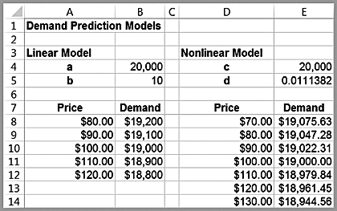
Example 2.1 Implementing Price-Demand Models in Excel
Two models for predicting demand as a function of price
Linear
D = a – bP
Formula in cell B8:
=$B$4-$B$5*$A8
Nonlinear
D = cP^{-d}
Formula in cell E8:
=$E$4*D8^-$E$5
Note how the absolute addresses are used so that as these formulas are copied down, the demand is computed correctly.

Slide 9
Copying Formulas
Formulas in cells can be copied in many ways.
Use the Copy button in the Home tab, then use the Paste button
Use Ctrl-C, then Ctrl-V
Drag the bottom right corner of a cell (the fill handle) across a row or column

Slide 10
Other Useful Excel Tips
Split Screen
Paste Special
  Paste Values will paste the results of the formulas
Column and Row Widths
Displaying Formulas in Worksheets
  Show Formulas in Formula Auditing group
Displaying Grid Lines and Column Headers for Printing
Filling a Range with a Series of Numbers

Slide 11
Basic Excel Functions
=MIN(range)
=MAX(range)
=SUM(range)
=AVERAGE(range)
=COUNT(range)
=COUNTIF(range,criteria)
  Excel has other useful COUNT-type functions: COUNTA counts the number of nonblank cells in a range, and COUNTBLANK counts the number of blank cells in a range. In addition, COUNTIFS(range1, criterion1, range2, criterion2,… range_n, criterion_n) finds the number of cells within multiple ranges that meet specific criteria for each range.

Slide 12
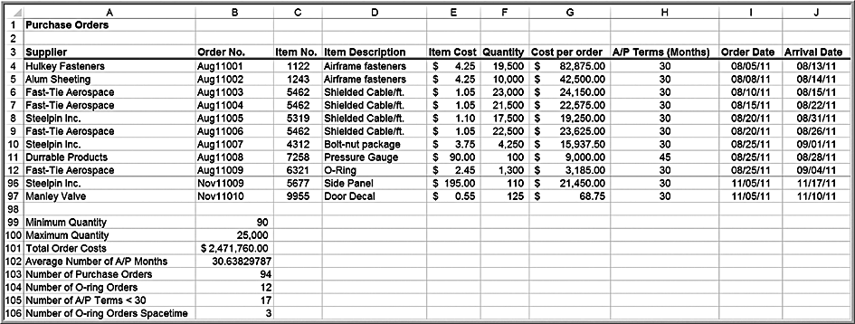
Example 2.2 Using Basic Excel Functions
=MIN(F4:F97)
=MAX(F4:F97)
=SUM(G4:G97)
=AVERAGE(H4:H97)
=COUNT(B4:B97)
=COUNTIF(D4:D97,”=O-Ring”)
=COUNTIF(H4:H97,”<30”)
=COUNTIFS(D4:D97,"O-Ring",A4:A97,"Spacetime Technologies")

Slide 13
Other IF-Type Functions
SUMIF, AVERAGEIF, SUMIFS, and AVERAGEIFS can be used to embed IF logic within mathematical functions.
For instance, the syntax of SUMIF is
  SUMIF(range, criterion, [sum range]). "Sum range" is an optional argument that allows you to add cells in a different range.
Example: In the Purchase Orders database, to find the total cost of all airframe fasteners, use
=SUMIF(D4:D97,"Airframe fasteners", G4:G97)

Slide 14
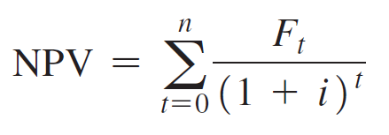
Functions for Specific Applications
Net Present Value (or discounted cash flow) measures the worth of a stream of cash flows, taking into account the time value of money.
Excel function: =NPV(rate,value1,value2,…)
  F is the cash flow ($)
  Rate (i) is the discount rate
  value1, value2,…are equally-spaced payments or income values
  t is a time period

Slide 15
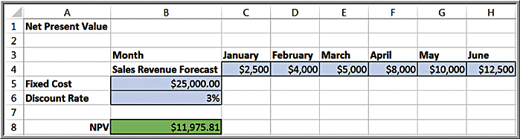
Example 2.3 Using the NPV Function
Cell B8:
=NPV(B6, C4:H4) – B5

Slide 16
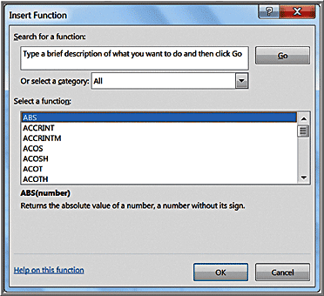
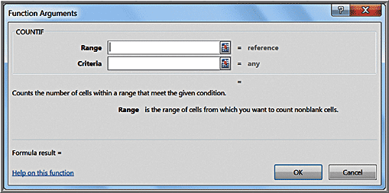
Insert Function
Click the Insert function button f_{x}.
You may type in a description or search.
Example for COUNTIF function

Slide 17
Logical Functions
=IF(condition, value if true, value if false) – a returns one value if the condition is true and another if the condition is false,
=AND(condition1, condition2, …) – returns TRUE if all conditions are true and FALSE if not,
=OR(condition1, condition2, …) – returns TRUE if any condition is true and FALSE if not.

Slide 18
IF Function
=IF(condition, value if true, value if false)
Conditions may include the following:
= equal <> not equal to
> greater than >= greater than or equal to
< less than <= less than or equal to
You may nest up to 7 IF functions, replacing the value if false with another IF function
Example:
=IF(A8 =2,(IF(B3 =5,”YES”,“ ”)),15)

Slide 19
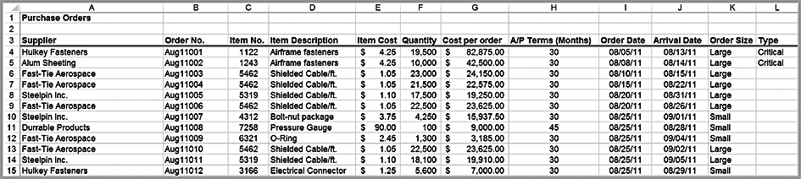
Example 2.4 Using the IF Function
Suppose that orders with quantities of at least 10,000 units are classified as Large.
  Cell K4: =IF(F4>=10000, “Large”, “Small”)
Suppose that large orders with a total cost of at least $25,000 are considered critical.
  Cell L4: =IF(AND(K4=“Large”, G4>=25000),“Critical”,“”)

Slide 20
Lookup Functions for Database Queries
These functions are useful for finding specific data in a spreadsheet.
=VLOOKUP(lookup_value, table_array, col_index_num, [range lookup]) - looks up a value in the leftmost column of a table and returns a value in the same row from a column you specify
=HLOOKUP(lookup_value, table_array, row_index_num, [range lookup]) - looks up a value in the top row of a table and returns a value in the same column from a row you specify.
=INDEX(array, row_num, col_num) - returns a value or reference of the cell at the intersection of a particular row and column in a given range.
=MATCH(lookup_value, lookup_array, match_type) - returns the relative position of an item in an array that matches a specified value in a specified order

Slide 21
Important Notes on Lookup Functions
In the VLOOKUP and HLOOKUP functions, range lookup is optional. If this is omitted or set as True, then the first column of the table must be sorted in ascending numerical order.
If an exact match for the lookup_value is found in the first column, then Excel will return the value the col_index_num of that row. If an exact match is not found, Excel will choose the row with the largest value in the first column that is less than the lookup_value.
If range lookup is False, then Excel seeks an exact match in the first column of the table range. If no exact match is found, Excel will return #N/A (not available).
We recommend that you specify the range lookup to avoid errors.

Slide 22
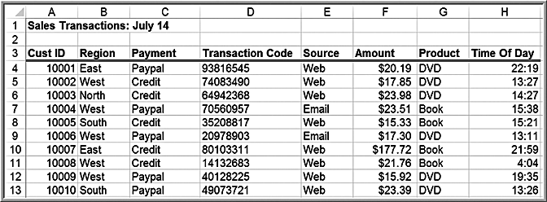
Example 2.5 Using the VLOOKUP Function
=VLOOKUP(10007, $A$4:$H$475,3) returns the payment type Credit.
=VLOOKUP(10007, $A$4:$H$475,4) returns the transaction code 80103311

Slide 23
INDEX Function
=INDEX(array, row_num, col_num)
The INDEX function works as a lookup procedure by returning the value in a particular row and column of an array. For example, in the Sales Transactions database,
INDEX($A$4:$H$475, 7, 4) would retrieve the transaction code 80103311, which is in the 7th row and 4th column.

Slide 24
MATCH Function
=MATCH(lookup_value, lookup_array, match_type)
In the MATCH function, lookup_value is value that you want to match in lookup_array, which is the range of cells being searched. The match_type is either -1, 0, or 1. The default is 1.
If match_type = 1, then the function finds the largest value that is less than or equal to lookup_value.
  The values in the lookup_array must be placed in ascending order.
If match_type = 0, MATCH finds the first value that is exactly equal to lookup_value.
  The values in the lookup_array can be in any order.
If match_type = -1, then the function finds the smallest value that is greater than or equal to lookup_value.
  The values in the lookup_array must be placed in descending order.

Slide 25
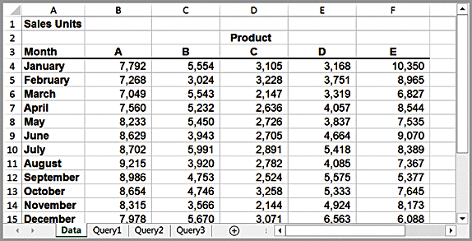
Example 2.6 Using INDEX and MATCH Functions for Database Queries
Suppose we wish to design a simple query application to input the month and product name, and retrieve the corresponding sales. The three additional worksheets in the workbook show how to do this in three different ways.

Slide 26
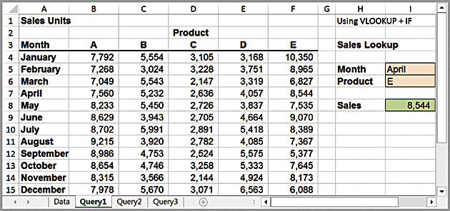
Example 2.6: Using VLOOKUP + IF
The Query1 worksheet uses the VLOOKUP function with embedded IF statements. The formulas in cell I8 is:
=VLOOKUP(I5,A4:F15,IF(I6="A",2,IF(I6="B",3,IF(I6="C",4,IF(I6="D",5,IF(I6="E",6))))),FALSE)

Slide 27
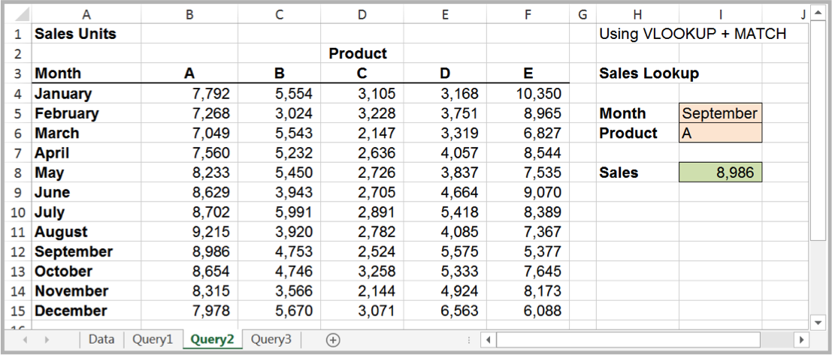
Example 2.6: Using VLOOKUP + MATCH
The formula in cell I8 is:
=VLOOKUP(I5,A4:F15,MATCH(I6,B3:F3,FALSE)+1,FALSE)
In this case, the MATCH function is used to identify the column in the table corresponding to the product name in cell I6. Note the use of the “+1” to shift the relative column number of the product to the correct column number in the lookup table.

Slide 28
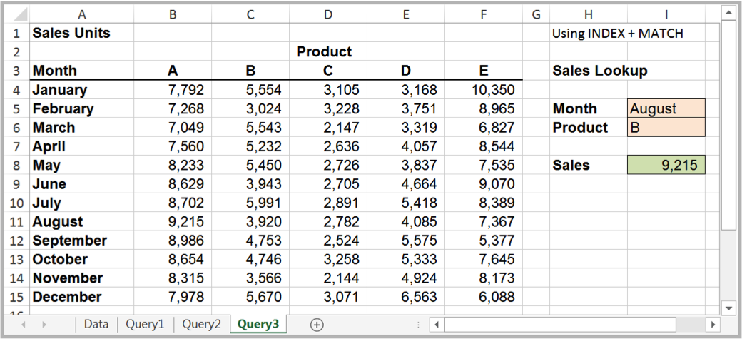
Example 2.6: Using INDEX + MATCH
The formula in cell I8 is:
=INDEX(A4:F15,MATCH(I5,A4:A15,FALSE),MATCH(I6,B3:F3,FALSE)+1)
The MATCH functions are used as arguments in the INDEX function to identify the row and column numbers in the table based on the month and product name. The INDEX function then retrieves the value in the corresponding row and column.

Slide 29
Spreadsheet Add-Ins for
Business Analytics
Microsoft Excel provides a number of add-ins for Business Analytics (Windows only), which will be used in subsequent chapters:
- Analysis Toolpak
- Analysis Toolpak VBA
- Solver
  To install them, click the File tab and then Options in the left column. Choose Add-Ins from the left column. At the bottom of the dialog, make sure Excel Add-ins is selected in the Manage: box and click Go. In the Add-Ins dialog, if Analysis Toolpak, Analysis Toolpak VBA, and Solver Add-in are not checked, simply check the boxes and click OK.
Frontline Systems provides:
- Analytic Solver Platform
  See the Preface for installation instructions

