Slide 1
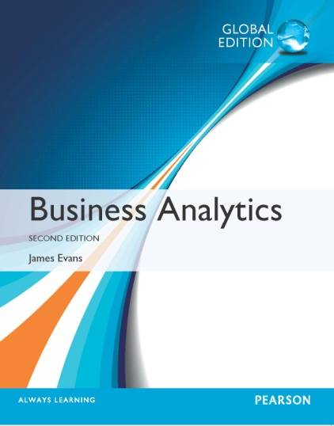
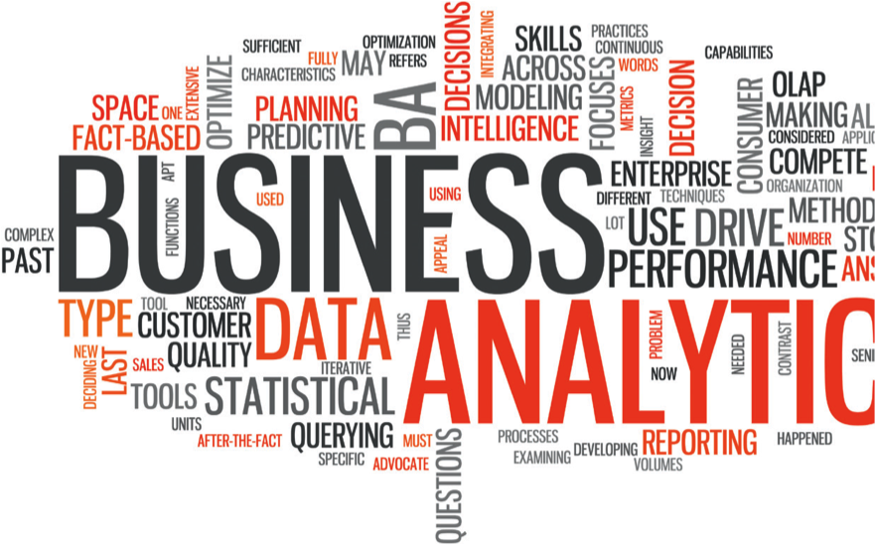
Chapter 1 Introduction to Business Analytics

Slide 2
Business Analytics
(Business) Analytics is the use of:
data,
information technology,
statistical analysis,
quantitative methods, and
mathematical or computer-based models
to help managers gain improved insight about their business operations and make better, fact-based decisions.

Slide 3
Examples of Applications
Pricing
setting prices for consumer and industrial goods, government contracts, and maintenance contracts
Customer segmentation
identifying and targeting key customer groups in retail, insurance, and credit card industries
Merchandising
determining brands to buy, quantities, and allocations
Location
finding the best location for bank branches and ATMs, or where to service industrial equipment
Social Media
understand trends and customer perceptions; assist marketing managers and product designers

Slide 4
Evolution of Business Analytics
Business intelligence (1960s)
Ability to store and analyse data
“How many units did we sell last month?”
“What products did customers buy and how much?”
“How many credit transactions are completed today?”
Information Systems (a modern discipline of BI)
Statistics (Regression, Forecast, Data Mining)
Operations research/Management science
Using math/computer “model” to analyse and find solution of complex decision problems
Decision support systems (BI + ORMS)

Slide 5
Decision support systems
Data management
Data storage
Model management
Stat tools for building, manipulate, solve models
Communication management
Interface for user to interact with data

Slide 6
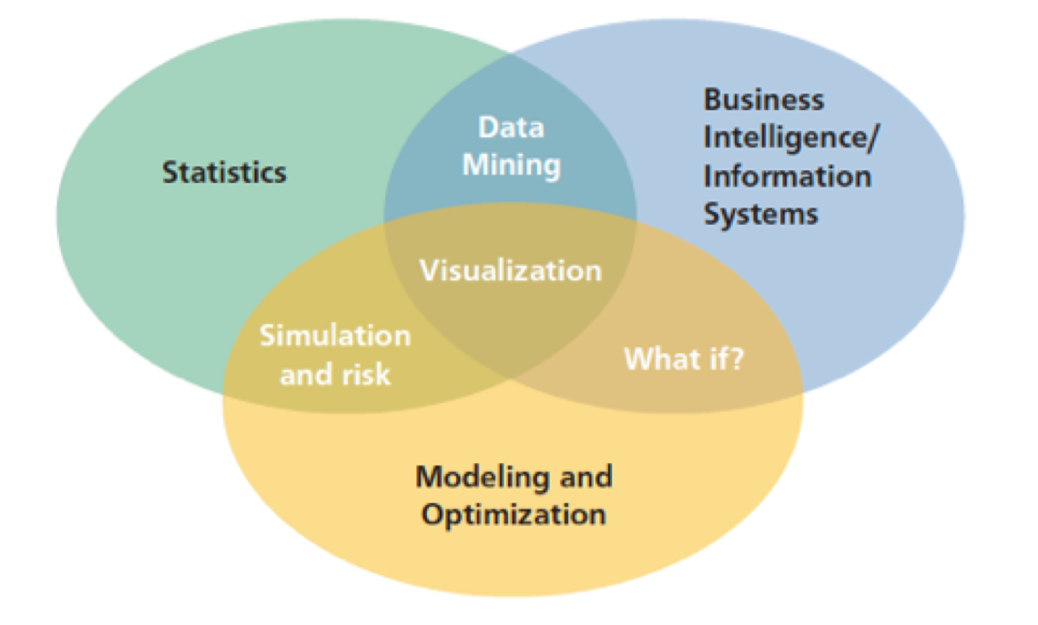
A Visual Perspective of Business Analytics

Slide 7
Impacts and Challenges
Benefits
…reduced costs, better risk management, faster decisions, better productivity and enhanced bottom-line performance such as profitability and customer satisfaction.
Challenges
…lack of understanding of how to use analytics, competing business priorities, insufficient analytical skills, difficulty in getting good data and sharing information, and not understanding the benefits versus perceived costs of analytics studies.

Slide 8
Scope of Business Analytics
Descriptive analytics: the use of data to understand past and current business performance and make informed decisions
Predictive analytics: predict the future by examining historical data, detecting patterns or relationships in these data, and then extrapolating these relationships forward in time.
Prescriptive analytics: identify the best alternatives to minimize or maximize some objective

Slide 9
Tools
Database queries and analysis
Dashboards to report key performance measures
Data visualization
Statistical methods
Spreadsheets and predictive models
Scenario and “what-if” analyses
Simulation
Forecasting
Data and text mining
Optimization
Social media, web, and text analytics

Slide 10
Example 1.1: Retail Markdown Decisions
Most department stores clear seasonal inventory by reducing prices.
Key question: When to reduce the price and by how much to maximize revenue?
Potential applications of analytics:
Descriptive analytics: examine historical data for similar products (prices, units sold, advertising, …)
Predictive analytics: predict sales based on price
Prescriptive analytics: find the best sets of pricing and advertising to maximize sales revenue

Slide 11
Software Support
IBM Cognos Express
An integrated business intelligence and planning solution designed to meet the needs of midsize companies, provides reporting, analysis, dashboard, scorecard, planning, budgeting and forecasting capabilities.
SAS Analytics
Predictive modeling and data mining, visualization, forecasting, optimization and model management, statistical analysis, text analytics, and more.
Tableau Software
Simple drag and drop tools for visualizing data from spreadsheets and other databases.

Slide 12
Data for Business Analytics
Data: numerical or textual facts and figures that are collected through some type of measurement process.
Information: result of analyzing data; that is, extracting meaning from data to support evaluation and decision making.

Slide 13
Examples of Data Sources and Uses
Annual reports
Accounting audits
Financial profitability analysis
Economic trends
Marketing research
Operations management performance
Human resource measurements
Web behavior
page views, visitor’s country, time of view, length of time, origin and destination paths, products they searched for and viewed, products purchased, what reviews they read, and many others.

Slide 14
Data Sets and Databases
Data set - a collection of data.
Examples: Marketing survey responses, a table of historical stock prices, and a collection of measurements of dimensions of a manufactured item.
Database - a collection of related files containing records on people, places, or things.
A database file is usually organized in a two-dimensional table, where the columns correspond to each individual element of data (called fields, or attributes), and the rows represent records of related data elements.

Slide 15
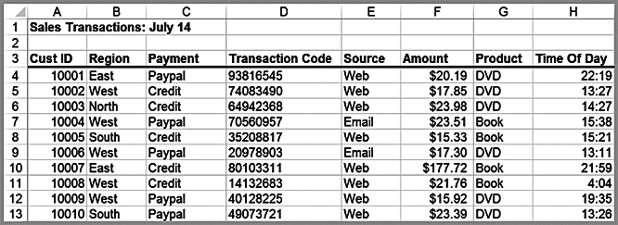
Example 1.2: A Sales Transaction Database File
Records
Entities
Fields or Attributes

Slide 16
Big Data
Big data to refer to massive amounts of business data from a wide variety of sources, much of which is available in real time, and much of which is uncertain or unpredictable. IBM calls these characteristics volume, variety, velocity, and veracity.
“The effective use of big data has the potential to transform economies, delivering a new wave of productivity growth and consumer surplus. Using big data will become a key basis of competition for existing companies, and will create new competitors who are able to attract employees that have the critical skills for a big data world.” - McKinsey Global Institute, 2011

Slide 17
Metrics and Data Classification
Metric - a unit of measurement that provides a way to objectively quantify performance.
Measurement - the act of obtaining data associated with a metric.
Measures - numerical values associated with a metric.

Slide 18
Types of Metrics
Discrete metric - one that is derived from counting something.
For example, a delivery is either on time or not; an order is complete or incomplete; or an invoice can have one, two, three, or any number of errors. Some discrete metrics would be the proportion of on-time deliveries; the number of incomplete orders each day, and the number of errors per invoice.
Continuous metrics are based on a continuous scale of measurement.
Any metrics involving dollars, length, time, volume, or weight, for example, are continuous.

Slide 19
Measurement Scales
Categorical (nominal) data - sorted into categories according to specified characteristics.
Ordinal data - can be ordered or ranked according to some relationship to one another.
Interval data - ordinal but have constant differences between observations and have arbitrary zero points (e.g., time, calendars).
Allows meaningful comparison of ranges, averages (not just ranking)
Ratio data - continuous and have a natural zero.
50 degree Celsius is not twice as 25 degree because it does not have absolute zero.
$12 million is as twice as $6 million
Notes:
Survey data (1 = poor, 5 = excellent) → ควรจะถูก Treat ให้เป็น Interval data เพราะระยะห่าง 2 ไป 3 กับ 4 ไป 5 ไม่เท่ากัน

Slide 20
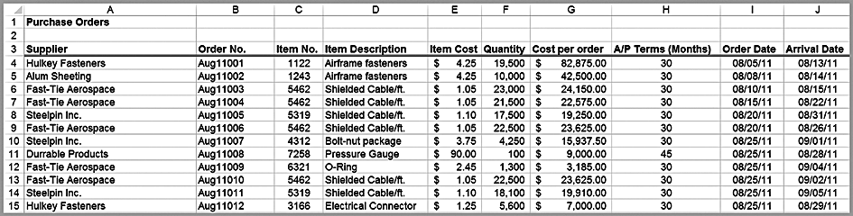
Example 1.3: Classifying Data Elements
Ordinal
Ratio
Ratio
Ratio
Ratio
Interval
Interval
Categorical
Categorical
Categorical

Slide 21
Data Reliability and Validity
Reliability - data are accurate and consistent.
Validity - data correctly measures what it is supposed to measure.
Examples:
A tire pressure gage that consistently reads several pounds of pressure below the true value is not reliable, although it is valid because it does measure tire pressure.
The number of calls to a customer service desk might be counted correctly each day (and thus is a reliable measure) but not valid if it is used to assess customer dissatisfaction, as many calls may be simple queries.
A survey question that asks a customer to rate the quality of the food in a restaurant may be neither reliable (because different customers may have conflicting perceptions) nor valid (if the intent is to measure customer satisfaction, as satisfaction generally includes other elements of service besides food).

Slide 22
Models in Business Analytics
Model - an abstraction or representation of a real system, idea, or object.
Captures the most important features
Can be a written or verbal description, a visual representation, a mathematical formula, or a spreadsheet.

Slide 23
Example 1.4: Three Forms of a Model
The sales of a new product, such as a first-generation iPad or 3D television, often follow a common pattern.
Verbal description: The rate of sales starts small as early adopters begin to evaluate a new product and then begins to grow at an increasing rate over time as positive customer feedback spreads. Eventually, the market begins to become saturated and the rate of sales begins to decrease.

Slide 24
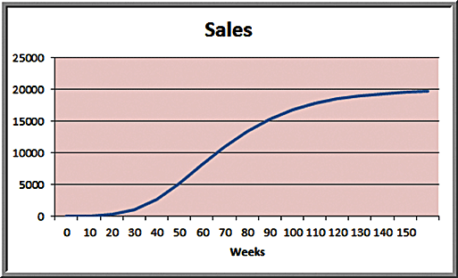
Example 1.4 (continued)
2. Visual model: A sketch of sales as an S-shaped curve over time

Slide 25
Example 1.4 (continued)
3. Mathematical model: S = ae^{bect}
where S is sales, t is time, e is the base of natural logarithms, and a, b and c are constants.

Slide 26
Influence Diagrams
Influence diagram - a visual representation of a descriptive model that shows how the elements of the model influence, or relate to, others.
An influence diagram is a useful approach for conceptualizing the structure of a model and can assist in building a mathematical or spreadsheet model.

Slide 27
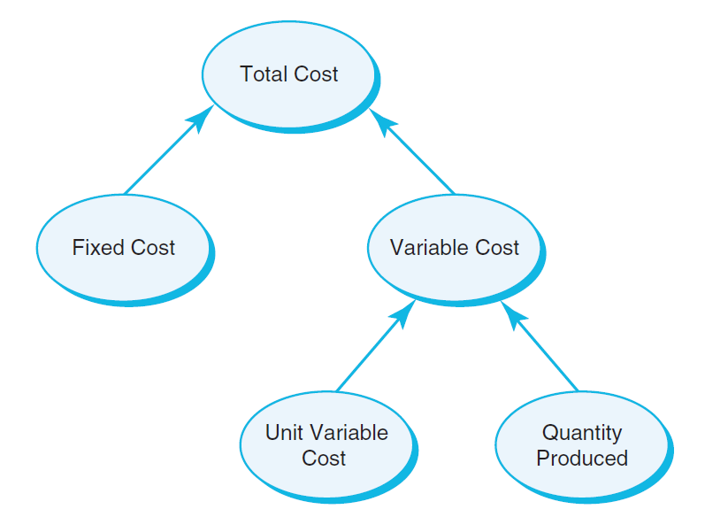
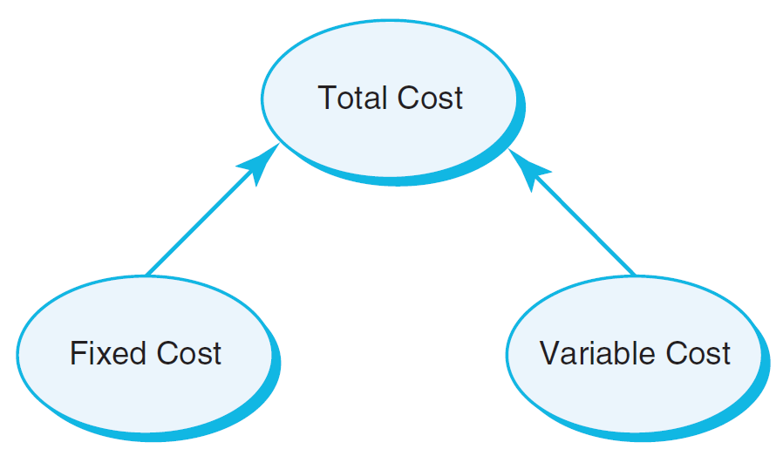
Example 1.5: An Influence Diagram for Total Cost
Basic Expanded

Slide 28
Example 1.6: Building a Mathematical Model
total cost = fixed cost + variable cost (1.1)
variable cost = unit variable cost × quantity produced (1.2)
total cost = fixed cost + variable cost
= fixed cost + unit variable cost × quantity produced (1.3)
Mathematical model:
TC = Total Cost
F = Fixed cost
V = Variable unit cost
Q = Quantity produced
TC = F +VQ (1.4)

Slide 29
Decision Models
Decision model - a logical or mathematical representation of a problem or business situation that can be used to understand, analyze, or facilitate making a decision.
Inputs:
Data, which are assumed to be constant for purposes of the model.
Uncontrollable variables, which are quantities that can change but cannot be directly controlled by the decision maker.
Decision variables, which are controllable and can be selected at the discretion of the decision maker.

Slide 30
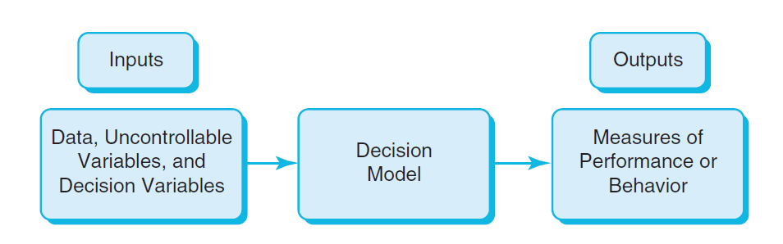
Nature of Decision Models

Slide 31
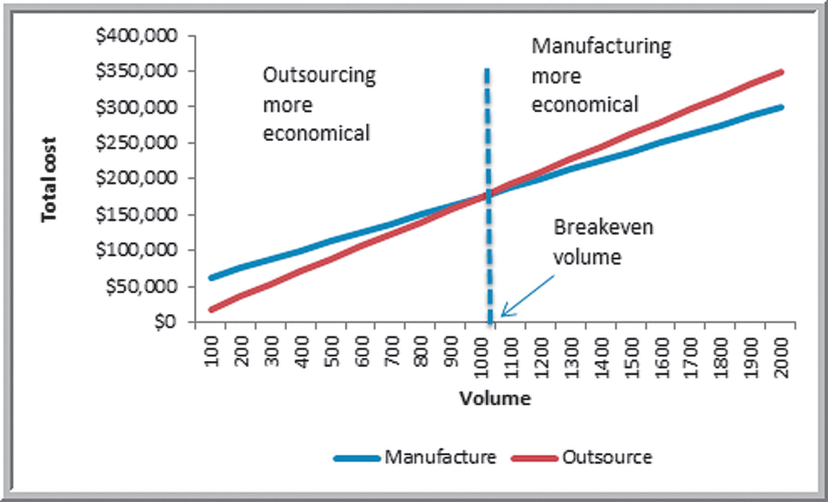
Example 1.7 A Break-Even Decision Model
TC(manufacturing) = $50,000 + $125*Q
TC(outsourcing) = $175*Q
Breakeven Point: TC(manufacturing) = TC(outsourcing)
$50,000 + $125 × Q = $175 × Q
$50,000 = 50 × Q
Q = 1,000
General Formula
F + VQ = CQ
Q = F/(C - V) (1.5)

Slide 32
Example 1.8: A Sales-Promotion Decision Model
In the grocery industry, managers typically need to know how best to use pricing, coupons and advertising strategies to influence sales. Grocers often study the relationship of sales volume to these strategies by conducting controlled experiments to identify the relationship between them and sales volumes. That is, they implement different combinations of pricing, coupons, and advertising, observe the sales that result, and use analytics to develop a predictive model of sales as a function of these decision strategies.

Slide 33
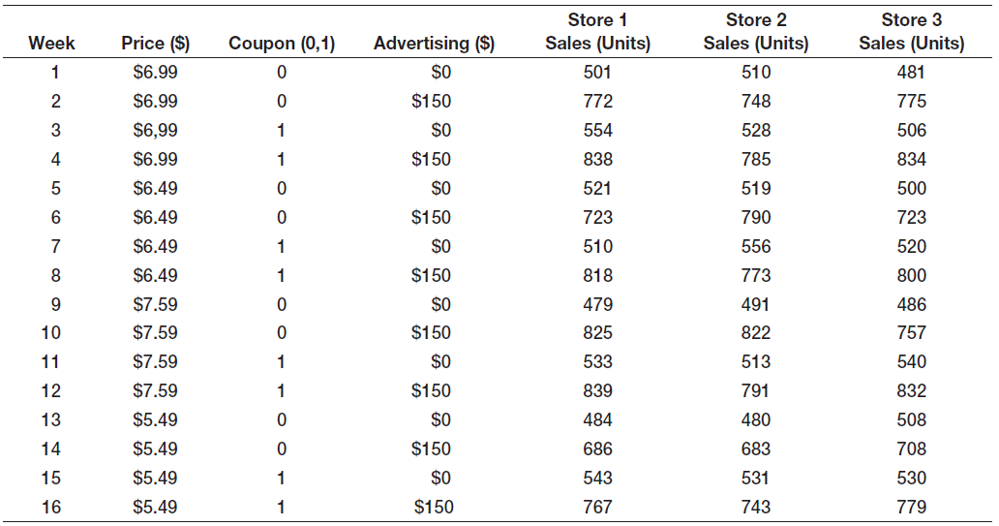
Example Model
Sales = 500 – 0.05(price) + 30(coupons) + 0.08(advertising) + 0.25(price)(advertising)
If the price is $6.99, no coupons are offered, and no advertising is done (the experiment corresponding to week 1), the model estimates sales as
Sales = 500 - 0.05 × $6.99 + 30 × 0 + 0.08 × 0 + 0.25 × $6.99 × 0 = 500 units

Slide 34
Model Assumptions
Assumptions are made to
simplify a model and make it more tractable; that is, able to be easily analyzed or solved.
better characterize historical data or past observations.
The task of the modeler is to select or build an appropriate model that best represents the behavior of the real situation.
Example: economic theory tells us that demand for a product is negatively related to its price. Thus, as prices increase, demand falls, and vice versa (modeled by price elasticity — the ratio of the percentage change in demand to the percentage change in price).

Slide 35
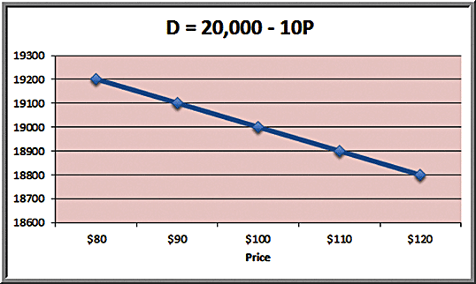
Example 1.9: A Linear Demand Prediction Model
As price increases, demand falls.

Slide 36
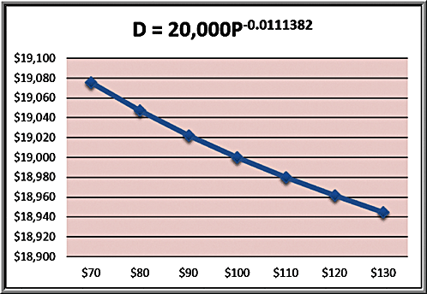
Example 1.10 A Nonlinear Demand Prediction Model
Assumes price elasticity is constant (constant ratio of % change in demand to % change in price)

Slide 37
Uncertainty and Risk
Uncertainty is imperfect knowledge of what will happen in the future.
Risk is associated with the consequences of what actually happens.
“To try to eliminate risk in business enterprise is futile. Risk is inherent in the commitment of present resources to future expectations. Indeed, economic progress can be defined as the ability to take greater risks. The attempt to eliminate risks, even the attempt to minimize them, can only make them irrational and unbearable. It can only result in the greatest risk of all: rigidity.”
– Peter Drucker

Slide 38
Prescriptive Decision Models
Prescriptive decision models help decision makers identify the best solution.
Optimization - finding values of decision variables that minimize (or maximize) something such as cost (or profit).
Objective function - the equation that minimizes (or maximizes) the quantity of interest.
Constraints - limitations or restrictions.
Optimal solution - values of the decision variables at the minimum (or maximum) point.

Slide 39
Example 1.11: A Prescriptive Pricing Model
A firm wishes to determine the best pricing for one of its products in order to maximize revenue.
Analysts determined the following model:
Sales = -2.9485(price) + 3240.9
Total revenue = (price)(sales)
= price × (-2.9485 × price + 3240.9)
= 22.9485 × price² + 3240.9 × price
Identify the price that maximizes total revenue, subject to any constraints that might exist.

Slide 40
Types of Prescriptive Models
Deterministic model – all model input information is known with certainty.
Stochastic model – some model input information is uncertain.
For instance, suppose that customer demand is an important element of some model. We can make the assumption that the demand is known with certainty; say, 5,000 units per month (deterministic). On the other hand, suppose we have evidence to indicate that demand is uncertain, with an average value of 5,000 units per month, but which typically varies between 3,200 and 6,800 units (stochastic).

Slide 41
Problem Solving With Analytics
1. Recognizing a problem
2. Defining the problem
3. Structuring the problem
4. Analyzing the problem
5. Interpreting results and making a decision
6. Implementing the solution

Slide 42
Recognizing a Problem
Problems exist when there is a gap between what is happening and what we think should be happening.
For example, costs are too high compared with competitors.

Slide 43
Defining the Problem
Clearly defining the problem is not a trivial task.
Complexity increases when the following occur:
- large number of courses of action
- the problem belongs to a group and not an individual
- competing objectives
- external groups are affected
- problem owner and problem solver are not the
same person
- time limitations exist

Slide 44
Structuring the Problem
Stating goals and objectives
Characterizing the possible decisions
Identifying any constraints or restrictions

Slide 45
Analyzing the Problem
Analytics plays a major role.
Analysis involves some sort of experimentation or solution process, such as evaluating different scenarios, analyzing risks associated with various decision alternatives, finding a solution that meets certain goals, or determining an optimal solution.

Slide 46
Interpreting Results and Making a Decision
Models cannot capture every detail of the real problem
Managers must understand the limitations of models and their underlying assumptions and often incorporate judgment into making a decision.

Slide 47
Implementing the Solution
Translate the results of the model back to the real world.
Requires providing adequate resources, motivating employees, eliminating resistance to change, modifying organizational policies, and developing trust.

Slide 48
Fun with Analytics
www.puzzlOR.com
Maintained by an analytics manager at ARAMARK.
Each month a new puzzle is posted.
Many puzzles can be solved using techniques you will learn in this book.
The puzzles are fun challenges.
A good one to start with is SurvivOR (June 2010).
Have fun!

