Slide 1

Platform Technology Linux Server and Services
อ.ไพฑูรย์ บุตรี

Slide 2
History of Linux

Slide 3

History of Linux
Linux is evolved from project started by a university student to the robust OS it now

Slide 4
History of Linux
In June 1971, Richard Matthew Stallman joined MIT Artificial Intelligence Laboratory as a programmer where he gained popularity with the hacker community and came to be known by his now popular name RMS.
At that time, all the programmers used to share their code freely among each other cutting across various institutions

Slide 5

History of Linux
Richard Stallman

Slide 6
History of Linux
In 1980, with the advent of portable software - ie software that can be compiled to run on different computers, a business model emerged.
So the companies developing the code refused to share the code with their clients and began restricting copying and redistribution of their software by copyrighting it.

Slide 7
History of Linux
In response to this trend, Stallman, who believed in the principle that software has to be free always, founded the Free Software Foundation and in 1985, published the GNU Manifesto.
This manifesto outlined his motivation for creating a free OS called GNU, which would be compatible with Unix.
He along with a group of like minded programmers started work in developing the tools needed to make a complete OS

Slide 8
History of Linux
In the same year (1985), a professor by name Andy Tanenbaum wrote a Unix like Operating system from scratch for the Intel i386 platform.
He named it Minix.

Slide 9

History of Linux
Andy Tanenbaum

Slide 10
History of Linux
In 1989, Stallman released the first program independent GNU General Public Licence now popularly known as GPL or copyleft.
Now the only thing that GNU lacked was a completely free OS kernel

Slide 11
History of Linux
In 1990, A finnish student by name Linus Torvalds studying in the University of Helsinki came into contact with Andy Tanenbaum's OS, Minix.
Linus wanted to upgrade Minix by putting in more features and improvements.
But he was prohibited by Tanenbaum to do so.
Then Linus decided to write his own kernel and released it under GPL.
This kernel is now popularly known as Linux.

Slide 12

History of Linux
Linus Torvalds

Slide 13

History of Linux
Tux the penguin: Linux’s Dear Logo

Slide 14
History of Linux
The logo of Linux is a penguin.
His cute logo has a very interesting history.
Initially no logo was selected for Linux.
Once Linus went to the southern hemisphere on a vacation.
As he tried to pat it, the penguin bit his hand.
This amusing incident led to the selection of a penguin as the logo of Linux sometime later.

Slide 15
History of Linux
Once Linus went to the southern hemisphere on a vacation
His cute logo has a very interesting history.
Initially no logo was selected for Linux.

Slide 16
History of Linux
Once Linus went to the southern hemisphere on a vacation
His cute logo has a very interesting history.
Initially no logo was selected for Linux.

Slide 17
What is Linux?

Slide 18
What is Linux?
Linux Operating System
Just like Windows XP, Windows 7, Windows 8, and Mac OS X, Linux is an operating system.
An operating system is software that manages all of the hardware resources associated with your desktop or laptop.
To put it simply – the operating system manages the communication between your software and your hardware.
Without the operating system (often referred to as the “OS”), the software wouldn’t function.

Slide 19
What is Linux?
Linux Components
The Bootloader: The software that manages the boot process of your computer. For most users, this will simply be a splash screen that pops up and eventually goes away to boot into the operating system.
The kernel: This is the one piece of the whole that is actually called “Linux”. The kernel is the core of the system and manages the CPU, memory, and peripheral devices. The kernel is the “lowest” level of the OS.

Slide 20
What is Linux?
Linux Components
Daemons: These are background services (printing, sound, scheduling, etc) that either start up during boot, or after you log into the desktop.
The Shell: You’ve probably heard mention of the Linux command line. This is the shell – a command process that allows you to control the computer via commands typed into a text interface.
Graphical Server: This is the sub-system that displays the graphics on your monitor. It is commonly referred to as the X server or just “X”.

Slide 21
What is Linux?
Linux Components
Desktop Environment: This is the piece of the puzzle that the users actually interact with. There are many desktop environments to choose from (Unity, GNOME, Cinnamon, Enlightenment, KDE, XFCE, etc).
Applications: Just like Windows and Mac, Linux offers thousands upon thousands of high-quality software titles that can be easily found and installed.

Slide 22
What is Linux?
Linux Distribution
Linux has a number of different versions to suit nearly any type of user.
From new users to hard-core users, you’ll find a “flavor” of Linux to match your needs.
These versions are called distributions (or, in the short form, “distros.”)
Nearly every distribution of Linux can be downloaded for free, burned onto disk (or USB thumb drive), and installed (on as many machines as you like).

Slide 23

What is Linux?
Linux Desktop
Ubuntu
Linux Mint
PCLinuxOS
ElementaryOS
Puppy Linux
SolydXK
OpenSuse Leap
Fedora
Arch
Debian
You can check out the top 100 distributions on the Distrowatch site.

Slide 24




What is Linux?
Linux Server
RedHat Enterprise Linux
Ubuntu Server
CentOS
SuSE Enterprise Linux

Slide 25
What is Enterprise Linux?

Slide 26
What is Enterprise Linux?
Enterprise Linux
Extended Support – It required when the system in production need to upgraded to the new releases.
Low-Risk Security Update – These are updates that are designed to fix a specific issue without making large, sweeping changes to a software application.
ABI/API Stability – For third-party applications. Enterprise Linux guarantees that during a given release, neither the ABI nor the API will change.
Regular Updates and Bug Fixes – Enterprise Linux also provides regular updates and bug fixes. These are released on a regular basis and ensure that everything continues to run smoothly.
Certification – Enterprise Linux is also certified to run on certain types of hardware, to run certain soft- ware applications, and to be used in certain environments.

Slide 27
What is Enterprise Linux?
Enterprise Linux
attempts to provide a platform that is based on stable software.
will be updated and supported for an extended period of time.
won’t change software versions in the middle of a release.
has low-risk security updates.
For these reasons, enterprise Linux is far better suited for production servers than consumer-grade solutions.

Slide 28
Linux Installation

Slide 29
CentOS Installation
Required environments
CentOS – RedHat Enterprise Linux Clone, CentOS-7-x86_64-Minimal-1708
VirtualBox – Oracle VM, VirtualBox-5.1.28-117968-Win
Putty.exe – SSH Clients for Windows

Slide 30
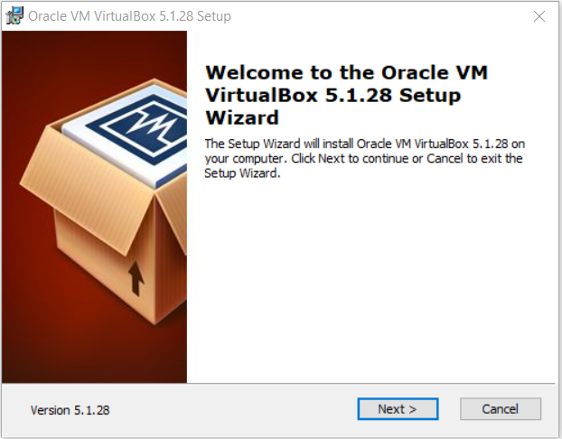
VirtualBox Installation
Double Click on VirtualBox-5.1.28-117968-Win, Click Next

Slide 31
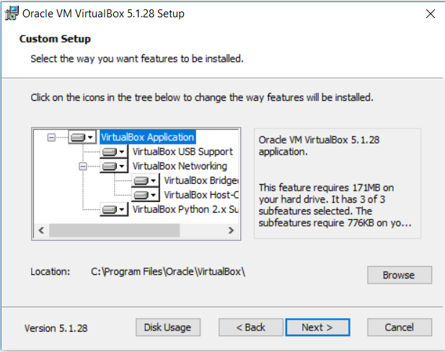
VirtualBox Installation
Click Next

Slide 32
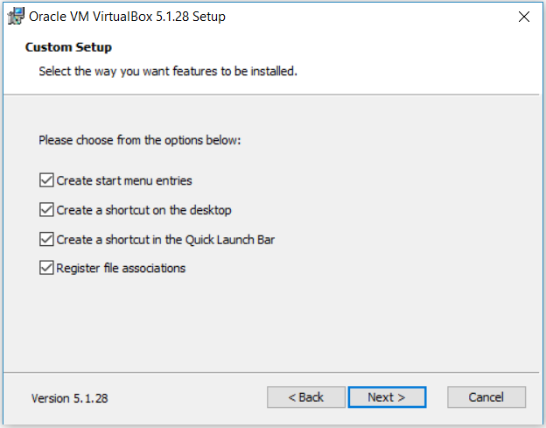
VirtualBox Installation
Click Next

Slide 33
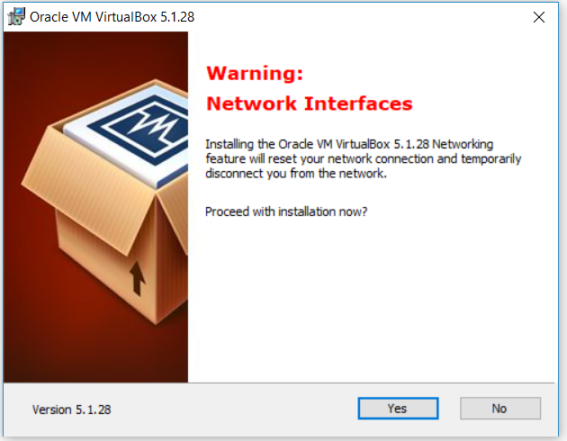
VirtualBox Installation
Click Yes

Slide 34
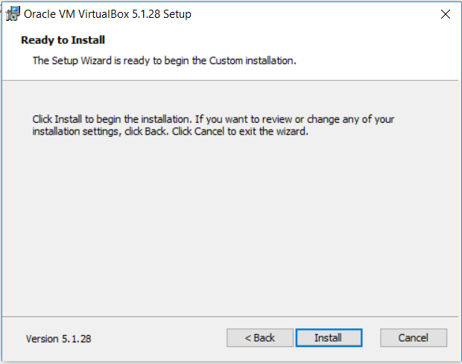
VirtualBox Installation
Click Install

Slide 35
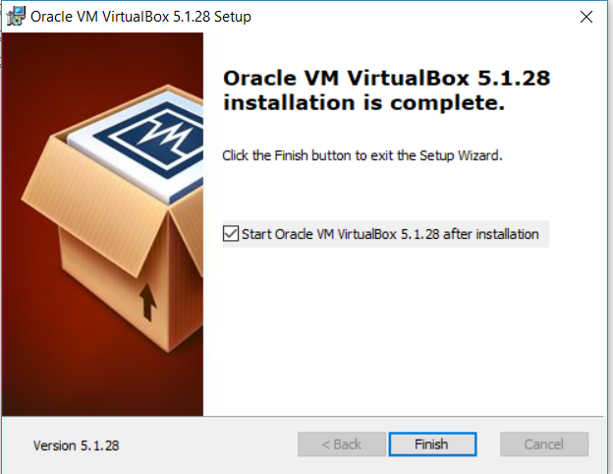
VirtualBox Installation
Click Finish

Slide 36
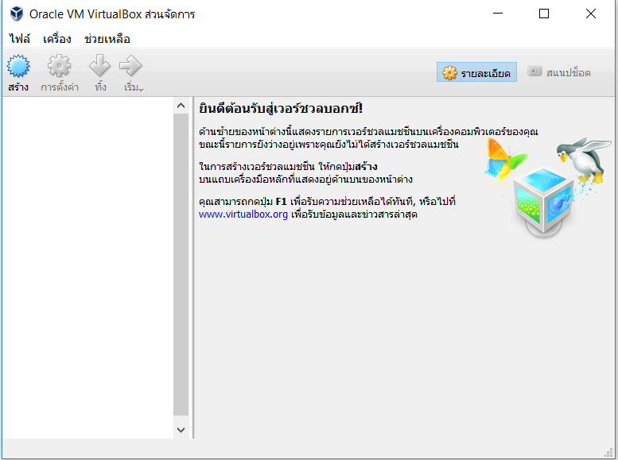
VirtualBox Installation
VirtualBox first page

Slide 37
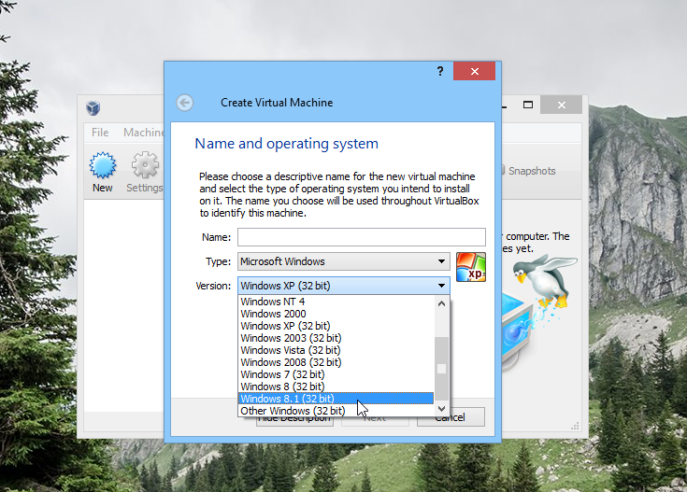
VirtualBox Installation
Why is VirtualBox only showing 32 bit guest versions on my 64 bit host OS?
VirtualBox categorically refused to display any 64-bit guest OSes in the Create Virtual Machine dialog box.

Slide 38
VirtualBox Installation
How to make VirtualBox display 64-bit guest OS version
Reboot Computer and press function key to enter BIOS setup. (or Access bios from windows 10, https://www.laptopmag.com/articles/access-bios-windows-10)
In security section, Virtualization, To enable Intel (R) Virtualization Technology and Intel (R) VT-d feature
Save and Exit

Slide 39
CentOS Installation
The minimum installation requirements
i386 or x86-64 processor
128MB of RAM for text install on i386 (all others are 512MB)
1.2GB of disk space

Slide 40
CentOS Installation
Open VirtualBox, Click สร้าง

Slide 41
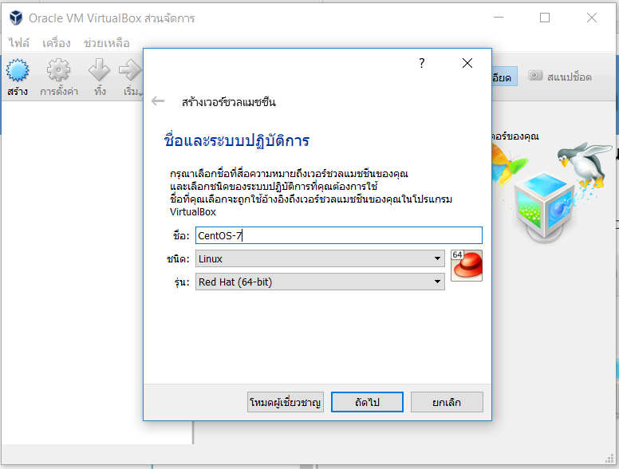
CentOS Installation
บันทึก ชื่อ, ชนิด, รุ่น แล้วคลิ๊ก ถัดไป

Slide 42
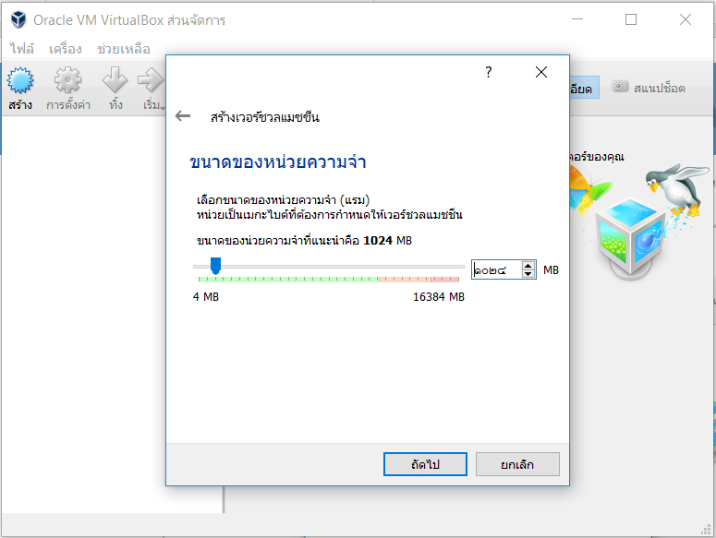
CentOS Installation
บันทึก ขนาดของหน่วยความจำ แล้วคลิ๊ก ถัดไป

Slide 43
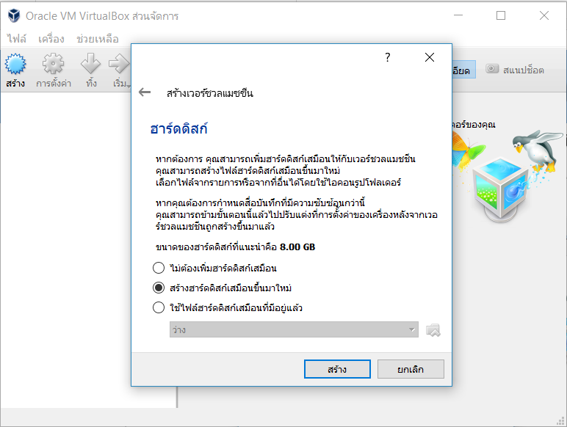
CentOS Installation
เลือก สร้างฮาร์ดดิสก์เสมือนขึ้นมาใหม่ แล้วคลิ๊ก สร้าง

Slide 44
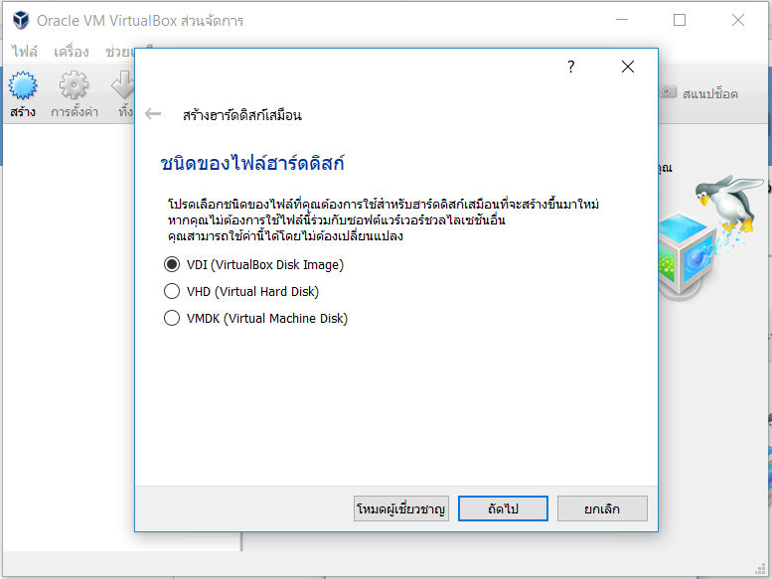
CentOS Installation
เลือก VDI (VirtualBox Disk Image) แล้วคลิ๊ก ถัดไป

Slide 45
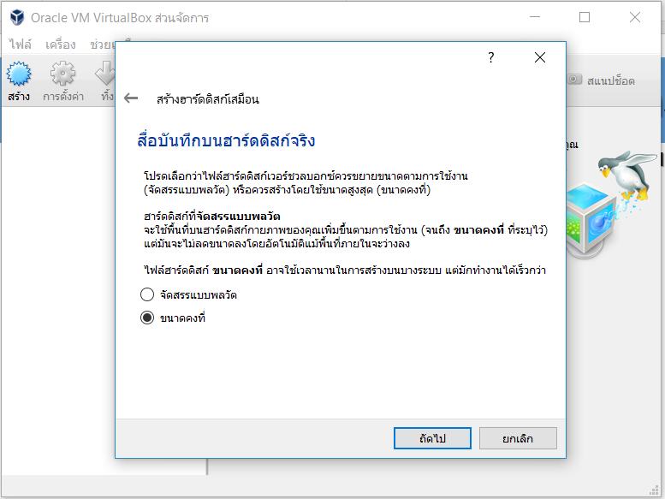
CentOS Installation
เลือก ขนาดคงที่ แล้วคลิ๊ก ถัดไป

Slide 46
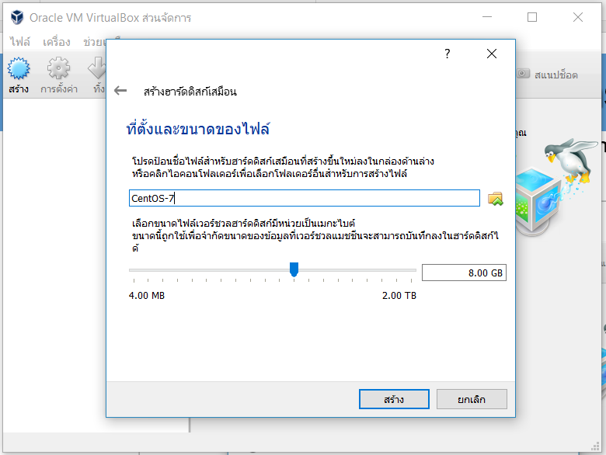
CentOS Installation
บันทึก ที่ตั้งและขนาดของไฟล์ แล้วคลิ๊ก สร้าง

Slide 47
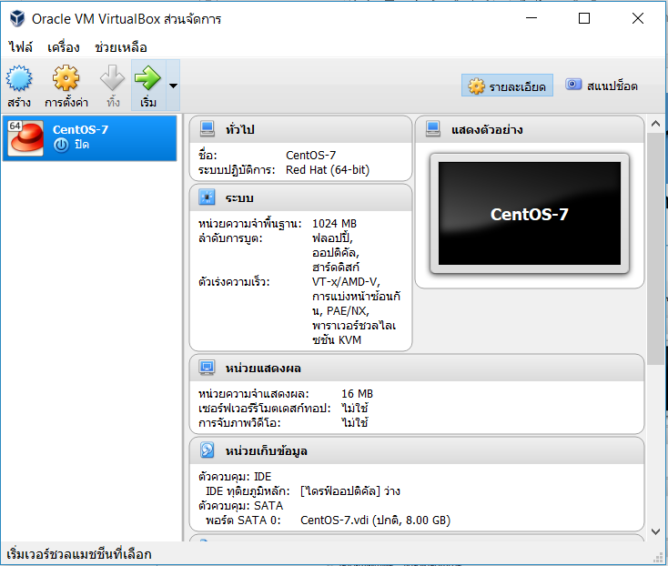
CentOS Installation
คลิ๊กที่ หน่วยเก็บข้อมูล

Slide 48
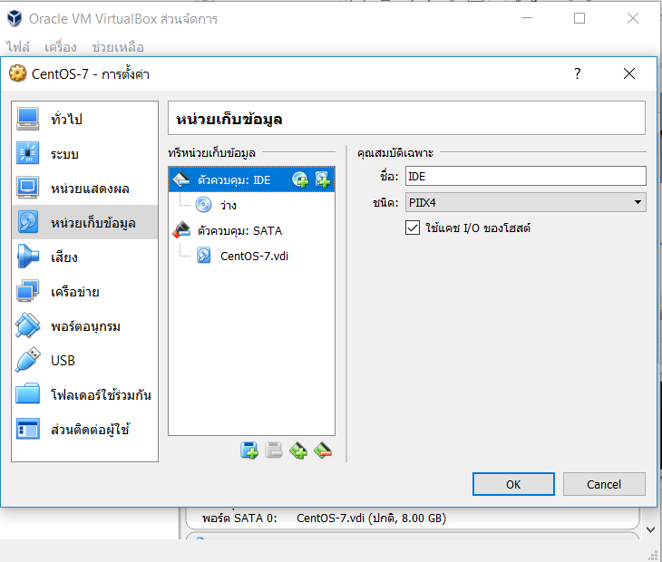
CentOS Installation
คลิ๊กที่ เพิ่มไดร์ฟออฟติคัล

Slide 49
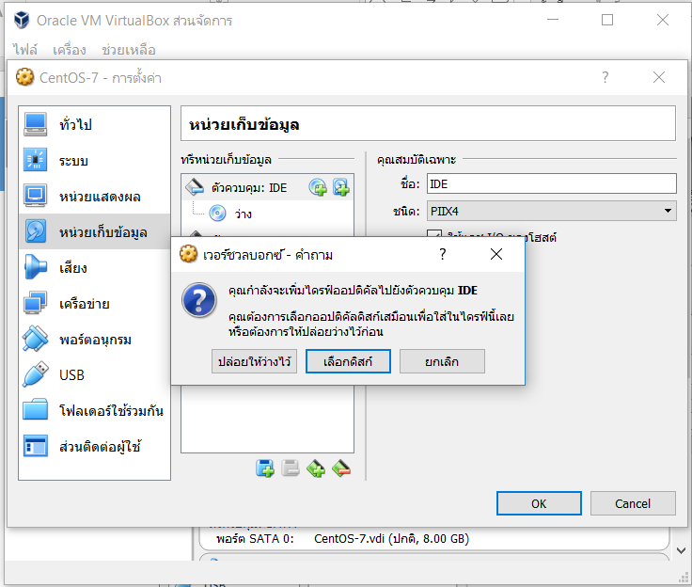
CentOS Installation
คลิ๊กที่ เลือกดิสก์

Slide 50
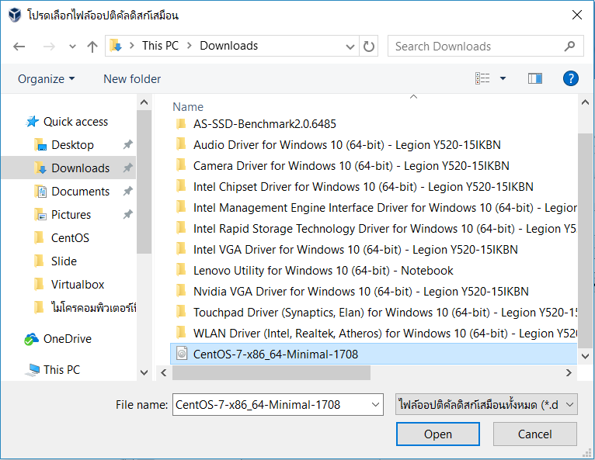
CentOS Installation
เลือกไฟล์ ISO ที่ต้องการ

Slide 51
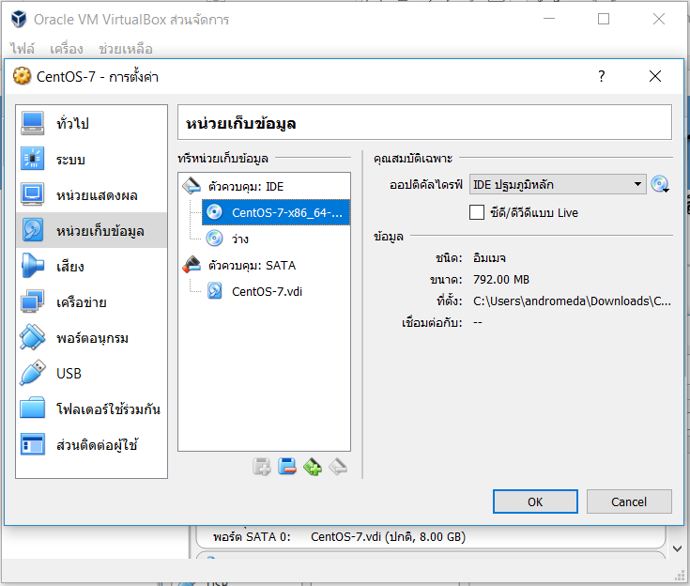
CentOS Installation
เลือก CentOS-7-x86_64… แล้วคลิ๊ก OK

Slide 52
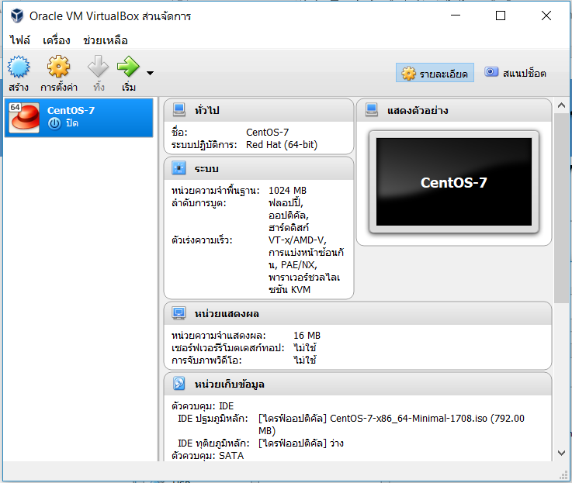
CentOS Installation
คลิ๊ก เริ่ม

Slide 53
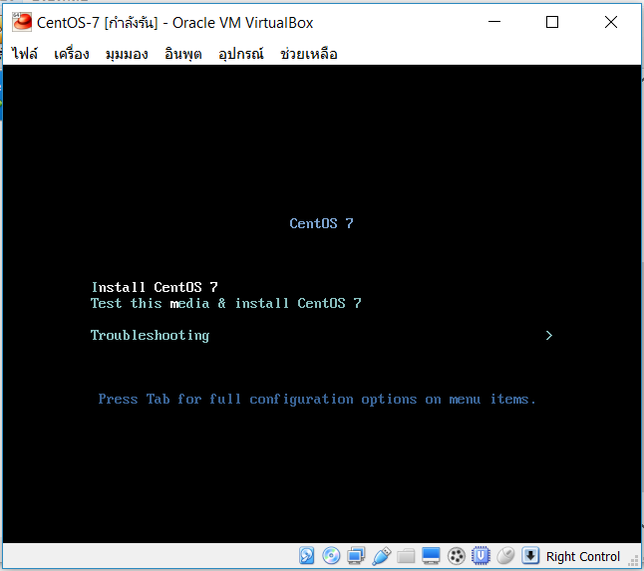
CentOS Installation
เลือก Install CentOS 7 แล้วกด Enter

Slide 54
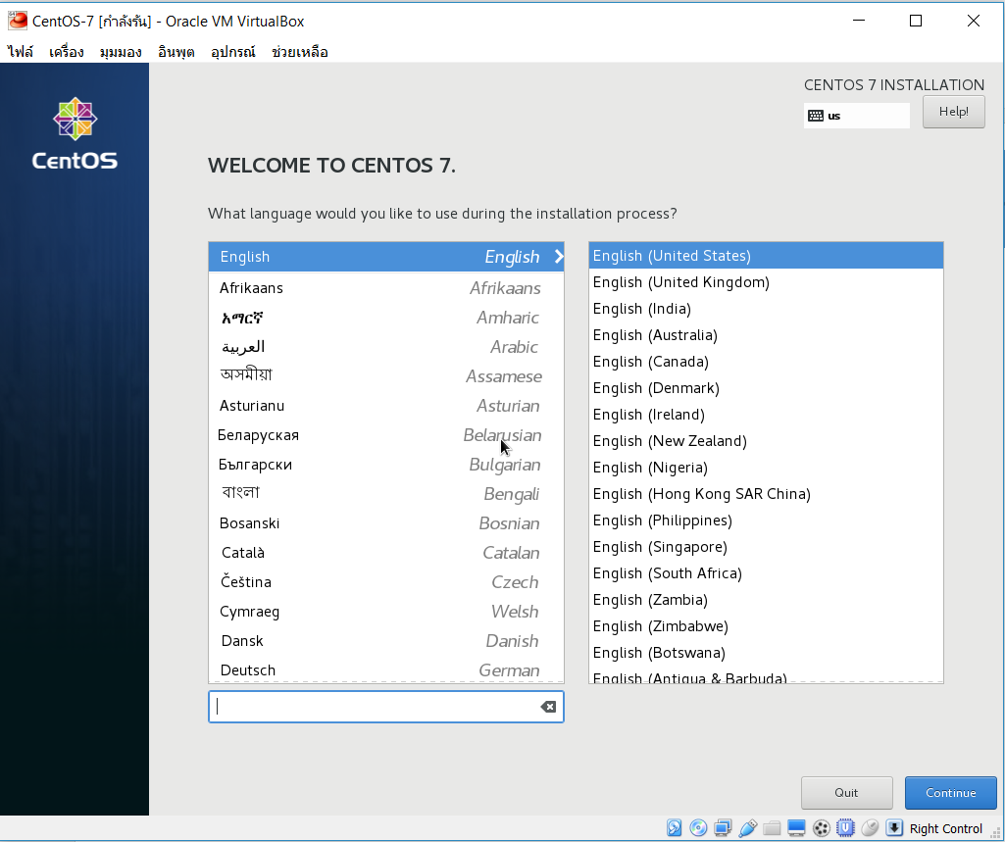
CentOS Installation
ที่หน้าจอเลือกภาษา แล้วคลิ๊ก Continue

Slide 55
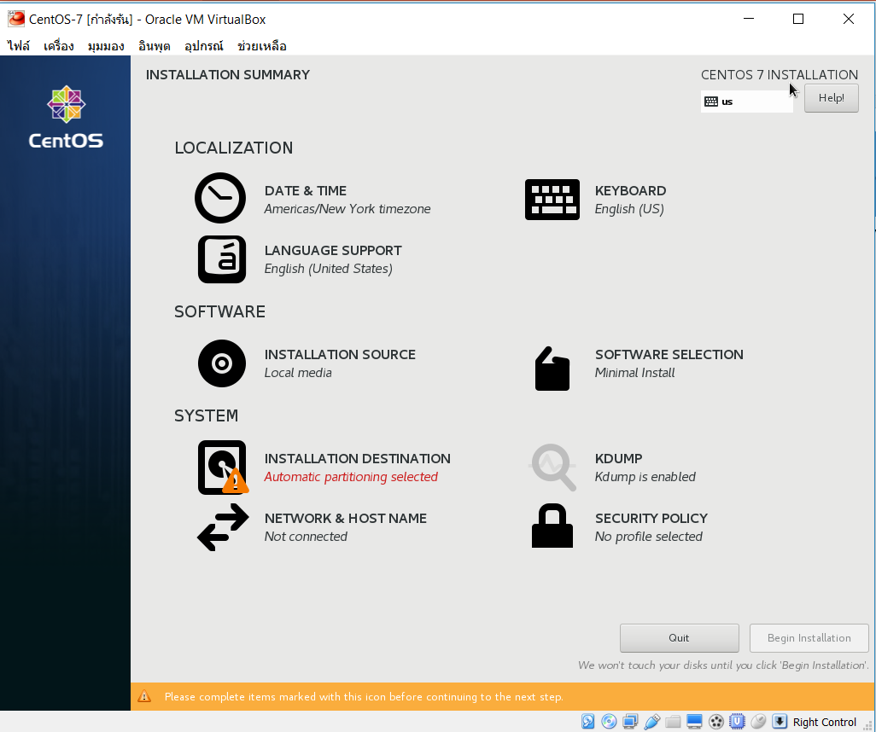
CentOS Installation
คลิ๊ก INSTALLATION DESTINATION

Slide 56
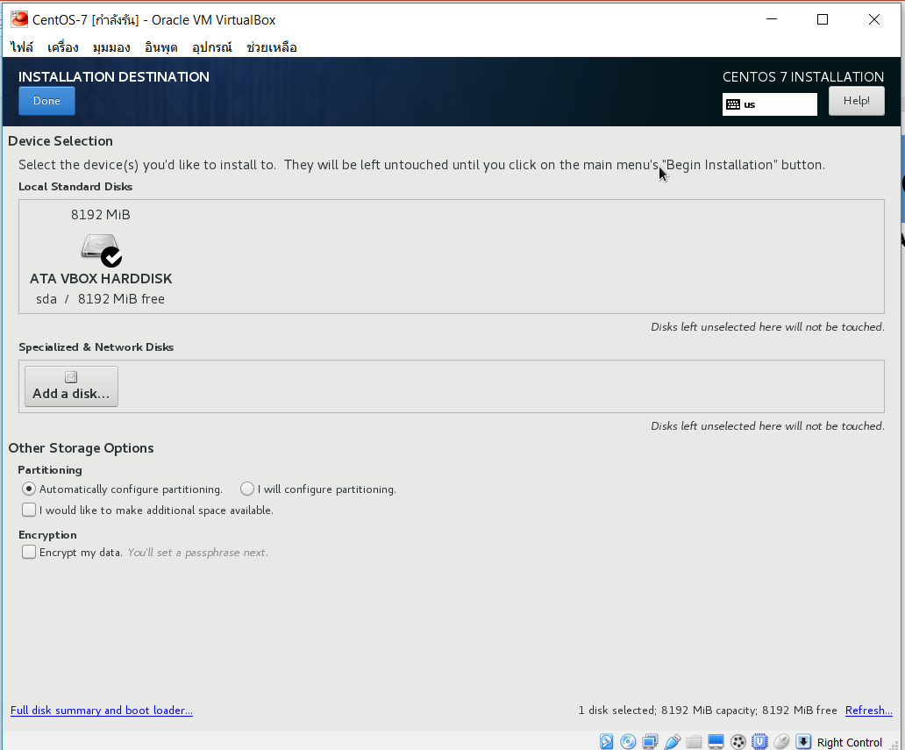
CentOS Installation
คลิ๊ก Done

Slide 57
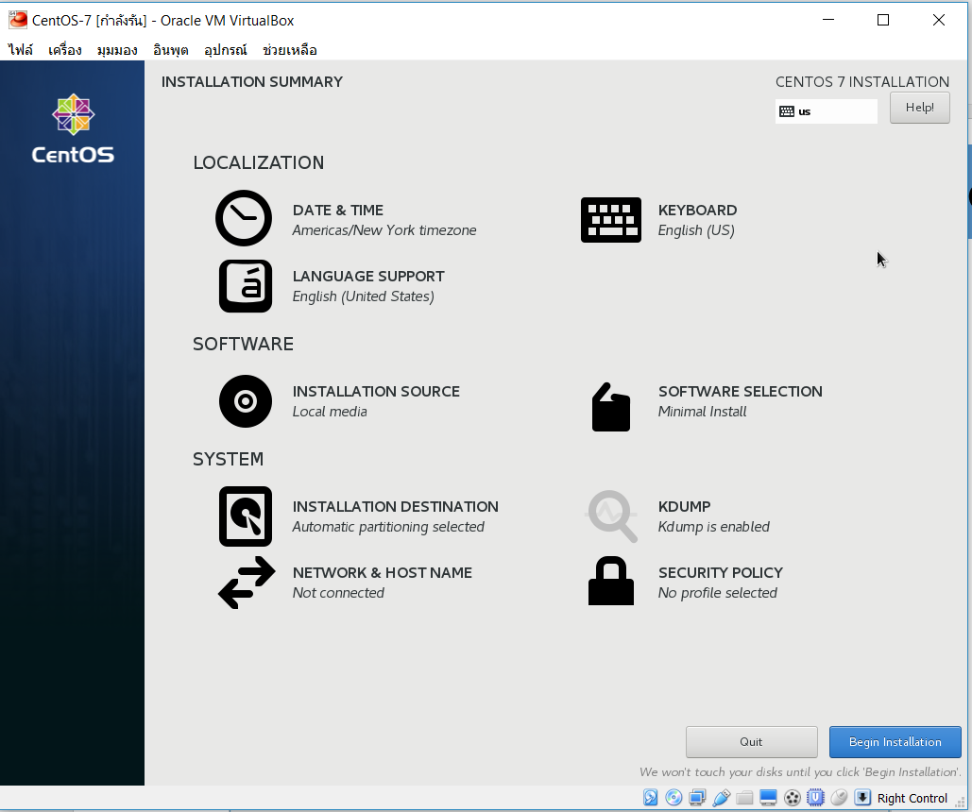
CentOS Installation
คลิ๊ก Begin Installation

Slide 58
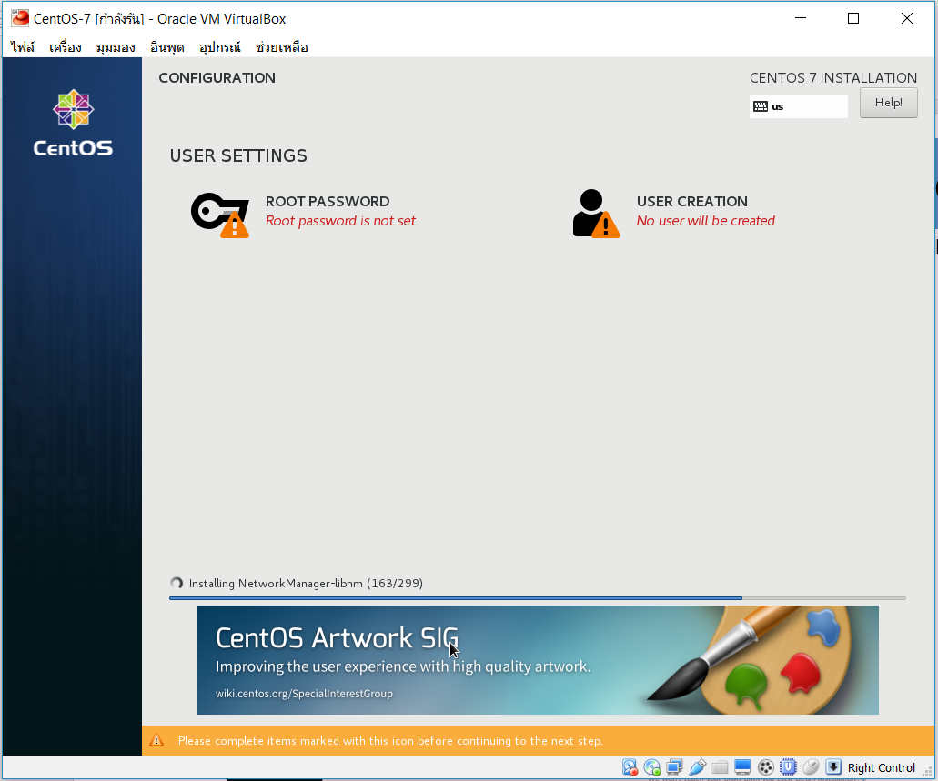
CentOS Installation
คลิ๊ก ROOT PASSWORD

Slide 59
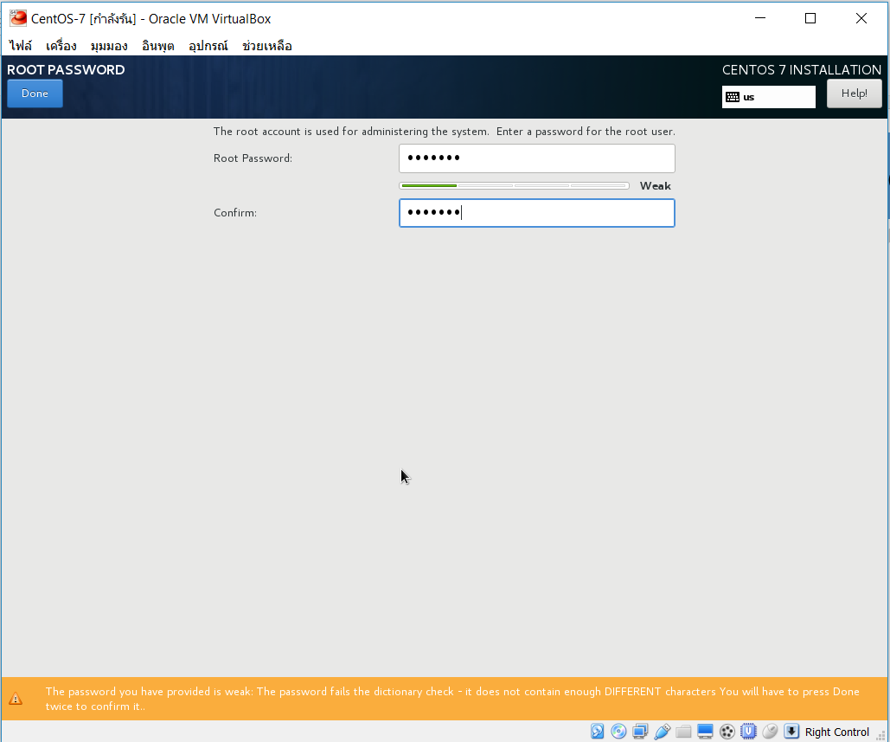
CentOS Installation
บันทึก Root Password, Confirm คลิ๊ก Done

Slide 60
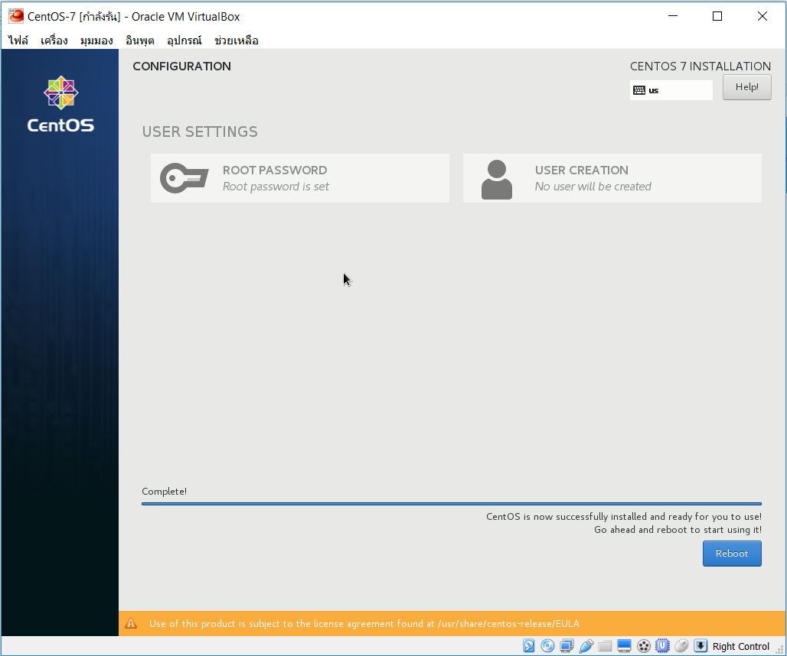
CentOS Installation
เมื่อ Complete คลิ๊ก Reboot

Slide 61
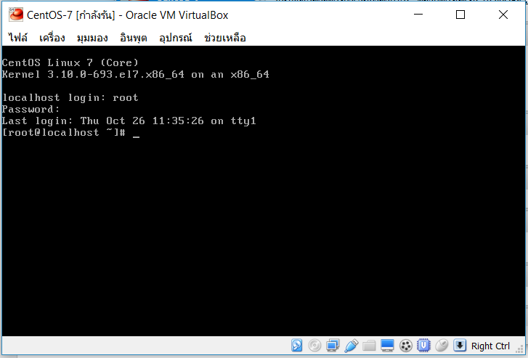
CentOS Installation
First Login
Login ด้วย root และ password

Slide 62
After Installation
Update Package
Enable network interface on boot
[root@192 ~]# cd /etc/sysconfig/network-scripts/
[root@192 network-scripts]# vi ifcfg-enp0s3
กด i เพื่อเข้าสู่ Edit Mode
แก้ไข ONBOOT จาก no เป็น yes
กด ESC เพื่อเข้าสู่ Command Mode
พิมพ์ :wq เพื่อ Save และ Exit
[root@192 network-scripts]# reboot
Update Package
Login เข้าสู่ระบบด้วย root และ password อีกครั้ง
[root@192 network-scripts]# yum update

Slide 63
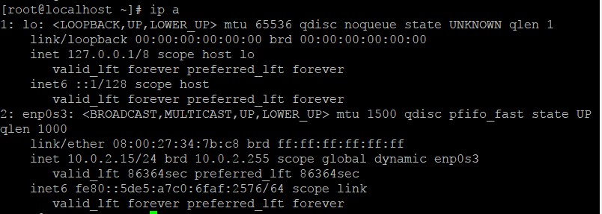
After Installation
VirtualBox network interface
Checking Guest IP address
ปกติแล้ว VirtualBox network interface จะถูกตั้งค่าเป็นแบบ NAT และจะกำหนด IP address ของเครื่อง Guest เป็น 10.0.2.15 สามารถตรวจสอบ โดยใช้คำสั่งดังนี้

Slide 64
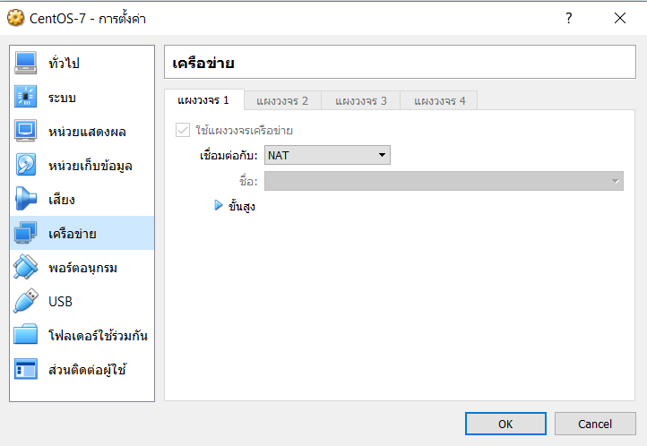
After Installation
Setting NAT with Port Forwarding
ปกติแล้ว VirtualBox network interface จะถูกตั้งค่าเป็นแบบ NAT และไม่อนุญาตให้เรียกใช้บริการไปยังเครื่อง Guest จากเครื่อง Host ต้องตั้งค่า Port Forwarding ถึงจะเรียกใช้บริการจากเครื่อง Guest ได้

Slide 65
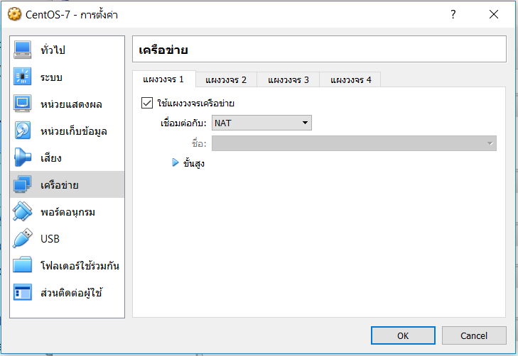
After Installation
Setting NAT with Port Forwarding
SSH (22) port forwarding
เปิดโปรแกรม VirtualBox แล้วไปยัง การตั้งค่า / เครือข่าย

Slide 66
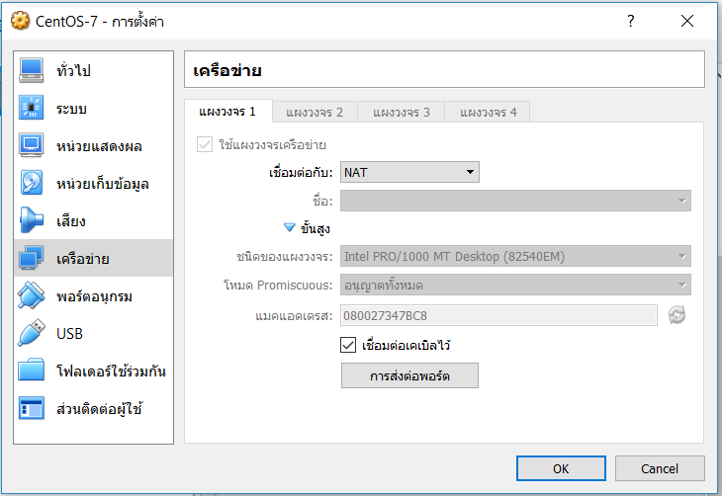
After Installation
Setting NAT with Port Forwarding
SSH (22) port forwarding
Click ขั้นสูง แล้ว Click การส่งต่อพอร์ต

Slide 67
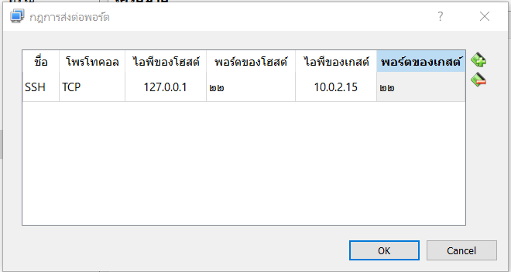
After Installation
Setting NAT with Port Forwarding
SSH (22) port forwarding
Click เพิ่มกฎการส่งต่อพอร์ต กำหนดค่า แล้วกดปุ่ม OK ดังรูป

Slide 68
After Installation
Logon from Host
Logon from Linux and Mac OSX
You can now open a terminal on Linux or Mac OSX and use ssh to log on to your virtual machine.
[root@localhost ~]# ssh root@127.0.0.1
The authenticity of host '127.0.0.1 (127.0.0.1)' can't be established.
ECDSA key fingerprint is SHA256:4YkNPs+b/ugXgXKxT1pZMmDwkEbNcMkDdsgjBtzszGA.
ECDSA key fingerprint is MD5:6b:6d:3f:d4:2d:26:c5:84:69:9d:82:e4:1d:ff:7b:28.
Are you sure you want to continue connecting (yes/no)? yes
Warning: Permanently added '127.0.0.1' (ECDSA) to the list of known hosts.
root@127.0.0.1's password:
Last login: Wed Nov 1 04:24:13 2017 from 10.0.2.2
[root@localhost ~]# hostname
localhost.localdomain
[root@localhost ~]#

Slide 69
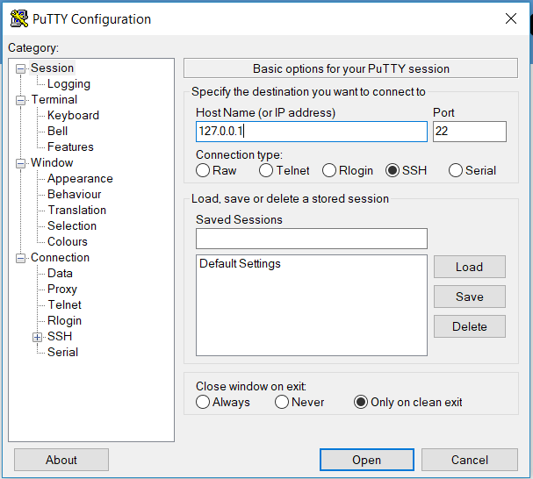
After Installation
logon from Host
Logon from Windows
เปิดโปรแกรม Putty.exe เพื่อ Logon ไป Guest โดยใช้ IP address เป็น 127.0.0.1 ด้วยพอร์ต 22 แล้วกดปุ่ม open ดังรูป

Slide 70
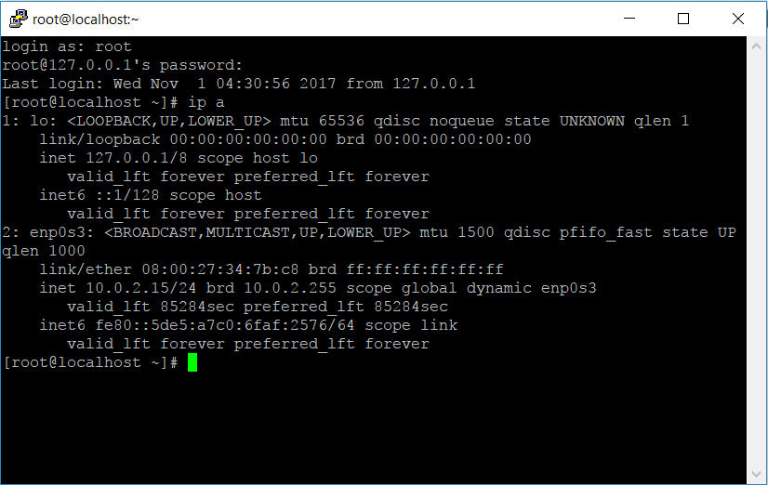
After Installation
logon from Host
Logon from Windows
Logon ด้วย root และ password

Slide 71
After Installation
setting the hostname
Setting the hostname is a simple as changing the /etc/hostname file. As you can see here, it is set to localhost.localdomain by default.
[root@localhost ~]# cat /etc/hostname
localhost.localdomain
[root@localhost ~]#
You could do echo server.bbu.local > /etc/hostname followed by a reboot .
[root@localhost ~]# echo server.bbu.local > /etc/hostname
[root@localhost ~]# reboot
After reboot.
[root@server ~]# hostname
server.bbu.local

Slide 72
Getting start to CentOS

Slide 73
Getting start
Filesystem layout
Under Linux, however, individual device type/location isn’t important. Instead, the file layout provides a homogenous view over all the content independent from where that content comes.
In theory, this means that working with files on a Linux system is simplified because the files look the same regardless of where they are. For example, files on a CD-ROM look the same as files on a hard disk or network share.

Slide 74
Getting start
Filesystem Layout
/ This is the root directory, and all other directories and files exist underneath it. It is often confused with the root home area ( /root/ ), which we’ll look at next. It also contains all the key directories for the system.
/root This directory is the root home area. This is where all of root’s personal configuration and files go.
/etc The /etc directory contains all the configuration and settings files for your server applications.
/proc /proc is a virtual filesystem used by the kernel to communicate with userland tools. It gives you everything you need to know about your running system such as details on the CPU ( /proc/cpuinfo ), memory usage ( /proc/meminfo ), and much more.

Slide 75
Getting start
Filesystem layout
/var /var (short for variable) is traditionally where data that is created during the running of a machine would go. It’s the default location now for web content ( /var/www/html/ ) and mail spools ( /var/spool/mail/ ) as well as all of the system log files ( /var/log/ ).
/boot /boot contains all the files needed to successfully boot CentOS. This includes the configu- ration files for GRUB (the boot loader) and the kernel itself.
/bin and /sbin /bin is the home for most user programs, and /sbin is the home for administration tools and privileged binaries.
/dev This is the location of all the device files on a Linux system. All hardware is accessed via a file in this directory. Ex. /dev/cdrom

Slide 76
Getting start
Filesystem layout
/home This directory holds the home directories of users.
/lib /lib contains system libraries.
/lost+found This directory can be found in the root of any ext2 or ext3 filesystem. It is used during disk checking ( fsck ) to store files that have become detached or missing from the filesystem because of filesystem damage.
/media In order to access data stored on removable storage, the devices have to be mounted first.
/mnt On older systems, removable media was generally mounted under the /mnt directory. Now that /media handles this.

Slide 77
Getting start
Filesystem layout
/usr This directory contains the vast majority of user software and is often the largest directory on a machine. Although it’s good to know where your software actually resides, because the default path includes /usr/bin.
/opt /opt is most often used for large third-party applications. For example, by default, Oracle will attempt to install itself in /opt .
/srv srv is used for storing files that are used in providing a service. Most services don’t make use of this directory and instead place such files somewhere under /var/ .
/sys This directory is for storing information about the system. The data stored here is written to hard disk, so it can survive a reboot.
/tmp This directory is used for the creation of temporary files.

Slide 78
Getting start
Relative and Absolute Paths
A path is the route you need to take to get from your current location to another.
There are two ways to specify a path. You can specify the path based on your current location (a relative path) or from the root directory (an absolute path).
A relative path is dependent on your current location. If you’re working on a machine and moving between a few directories.
If you need to be explicit about which file you are talking about or you want to provide the path to a third party, it is far better to use an absolute path.

Slide 79
Linux Command

Slide 80
Linux Command
Command Prompt
Before we can discuss how to use bash or work with your new server, we need to first gain access to the command line. This is normally referred to as a command prompt on a Windows machine but is normally simply called a shell on Unix machines.
The following is an example of a prompt:
[pmembrey@doublehelix ~]$
pmembrey This shows the current user.
doublehelix This identifies the hostname of the machine to which you’re connected.
The tilde ( ~ ) This is a special Unix convention meaning home directory. Normally, This is represent the current directory.
$ This denotes whether the current user has root privileges (#) or user privileges ($).

Slide 81
Linux Command
Man Pages
mandb
mandb - create or update the manual page index caches
[root@192 ~]# mandb
…
Purging old database entries in /usr/share/man/sk...
Processing manual pages under /usr/share/man/sk...
Purging old database entries in /usr/share/man/es...
Processing manual pages under /usr/share/man/es...
Purging old database entries in /usr/share/man/pt...
Processing manual pages under /usr/share/man/pt...
Purging old database entries in /usr/local/share/man...
Processing manual pages under /usr/local/share/man...
0 man subdirectories contained newer manual pages.
0 manual pages were added.
0 stray cats were added.
0 old database entries were purged.

Slide 82
Linux Command
Man Pages
man $command
Type man followed by a command (for which you want help) and start reading. Press q to quit the manpage. Some man pages contain examples (near the end).
[root@192 ~]# man ls
Reformatting ls(1), please wait...
man $configfile
Most configuration files have their own manual.
[root@192 ~]# man syslog.conf
Reformatting syslog.conf(5), please wait..

Slide 83
Linux Command
Man Pages
man -k (apropos)
man -k (or apropos ) shows a list of man pages containing a string.
[root@192 ~]# man -k syslog
logger (1) - a shell command interface to the syslog(3) system log ...
rsyslog.conf (5) - rsyslogd(8) configuration file
rsyslogd (8) - reliable and extended syslogd
man $section $file
Therefor, when referring to the man page of the crontab command, you will see it written as crontab(1) ; you will see it written as crontab(5) . The screenshot explains how to open the man page in the correct section.
[root@192 ~]# man –k crontab
[root@192 ~]# man crontab # opens the first manual found
[root@192 ~]# man 5 crontab # opens a page from section 5

Slide 84
Linux Command
Man Pages
whatis
To see just the description of a manual page, use whatis followed by a string.
[root@192 bin]# whatis route
route (8) - show / manipulate the IP routing table
whereis
The location of a manpage can be revealed with whereis .
[root@192 bin]# whereis -m route
route: /usr/share/man/man8/route.8.gz
This file is directly readable by man .
[root@192 bin]# man /usr/share/man/man8/route.8.gz

Slide 85
Linux Command
working with directories
whatis
To see just the description of a manual page, use whatis followed by a string.
[root@192 bin]# whatis route
route (8) - show / manipulate the IP routing table
whereis
The location of a manpage can be revealed with whereis .
[root@192 bin]# whereis -m route
route: /usr/share/man/man8/route.8.gz
This file is directly readable by man .
[root@192 bin]# man /usr/share/man/man8/route.8.gz

Slide 86
Linux Command
working with directories
pwd
The pwd command show you which directory you’re currently in. There will be many times when you’ll be working on files with identical names stored in different directories. pwd will ensure you don’t accidentally change the wrong one!
pmembrey@doublehelix ~]$ pwd
/home/pmembrey
[pmembrey@doublehelix ~]$

Slide 87
Linux Command
working with directories
cd
You can change your current directory with the cd command (Change Directory).
[root@192 bin]# cd /etc
[root@192 etc]# pwd
/etc
cd ~
The cd is also a shortcut to get back into your home directory. Just typing cd without a target directory, will put you in your home directory.
Typing cd ~ has the same effect.
[root@192 etc]# cd
[root@192 ~]# pwd
/root
[root@192 ~]# cd ~
[root@192 ~]# pwd
/root

Slide 88
Linux Command
working with directories
cd ..
To go to the parent directory (the one just above your current directory in the directory tree), type cd .. .
[root@192 ~]# cd /var/lib/
[root@192 lib]# pwd
/var/lib
[root@192 lib]# cd ..
[root@192 var]# pwd
/var
cd -
Another useful shortcut with cd is to just type cd - to go to the previous directory.
[root@192 ~]# cd /etc
[root@192 etc]# cd /var
[root@192 var]# cd -
/etc

Slide 89
Linux Command
working with directories
path completion
The tab key can help you in typing a path without errors. Typing cd /et followed by the tab key will expand the command line to cd /etc/ . When typing cd /Et followed by the tab key , nothing will happen because you typed the wrong path (upper case E).
You will need fewer key strokes when using the tab key , and you will be sure your typed path is correct!
cd -
Another useful shortcut with cd is to just type cd - to go to the previous directory.
[root@192 ~]# cd /etc
[root@192 etc]# cd /var
[root@192 var]# cd -
/etc

Slide 90
Linux Commamnd
working with directories
ls
You can list the contents of a directory with ls .
[root@192 ~]# ls
anaconda-ks.cfg dir1
ls –a
A frequently used option with ls is -a to show all files. Showing all files means including the hidden files. When a file name on a Linux file system starts with a dot, it is considered a hidden file and it doesn't show up in regular file listings.
[root@192 ~]# ls -a
. anaconda-ks.cfg .bash_logout .bashrc dir1
.. .bash_history .bash_profile .cshrc .tcshrc

Slide 91
Linux Commamnd
working with directories
ls -l
Typing ls -l (that is a letter L, not the number 1) gives you a long listing.
[root@192 ~]# ls -l
total 4
-rw-------. 1 root root 1261 Oct 26 11:24 anaconda-ks.cfg
drwxr-xr-x. 3 root root 18 Oct 26 16:20 dir1
ls –lh
Another frequently used ls option is -h . It shows the numbers (file sizes) in a more human readable format.
[root@192 ~]# ls -lh
total 4.0K
-rw-------. 1 root root 1.3K Oct 26 11:24 anaconda-ks.cfg
drwxr-xr-x. 3 root root 18 Oct 26 16:20 dir1

Slide 92
Linux Command
working with directories
mkdir
Once you can look at which directories you have, you’ll need mkdir to create new ones. mkdir is short for “make directory”.
pmembrey@doublehelix ~]$ mkdir dir1
[pmembrey@doublehelix ~]$
[pmembrey@doublehelix ~]$ mkdir dir1/dir2/dir3
mkdir: cannot create directory dir1/dir2/dir3 ': No such file or directory
mkdir -p
Now, if you run the same command but this time add –p , you instead get this:
[pmembrey@doublehelix ~]$ mkdir -p dir1/dir2/dir3
[pmembrey@doublehelix ~]$ ls dir1/dir2/dir3
[pmembrey@doublehelix ~]$

Slide 93
Linux Command
working with directories
rmdir
This command lets you remove a directory.
root@192 ~]# mkdir dir4
[root@192 ~]# ls
anaconda-ks.cfg dir1 dir4
[root@192 ~]# rmdir dir4
[root@192 ~]# ls
anaconda-ks.cfg dir1
If you try to delete a directory (such as the directories that were created earlier in this chapter), you will get an error message:
[root@192 ~]# rmdir dir1
rmdir: failed to remove ‘dir1’: Directory not empty

Slide 94
Linux Command
working with directories
rmdir -p
To remove a chain of empty directories, you can use the option –p , which works a lot like the mkdir option. If any of the directories aren’t empty, however, rmdir will fail. This is a built-in safety feature.
[root@192 ~]# rmdir -p dir1/dir2/dir3
[root@192 ~]# cd dir1
-bash: cd: dir1: No such file or directory
[root@192 ~]#

Slide 95
Linux Command
working with files
all files are case sensitive
Files on Linux (or any Unix) are case sensitive . This means that FILE1 is different from file1 , and /etc/hosts is different from /etc/Hosts (the latter one does not exist on a typical Linux computer).
[root@192 ~]# ls anaconda-ks.cfg
anaconda-ks.cfg
[root@192 ~]# ls Anaconda-ks.cfg
ls: cannot access Anaconda-ks.cfg: No such file or directory
[root@192 ~]#
everything is a file
A directory is a special kind of file , but it is still a (case sensitive!) file. A hard disk or partition (for example /dev/sdb1 ) and any process are all represented somewhere in the file system as a file . It will become clear throughout this course that everything on Linux is a file.

Slide 96
Linux Command
working with files
file
The file utility determines the file type. Linux does not use extensions to determine the file type. The command line does not care whether a file ends in .txt or .pdf.
[root@192 ~]# file /etc/passwd
/etc/passwd: ASCII text
[root@192 ~]# file /dev/sda1
/dev/sda1: block special
It is interesting to point out file -s for special files like those in /dev and /proc .
[root@192 ~]# file -s /dev/sda1
/dev/sda1: SGI XFS filesystem data (blksz 4096, inosz 512, v2 dirs)
[root@192 ~]# file /proc/cpuinfo
/proc/cpuinfo: empty
[root@192 ~]# file -s /proc/cpuinfo
/proc/cpuinfo: ASCII text, with very long lines

Slide 97
Linux Command
working with files
touch
This command has two purposes. First, it will update the last modified time on a given file. This is useful if you want to update a cache or simply make a program reload a con-figuration file. Second, if the file doesn’t exist, touch will create it.
pmembrey@doublehelix ~]$ touch test
[pmembrey@doublehelix ~]$ ls -lha test
-rw-rw-r-- 1 pmembrey pmembrey 0 Nov 10 16:02 test
[pmembrey@doublehelix ~]$ touch test
[pmembrey@doublehelix ~]$ ls -lha test
-rw-rw-r-- 1 pmembrey pmembrey 0 Nov 10 16:03 test
[pmembrey@doublehelix ~]$

Slide 98
Linux Command
working with files
rm
rm is by far the most dangerous command on any Linux system. rm with the corr ect options can destroy a server with just a single command.
The –r option, rm will attempt to remove any files and directories in the path that you specify.
The option –f , however, effectively tells rm to ignore confirmations and errors and just keep on going.

Slide 99
Linux Command
Working with files
rm
Combining the two gives you rm –rf , which is probably the most dreaded command in a sysadmin’s arsenal. Like nuclear weapons, this is one command that should be used with extreme caution and even then only after checking that everything is typed in as it should be.
For example, say you want to vaporize your current directory. You could enter a command like this:
rm –rf ./
which as expected removes the current directory. However, if a typo was made and there was a space between the dot and the slash:
rm –rf . /
the command would erase the current directory and continue to erase everything under the root (/) directory

Slide 100
Linux Command
Working with files
cp
copy one file
To copy a file, use cp with a source and a target argument.
[root@192 ~]# ls
anaconda-ks.cfg dir1
[root@192 ~]# cp anaconda-ks.cfg anaconda-ks.cfg.1
[root@192 ~]# ls
anaconda-ks.cfg anaconda-ks.cfg.1 dir1
[root@192 ~]#
Copy to another directory
If the target is a directory, then the source files are copied to that target directory.
[root@192 ~]# cp anaconda-ks.cfg.1 dir1/
[root@192 ~]# ls dir1
anaconda-ks.cfg.1 dir2
[root@192 ~]#

Slide 101
Linux Command
Working with files
cp -r
To copy complete directories, use cp -r (the -r option forces recursive copying of all files in all subdirectories).
[root@192 ~]# cp -r dir1 dir11
[root@192 ~]# ls
anaconda-ks.cfg anaconda-ks.cfg.1 dir1 dir11
[root@192 ~]# ls dir11
anaconda-ks.cfg.1 dir2

Slide 102
Linux Command
Working with files
cp –avp
To archive files with cp command with –avp option. It include –a (--archive),
-v (--verbose, explain what is being done) and –p (same as --preserve=mode,ownership,timestamps).
root@192 ~]# cp -avp dir11 dir12
‘dir11’ -> ‘dir12’
‘dir11/dir2’ -> ‘dir12/dir2’
‘dir11/dir2/dir3’ -> ‘dir12/dir2/dir3’
‘dir11/anaconda-ks.cfg.1’ -> ‘dir12/anaconda-ks.cfg.1’

Slide 103
Linux Command
Working with files
mv
rename files with mv
Use mv to rename a file or to move the file to another directory.
[root@192 ~]# ls
anaconda-ks.cfg anaconda-ks.cfg.1 dir1 dir11 dir13
[root@192 ~]# mv anaconda-ks.cfg.1 anaconda-ks.cfg.2
[root@192 ~]# ls
anaconda-ks.cfg anaconda-ks.cfg.2 dir1 dir11 dir13
[root@192 ~]#
rename directories with mv
The same mv command can be used to rename directories.
[root@192 ~]# ls
anaconda-ks.cfg anaconda-ks.cfg.1 dir1 dir11 dir12
[root@192 ~]# mv dir12 dir13
[root@192 ~]# ls
anaconda-ks.cfg anaconda-ks.cfg.1 dir1 dir11 dir13

Slide 104
Linux Command
Working with files
rename
The first example below renames all *.conf files replacing any occurrence of .conf with .backup.
[root@192 ~]# touch one.conf two.conf three.conf
[root@192 ~]# rename .conf .backup *.conf
[root@192 ~]# ls *.conf
ls: cannot access *.conf: No such file or directory
[root@192 ~]# ls *.backup
one.backup three.backup two.backup

Slide 105
Linux Command
Working with file contents
head
You can use head to display the first ten lines of a file.
[root@192 ~]# head /etc/passwd
root:x:0:0:root:/root:/bin/bash
bin:x:1:1:bin:/bin:/sbin/nologin
daemon:x:2:2:daemon:/sbin:/sbin/nologin
adm:x:3:4:adm:/var/adm:/sbin/nologin
lp:x:4:7:lp:/var/spool/lpd:/sbin/nologin
sync:x:5:0:sync:/sbin:/bin/sync
shutdown:x:6:0:shutdown:/sbin:/sbin/shutdown
halt:x:7:0:halt:/sbin:/sbin/halt
mail:x:8:12:mail:/var/spool/mail:/sbin/nologin
operator:x:11:0:operator:/root:/sbin/nologin
[root@192 ~]#

Slide 106
Linux Command
Working with file contents
head
The head command can also display the first n lines of a file.
[root@192 ~]# head -4 /etc/passwd
root:x:0:0:root:/root:/bin/bash
bin:x:1:1:bin:/bin:/sbin/nologin
daemon:x:2:2:daemon:/sbin:/sbin/nologin
adm:x:3:4:adm:/var/adm:/sbin/nologin
[root@192 ~]#

Slide 107
Linux Command
Working with file contents
tail
Similar to head , the tail command will display the last ten lines of a file.
[root@192 ~]# tail /etc/services
3gpp-cbsp 48049/tcp # 3GPP Cell Broadcast Service Protocol
isnetserv 48128/tcp # Image Systems Network Services
isnetserv 48128/udp # Image Systems Network Services
blp5 48129/tcp # Bloomberg locator
blp5 48129/udp # Bloomberg locator
com-bardac-dw 48556/tcp # com-bardac-dw
com-bardac-dw 48556/udp # com-bardac-dw
iqobject 48619/tcp # iqobject
iqobject 48619/udp # iqobject
matahari 49000/tcp # Matahari Broker

Slide 108
Linux Command
Working with file contents
tail
You can give tail the number of lines you want to see.
[root@192 ~]# tail -4 /etc/services
com-bardac-dw 48556/udp # com-bardac-dw
iqobject 48619/tcp # iqobject
iqobject 48619/udp # iqobject
matahari 49000/tcp # Matahari Broker
tail –f
The –f option (--follow[={name|descriptor}]), output appended data as the file grows. Normally it use for service logs monitoring.
[root@192 ~]# tail -f -n 3 /var/log/messages
Oct 27 01:22:23 localhost systemd: Started Network Manager Script Dispatcher Service.
Oct 27 01:22:23 localhost nm-dispatcher: req:1 'hostname': new request (3 scripts)
Oct 27 01:22:23 localhost nm-dispatcher: req:1 'hostname': start running ordered scripts...

Slide 109
Linux Command
Working with file contents
cat
The cat command is one of the most universal tools, yet all it does is copy standard input to standard output.
Display a files on the screen
[root@192 ~]# cat /etc/hosts
127.0.0.1 localhost localhost.localdomain localhost4 localhost4.localdomain4
::1 localhost localhost.localdomain localhost6 localhost6.localdomain6
[root@192 ~]#
concatenate
cat is short for concatenate . One of the basic uses of cat is to concatenate files into a bigger (or complete) file.

Slide 110
Linux Command
Working with file contents
cat
concatenate
cat is short for concatenate . One of the basic uses of cat is to concatenate files into a bigger (or complete) file.
[root@192 ~]# echo one > part1
[root@192 ~]# echo two > part2
[root@192 ~]# echo three > part3
[root@192 ~]# cat part1
one
[root@192 ~]# cat part2
two
[root@192 ~]# cat part3
three
[root@192 ~]# cat part1 part2 part3 > all
[root@192 ~]# cat all
one
two
three

Slide 111
Linux Command
Working with file contents
cat
create file
You can use cat to create flat text files. Type the cat > winter.txt command as shown in the screenshot below. Then type one or more lines, finishing each line with the enter key. After the last line, type and hold the Control (Ctrl) key and press d.
[root@192 ~]# cat > writer.txt
It is very hot today!
[root@192 ~]# cat writer.txt
It is very hot today!
[root@192 ~]#
The Ctrl d key combination will send an EOF (End of File) to the running process ending the cat command.

Slide 112
Linux Command
Working with file contents
cat
copy file
You will see that cat can be used to copy files.
[root@192 ~]# cat writer.txt > hot.txt
[root@192 ~]# cat hot.txt
It is very hot today!
[root@192 ~]#

Slide 113
Linux Command
Working with file contents
more and less
The more command is useful for displaying files that take up more than one screen. More will allow you to see the contents of the file page by page. Use the space bar to see the next page, or q to quit. Some people prefer the less command to more.
[root@192 ~]# more /etc/services
[root@192 ~]# less /etc/services

Slide 114
Linux Command
Working with file contents
strings
With the strings command you can display readable ascii strings found in (binary) files. This example locates the ls binary then displays readable strings in the binary file (output is truncated).
[root@192 ~]# which ls
alias ls='ls --color=auto'
/usr/bin/ls
[root@192 ~]# strings /usr/bin/ls | more
/lib64/ld-linux-x86-64.so.2
=pYq
libselinux.so.1
_ITM_deregisterTMCloneTable
__gmon_start__
_Jv_RegisterClasses
_ITM_registerTMCloneTable
…

Slide 115
Linux Shell

Slide 116
Linux Shell
commands and arguments
The command line interface or shell used on most Linux systems is called bash , which stands for Bourne again shell.
white space removal
Parts that are separated by one or more consecutive white spaces (or tabs) are considered separate arguments , any white space is removed. The first argument is the command to be executed, the other arguments are given to the command. The shell effectively cuts your command into one or more arguments.
This explains why the following four different command lines are the same after shell expansion.
[root@server configure]# cd
[root@server ~]# echo Hello World
Hello World
[root@server ~]# echo Hello World
Hello World
[root@server ~]# echo Hello World
Hello World
[root@server ~]#

Slide 117
Linux Shell
commands and arguments
single quotes
You can prevent the removal of white spaces by quoting the spaces. The contents of the quoted string are considered as one argument, echo receives only one argument .
[root@server ~]# echo 'A line with single quote'
A line with single quote
[root@server ~]#
double quotes
You can also prevent the removal of white spaces by double quoting the spaces. Same as above, echo only receives one argument.
[root@server ~]# echo “A line with double quote”
A line with double quote
[root@server ~]#
when discussing variables we will see important differences between single and double quotes.

Slide 118
Linux Shell
commands and arguments
echo and quotes
Quoted lines can include special escaped characters recognised by the echo command (when using echo -e ). The screenshot below shows how to use \n for a newline and \t for a tab.
[root@server ~]# echo -e "A line with \na newline"
A line with
a newline
[root@server ~]# echo -e 'A line with \na newline'
A line with
a newline
[root@server ~]# echo -e "A line with \ta tab"
A line with a tab
[root@server ~]# echo -e 'A line with \ta tab'
A line with a tab

Slide 119
Linux Shell
control operators
; semicolon
You can put two or more commands on the same line separated by a semicolon ; . All the arguments before this semicolon will be considered a separate command from all the arguments after the semicolon. Both series will be executed sequentially with the shell waiting for each command to finish before starting the next one.
[root@server ~]# echo Hello ; echo World
Hello
World

Slide 120
Linux Shell
control operators
& ampersand
When a line ends with an ampersand & , the shell will not wait for the command to finish. You will get your shell prompt back, and the command is executed in background. You will get a message when this command has finished executing in background.
[root@server ~]# sleep 20 &
[1] 1178
[root@server ~]#
[1]+ Done sleep 20

Slide 121
Linux Shell
control operators
$? dollar question mark
The exit code of the previous command is stored in the shell variable $? . Actually $? is a shell parameter and not a variable, since you cannot assign a value to $? .
[root@server ~]# touch file1
[root@server ~]# rm file1
rm: remove regular empty file ‘file1’? y
[root@server ~]# echo $?
0
[root@server ~]# rm file1
rm: cannot remove ‘file1’: No such file or directory
[root@server ~]# echo $?
1
[root@server ~]#

Slide 122
Linux Shell
control operators
&& double ampersand
The shell will interpret && as a logical AND . When using && the second command is executed only if the first one succeeds (returns a zero exit status).
[root@server ~]# echo first && echo second
first
second
[root@server ~]# zecho first && echo second
-bash: zecho: command not found
[root@server ~]#

Slide 123
Linux Shell
control operators
|| double vertical bar
The || represents a logical OR . The second command is executed only when the first command fails (returns a non-zero exit status).
[root@server ~]# echo first || echo second ; echo third
first
third
[root@server ~]# zecho first || echo second ; echo third
-bash: zecho: command not found
second
third
[root@server ~]#

Slide 124
Linux Shell
control operators
# pound sign
Everything written after a pound sign (#) is ignored by the shell. This is useful to write a shell comment , but has no influence on the command execution or shell expansion.
[root@server ~]# mkdir test # we create a directory
[root@server ~]# cd test ##### we enter the directory
[root@server test]# ls # is it empty?
[root@server test]#

Slide 125
Linux Shell
control operators
\ escaping special characters
The backslash \ character enables the use of control characters, but without the shell interpreting it, this is called escaping characters.
[root@server test]# echo hello \; world
hello ; world
[root@server test]# echo hello \ \ \ world
hello world
[root@server test]# echo escaping \\\ \#\ \&\ \"\ \'
escaping \ # & " '
[root@server test]# echo escaping \\\?\*\"\'
escaping \?*"'
[root@server test]#

Slide 126
Linux Shell
control operators
end of line backslash
Lines ending in a backslash are continued on the next line. The shell does not interpret the newline character and will wait on shell expansion and execution of the command line until a newline without backslash is encountered.
[root@server test]# echo This command line \
> is split in three \
> parts
This command line is split in three parts
[root@server test]#

Slide 127
Linux Shell
shell variables
$ dollar sign
Another important character interpreted by the shell is the dollar sign $ . The shell will look for an environment variable named like the string following the dollar sign and replace it with the value of the variable.
These are some examples using $HOSTNAME, $USER, $UID, $SHELL, and $HOME.
[root@server test]# echo This is the $SHELL shell
This is the /bin/bash shell
[root@server test]# echo This is $SHELL on computer $HOSTNAME
This is /bin/bash on computer server.bbu.local
[root@server test]# echo My homedir is $HOME
My homedir is /root
[root@server test]# echo The userid of $USER is $UID
The userid of root is 0
[root@server test]#

Slide 128
Linux Shell
shell variables
Creating variables
This example creates the variable $MyVar and sets its value. It then uses echo to verify the value.
[root@server ~]# MyVar=555
[root@server ~]# echo $MyVar
555
Quotes
Notice that double quotes still allow the parsing of variables, whereas single quotes prevent this.
[root@server ~]# city=Bangkok
[root@server ~]# echo "We are in $city today."
We are in Bangkok today.
[root@server ~]# echo 'We are in $city today.'
We are in $city today.
[root@server ~]#

Slide 129
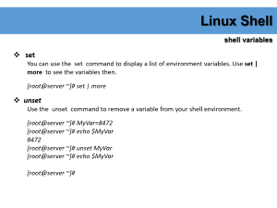
Linux Shell
shell variables
set
You can use the set command to display a list of environment variables. Use set | more to see the variables then.
[root@server ~]# set | more
unset
Use the unset command to remove a variable from your shell environment.
[root@server ~]# MyVar=8472
[root@server ~]# echo $MyVar
8472
[root@server ~]# unset MyVar
[root@server ~]# echo $MyVar
[root@server ~]#

Slide 130
Linux Shell
shell variables
$PATH
The $PATH variable is determines where the shell is looking for commands to execute (unless the command is builtin or aliased). This variable contains a list of directories, separated by colons.
[root@server ~]# echo $PATH
/usr/local/sbin:/usr/local/bin:/usr/sbin:/usr/bin:/root/bin
env
The env command without options will display a list of exported variables . The difference with set with options is that set lists all variables, including those not exported to child shells.
The env -i command clears the environment for the subshell.
[root@server ~]# bash -c 'echo $SHELL $HOME $USER'
/bin/bash /root root
[root@server ~]# env -i bash -c 'echo $SHELL $HOME $USER'
/bin/bash

Slide 131
Linux Shell
shell variables
export
You can export shell variables to other shells with the export command. This will export the variable to child shells.
[root@server ~]# var3=three
[root@server ~]# var4=four
[root@server ~]# echo $var3 $var4
three four
[root@server ~]# export var4
[root@server ~]# bash -c 'echo $var3 $var4'
four
[root@server ~]#
But it will not export to the parent shell (previous screenshot continued).

Slide 132
Linux Shell
shell variables
delineate variables
Until now, we have seen that bash interprets a variable starting from a dollar sign, continuing until the first occurrence of a non-alphanumeric character that is not an underscore. In some situations, this can be a problem. This issue can be resolved with curly braces like in this example.
[root@server ~]# prefix=Super
[root@server ~]# echo Hello $prefixman and $prefixgirl
Hello and
[root@server ~]# echo Hello ${prefix}man and ${prefix}girl
Hello Superman and Supergirl
[root@server ~]#

Slide 133
Linux Shell
shell history
repeating the last command
To repeat the last command in bash, type !! . This is pronounced as bang bang .
[root@server ~]# echo this will be repeated > file42.txt
[root@server ~]# !!
echo this will be repeated > file42.txt
[root@server ~]#
repeating other commands
You can repeat other commands using one bang followed by one or more characters. The shell will repeat the last command that started with those characters.
[root@server ~]# touch file42
[root@server ~]# cat file42
[root@server ~]# !to
touch file42
[root@server ~]#

Slide 134
Linux Shell
shell history
history
To see older commands, use history to display the shell command history (or use history n to see the last n commands).
[root@server ~]# history 5
1079 cat file42
1080 touch file42
1081 history 5
1082 history 10
1083 history 5
!n
When typing ! followed by the number preceding the command you want repeated, then the shell will echo the command and execute it.
[root@server ~]# !1079
cat file42

Slide 135
Linux Shell
shell history
Ctrl-r
Another option is to use ctrl-r to search in the history. In the screenshot below i only typed ctrl-r followed by four characters echo this and it finds the last command containing these four consecutive characters.
[root@server ~]#
(reverse-i-search)`echo this': echo this will be repeated > file42.txt
$HISTSIZE
The $HISTSIZE variable determines the number of commands that will be remembered in your current environment. Most distributions default this variable to 500 or 1000.
[root@server ~]# echo $HISTSIZE
1000
[root@server ~]#

Slide 136
Linux Shell
shell history
$HISTFILE
The $HISTFILE variable points to the file that contains your history. The bash shell defaults this value to ~/.bash_history.
[root@server ~]# echo $HISTFILE
/root/.bash_history
[root@server ~]#
$HISTFILESIZE
The number of commands kept in your history file can be set using $HISTFILESIZE.
[root@server ~]# echo $HISTFILESIZE
1000
[root@server ~]#

Slide 137
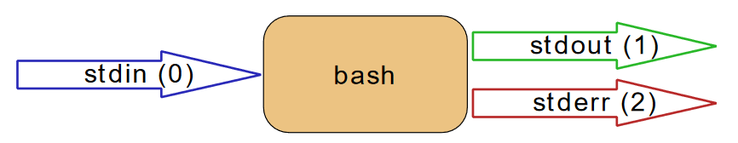
pipes and commands
I/O redirection
stdin, stdout, and stderr
The bash shell has three basic streams; it takes input from stdin (stream 0 ), it sends output to stdout (stream 1 ) and it sends error messages to stderr (stream 2 ) .
The drawing below has a graphical interpretation of these three streams.

Slide 138

pipes and commands
output redirection
> stdout
stdout can be redirected with a greater than sign. While scanning the line, the shell will see the > sign and will clear the file.
The > notation is in fact the abbreviation of 1> ( stdout being referred to as stream 1 ).
[root@server ~]# echo It is hot today!
It is hot today!
[root@server ~]# echo It is hot today! > hot.txt
[root@server ~]# cat hot.txt
It is hot today!
[root@server ~]#

Slide 139

pipes and commands
error redirection
2> stderr
Redirecting stderr is done with 2> . This can be very useful to prevent error messages from cluttering your screen.
The screenshot below shows redirection of stdout to a file, and stderr to /dev/null . Writing 1> is the same as >.
[root@server ~]# find /etc > etcfiles.txt 2> /dev/null
[root@server ~]#

Slide 140
pipes and commands
error redirection
2>&1
To redirect both stdout and stderr to the same file, use 2>&1 .
[root@server ~]# find /etc > etcfiles_and_errors.txt 2>&1
[root@server ~]#
joining stdout and stderr
The &> construction will put both stdout and stderr in one stream (to a file).
[root@server ~]# rm file42 &> out_and_err
[root@server ~]# cat out_and_err
rm: cannot remove ‘file42’: No such file or directory
[root@server ~]# echo file42 &> out_and_err
[root@server ~]# cat out_and_err
file42

Slide 141
pipes and commands
input redirection
< stdin
Redirecting stdin is done with < (short for 0<).
[root@server ~]# cat < winter.txt
It is cold today!
Where is the summer ?
[root@server ~]# grep summer < winter.txt
Where is the summer ?

Slide 142
pipes and commands
input redirection
<< here document
The here document (sometimes called here-is-document) is a way to append input until a certain sequence (usually EOF) is encountered. The EOF marker can be typed literally or can be called with Ctrl-D.
[root@server ~]# cat <<EOF > text.txt
> one
> two
> EOF
[root@server ~]# cat text.txt
one
two
[root@server ~]# cat <<brol > text.txt
> brel
> brol
[root@server ~]# cat text.txt
brel
[root@server ~]#

Slide 143
pipes and commands
filters
grep
The grep filter is famous among Unix users. The most common use of grep is to filter lines of text containing (or not containing) a certain string.
[root@server ~]# cat tennis.txt
Amelie Mauresmo, Fra
Kim Clijsters, BEL
Justine Henin, Bel
Serena Williams, usa
Venus Williams, USA
[root@server ~]# cat tennis.txt | grep William
Serena Williams, usa
Venus Williams, USA
You can write this without the cat.
[root@server ~]# grep William tennis.txt
Serena Williams, usa
Venus Williams, USA

Slide 144
pipes and commands
filters
grep
One of the most useful options of grep is grep -i which filters in a case insensitive way.
[root@server ~]# grep Bel tennis.txt
Justine Henin, Bel
[root@server ~]# grep -i Bel tennis.txt
Kim Clijsters, BEL
Justine Henin, Bel
[root@server ~]#

Slide 145
pipes and commands
filters
cut
The cut filter can select columns from files, depending on a delimiter or a count of bytes. The below uses cut to filter for the username and userid in the /etc/passwd file. It uses the colon as a delimiter, and selects fields 1 and 3.
[root@server ~]# grep Bel tennis.txt
Justine Henin, Bel
[root@server ~]# grep -i Bel tennis.txt
Kim Clijsters, BEL
Justine Henin, Bel
[root@server ~]#
When using a space as the delimiter for cut , you have to quote the space.
[root@server ~]# cut -d" " -f1 tennis.txt
…
Serena
Venus
[root@server ~]#

Slide 146
pipes and commands
filters
wc
Counting words, lines and characters is easy with wc .
[root@server ~]# wc tennis.txt
5 15 100 tennis.txt
[root@server ~]# wc -l tennis.txt
5 tennis.txt
[root@server ~]# wc -w tennis.txt
15 tennis.txt
[root@server ~]# wc -c tennis.txt
100 tennis.txt
[root@server ~]#

Slide 147
pipes and commands
filters
sed
The stream ed itor sed can perform editing functions in the stream, using regular expressions .
[root@server ~]# echo level5 | sed 's/5/42/'
level42
[root@server ~]#
Add g for global replacements (all occurrences of the string per line).
[root@server ~]# echo level5 level7 | sed 's/level/jump/'
jump5 level7
[root@server ~]# echo level5 level7 | sed 's/level/jump/g'
jump5 jump7
[root@server ~]#

Slide 148
pipes and commands
filters
sed
With d you can remove lines from a stream containing a character.
[root@server ~]# cat tennis.txt
Venus Williams, USA
Martina Hingis, SUI
Justine Henin, BE
Serena williams, USA
Kim Clijsters, BE
Yanina Wickmayer, BE
[root@server ~]# cat tennis.txt | sed '/BE/d'
Venus Williams, USA
Martina Hingis, SUI
Serena williams, USA
[root@server ~]#

Slide 149
pipes and commands
filters
pipe examples
who | wc
How many users are in this system ?
[root@server ~]# cat /etc/passwd | wc -l
21
[root@server ~]#
grep | cut
Display a list of all bash user accounts on this computer.
[root@server ~]# grep bash /etc/passwd
root:x:0:0:root:/root:/bin/bash
[root@server ~]# grep bash /etc/passwd | cut -d: -f1
root
[root@server ~]#

Slide 150
Basic Unix Tools
find
The find command can be very useful at the start of a pipe to search for files. Here are some examples.
[root@server ~]# find /etc/ > etcfiles.txt
[root@server ~]#
Find files that end in .conf in the /etc (and all subdirs).
[root@server ~]# find /etc -name "*.conf" > fileconfs.txt
[root@server ~]#
Find files of type file (not directory, pipe or etc.) that end in .conf.
[root@server ~]# find /etc -type f -name "*.conf" > fileconfs.txt
[root@server ~]#

Slide 151
Basic Unix Tools
find
Find files of type directory that end in .d.
[root@server ~]# find /etc -type d -name "*.d"
/etc/yum.repos.d
/etc/yum/pluginconf.d
/etc/yum/fssnap.d
/etc/yum/protected.d
…
Find can also execute another command on every file found.
[root@server ~]# find /etc -name "*.d" -exec ls -ld {} \;
drwxr-xr-x. 2 root root 187 Oct 31 00:35 /etc/yum.repos.d
drwxr-xr-x. 2 root root 54 Oct 26 11:24 /etc/yum/pluginconf.d
…

Slide 152
Basic Unix Tools
find
Find files of type directory that end in .d.
[root@server ~]# find /etc -type d -name "*.d"
/etc/yum.repos.d
/etc/yum/pluginconf.d
/etc/yum/fssnap.d
/etc/yum/protected.d
…
Find can also execute another command on every file found.
[root@server ~]# find /etc -name "*.d" -exec ls -ld {} \;
drwxr-xr-x. 2 root root 187 Oct 31 00:35 /etc/yum.repos.d
drwxr-xr-x. 2 root root 54 Oct 26 11:24 /etc/yum/pluginconf.d
…

Slide 153
Basic Unix Tools
locate
The locate tool is very different from find in that it uses an index to locate files. If the index does not exist yet, then you have to create it (as root on Red Hat Enterprise Linux) with the updatedb command.
First, install mlocate package and updatedb.
[root@server ~]# yum install mlocate
[root@server ~]# updatedb
[root@server ~]#
For example, locate files that end in .conf.
[root@server ~]# locate *.conf
/etc/GeoIP.conf
/etc/asound.conf
/etc/chrony.conf
…

Slide 154
Basic Unix Tools
File Compression and Archiving
Compressing Files at the Shell Prompt
Red Hat Enterprise Linux provides the bzip2, gzip, and zip tools for compression from a shell prompt.
The bzip2 compression tool is recommended because it provides the most compression and is found on most UNIX-like operating systems.
The gzip compression tool can also be found on most UNIX-like operating systems.
To transfer files between Linux and other operating system such as MS Windows, use zip because it is more compatible with the compression utilities available for Windows.

Slide 155
Basic Unix Tools
File Compression and Archiving
Bzip2 and Bunzip2
To use bzip2 to compress a file, enter the following command at a shell prompt:
bzip2 filename
The file is compressed and saved as filename.bz2.
To expand the compressed file, enter the following command:
bunzip2 filename.bz2
You can use bzip2 to compress multiple files and directories at the same time by listing them with a space between each one:
bzip2 filename.bz2 file1 file2 file3 /usr/work/school

Slide 156
Basic Unix Tools
File Compression and Archiving
Gzip and Gunzip
To use gzip to compress a file, enter the following command at a shell prompt:
gzip filename
The file is compressed and saved as filename.gz.
To expand the compressed file, enter the following command:
gunzip filename.gz
You can use gzip to compress multiple files and directories at the same time by listing them with a space between each one:
gzip -r filename.gz file1 file2 file3 /usr/work/school

Slide 157
Basic Unix Tools
File Compression and Archiving
Zip and Unzip
To compress a file with zip, enter the following command:
zip -r filename.zip filesdir
The -r option specifies that you want to include all files contained in the filesdir directory recursively.
To extract the contents of a zip file, enter the following command:
unzip filename.zip
You can use zip to compress multiple files and directories at the same time by listing them with a space between each one:
zip -r filename.zip file1 file2 file3 /usr/work/school

Slide 158
Basic Unix Tools
File Compression and Archiving
Archiving Files at the Shell Prompt
A tar file is a collection of several files and/or directories in one file. This is a good way to create backups and archives.
To create a tar file, enter:
tar -cvf filename.tar directory/file
You can tar multiple files and directories at the same time by listing them with a space between each one:
tar -cvf filename.tar /home/mine/work /home/mine/school

Slide 159
Basic Unix Tools
File Compression and Archiving
Archiving Files at the Shell Prompt
To list the contents of a tar file, enter:
tar -tvf filename.tar
To extract the contents of a tar file, enter:
tar -xvf filename.tar

Slide 160
Basic Unix Tools
File Compression and Archiving
Archiving Files at the Shell Prompt
To create a tarred and bzipped compressed file, use the -j option:
tar -cjvf filename.tbz file or tar -cjvf filename.tar.bz2 file
To list the contents of a filename.tbz file, enter:
tar –tjvf filename.tbz
You can also expand and unarchive a bzip tar file in one command:
tar -xjvf filename.tbz

Slide 161
Basic Unix Tools
File Compression and Archiving
Archiving Files at the Shell Prompt
To create a tarred and gzipped compressed file, use the -z option:
tar -czvf filename.tgz file or tar -czvf filename.tar.gz file
To list the contents of a filename.tgz file, enter:
tar –tzvf filename.tgz
You can also expand and unarchive a gzip tar file in one command:
tar -xzvf filename.tgz

Slide 162
Local User Management

Slide 163
Local User Management
User Management
/etc/passwd
The local user database on Linux (and on most Unixes) is /etc/passwd .
[root@server ~]# tail /etc/passwd
ftp:x:14:50:FTP User:/var/ftp:/sbin/nologin
nobody:x:99:99:Nobody:/:/sbin/nologin
systemd-network:x:192:192:systemd Network Management:/:/sbin/nologin
dbus:x:81:81:System message bus:/:/sbin/nologin
polkitd:x:999:997:User for polkitd:/:/sbin/nologin
postfix:x:89:89::/var/spool/postfix:/sbin/nologin
chrony:x:998:996::/var/lib/chrony:/sbin/nologin
sshd:x:74:74:Privilege-separated SSH:/var/empty/sshd:/sbin/nologin
apache:x:48:48:Apache:/usr/share/httpd:/sbin/nologin
saslauth:x:997:76:Saslauthd user:/run/saslauthd:/sbin/nologin
[root@server ~]#

Slide 164
Local User Management
User Management
root
The root user also called the superuser is the most powerful account on your Linux system. This user can do almost anything, including the creation of other users. The root user always has userid 0 (regardless of the name of the account).
[root@server ~]# head -1 /etc/passwd
root:x:0:0:root:/root:/bin/bash
[root@server ~]#

Slide 165
Local User Management
User Management
useradd
You can add users with the useradd command. The example below shows how to add a user.
[root@server ~]# useradd paitoon
[root@server ~]# tail -1 /etc/passwd
paitoon:x:1000:1000::/home/paitoon:/bin/bash
[root@server ~]#
The user named paitoon received userid 1000 and primary group id 1000.
userdel
You can delete the user yanina with userdel . The -r option of userdel will also remove the home directory.
[root@server ~]# userdel -r paitoon
[root@server ~]#

Slide 166
Local User Management
User Management
usermod
You can modify the properties of a user with the usermod command. This example uses usermod to change the description of the user.
[root@server ~]# usermod -c 'paitoon butri' paitoon
[root@server ~]# tail -1 /etc/passwd
paitoon:x:1000:1000:paitoon butri:/home/paitoon:/bin/bash
[root@server ~]#

Slide 167
Local User Management
User Password
userpasswd
Passwords of users can be set with the passwd command. Users will have to provide their old password before twice entering the new one.
Changing password for user root.
New password:
BAD PASSWORD: The password fails the dictionary check - it is based on a dictionary word
Retype new password:
passwd: all authentication tokens updated successfully.
[root@server ~]#
You can change password of other users. For example.
[root@server ~]# passwd paitoon
Changing password for user paitoon.
New password:
[root@server ~]#

Slide 168
Local User Management
User Password
shadow file
User passwords are encrypted and kept in /etc/shadow . The /etc/shadow file is read only and can only be read by root.
[root@server ~]# tail -1 /etc/shadow
paitoon:$6$le/1Xsiw$Pq7z/son80jWRX75Pfw1bC1dWgyoBlctwAYsuvfXXBV6WW6HfxiLMor.6kJs9E2KTORTBBGWdpzbj7TGJoMQS1:17472:0:99999:7:::
[root@server ~]#
/etc/login.defs
The /etc/login.defs file contains some default settings for user passwords like password aging and length settings. (You will also find the numerical limits of user ids and group ids and whether or not a home directory should be created by default).
[root@server ~]# grep -E 'UID_MIN|CREATE_HOME|ENCRYPT_METHOD' /etc/login.defs
UID_MIN 1000
CREATE_HOME yes
ENCRYPT_METHOD SHA512

Slide 169
Local User Management
User Password
chage
The chage command can be used to set an expiration date for a user account (-E), set a minimum (-m) and maximum (-M) password age, a password expiration date, and set the number of warning days before the password expiration date. Much of this functionality is also available from the passwd command. The -l option of chage will list these settings for a user.
[root@server ~]# chage -l root
Last password change : Nov 02, 2017
Password expires : never
Password inactive : never
Account expires : never
Minimum number of days between password change : 0
Maximum number of days between password change : 99999
Number of days of warning before password expires : 7
[root@server ~]#

Slide 170
Local User Management
User Password
disabling a password
Passwords in /etc/shadow cannot begin with an exclamation mark (!). When the second field in /etc/passwd starts with an exclamation mark, then the password can not be used.
Using this feature is often called locking , disabling , or suspending a user account. Besides vi (or vipw) you can also accomplish this with usermod .
[root@server ~]# grep paitoon /etc/shadow | cut -c1-70
paitoon:$6$le/1Xsiw$Pq7z/son80jWRX75Pfw1bC1dWgyoBlctwAYsuvfXXBV6WW6Hfx
[root@server ~]# usermod -L paitoon
[root@server ~]# grep paitoon /etc/shadow | cut -c1-70
paitoon:!$6$le/1Xsiw$Pq7z/son80jWRX75Pfw1bC1dWgyoBlctwAYsuvfXXBV6WW6Hf
[root@server ~]#
You can unlock the account again with usermod -U .
[root@server ~]# usermod -U paitoon
[root@server ~]# grep paitoon /etc/shadow | cut -c1-70
paitoon:$6$le/1Xsiw$Pq7z/son80jWRX75Pfw1bC1dWgyoBlctwAYsuvfXXBV6WW6Hfx
[root@server ~]#

Slide 171
Local User Management
User Profile
Logged on users have a number of preset (and customized) aliases, variables, and functions, but where do they come from ? The shell uses a number of startup files that are executed (or rather sourced ) whenever the shell is invoked.
system profile
Both the bash and the ksh shell will verify the existence of /etc/profile and source it if it exists.
[root@server ~]# grep PATH /etc/profile
case ":${PATH}:" in
PATH=$PATH:$1
PATH=$1:$PATH
export PATH USER LOGNAME MAIL HOSTNAME HISTSIZE HISTCONTROL
The root user can use this script to set aliases, functions, and variables for every user on the system.

Slide 172
Local User Management
User Profile
~/.bash_profile
When this file exists in the home directory, then bash will source it. RHEL7/CentOS7 uses a small ~/.bash_profile where it checks for the existence of ~/.bashrc and then sources it. It also adds $HOME/bin to the $PATH variable.
[root@server ~]# cat /home/paitoon/.bash_profile
# .bash_profile
# Get the aliases and functions
if [ -f ~/.bashrc ]; then
. ~/.bashrc
fi
# User specific environment and startup programs
PATH=$PATH:$HOME/.local/bin:$HOME/bin
export PATH

Slide 173
Local User Management
Group
groupadd
Groups can be created with the groupadd command. The example below shows the creation of five (empty) groups.
[root@server ~]# groupadd tennis
[root@server ~]# groupadd football
[root@server ~]# groupadd snooker
[root@server ~]# groupadd formula1
group file
Users can be a member of several groups. Group membership is defined by the /etc/group file.
[root@server ~]# tail -4 /etc/group
tennis:x:1001:
football:x:1002:
snooker:x:1003:
formula1:x:1004:

Slide 174
Local User Management
Group
groups
A user can type the groups command to see a list of groups where the user belongs to.
[root@server ~]# groups
root
[root@server ~]#
usermod
Group membership can be modified with the useradd or usermod command.
[root@server ~]# usermod -a -G tennis paitoon
[root@server ~]# usermod -a -G snooker paitoon
[root@server ~]# tail -4 /etc/group
tennis:x:1001:paitoon
football:x:1002:
snooker:x:1003:paitoon
formula1:x:1004:

Slide 175
Local User Management
Group
groupmod
You can change the group name with the groupmod command.
[root@server ~]# groupmod -n badminton tennis
[root@server ~]# tail -4 /etc/group
football:x:1002:
snooker:x:1003:paitoon
formula1:x:1004:
badminton:x:1001:paitoon
[root@server ~]#
groupdel
You can permanently remove a group with the groupdel command.
[root@server ~]# tail -4 /etc/group
paitoon:x:1000:
football:x:1002:
snooker:x:1003:paitoon
formula1:x:1004:

Slide 176
File Security

Slide 177
File Security
standard file permissions
file ownership
user owner and group owner
The users and groups of a system can be locally managed in /etc/passwd and /etc/group , or they can be in a NIS, LDAP, or Samba domain.
[root@server ~]# ls -lh
total 264K
-rw-r--r--. 1 root root 14 Oct 27 01:58 all
-rw-------. 1 root root 1.3K Oct 26 11:24 anaconda-ks.cfg
-rw-------. 1 root root 1.3K Oct 27 00:53 anaconda-ks.cfg.2
drwxr-xr-x. 3 root root 43 Oct 27 00:56 dir1
drwxr-xr-x. 3 root root 43 Oct 27 00:59 dir11
drwxr-xr-x. 3 root root 43 Oct 27 00:59 dir13

Slide 178
File Security
standard file permissions
file ownership
listing user accounts
You can use the following command to list all local user accounts.
[root@server ~]# cut -d: -f1 /etc/passwd | column
root sync games polkitd saslauth
bin shutdown ftp postfix paitoon
daemon halt nobody chrony
adm mail systemd-network sshd
lp operator dbus apache
chgrp
You can change the group owner of a file using the chgrp command.
[root@server ~]# chgrp football winter.txt
[root@server ~]# ls -l winter.txt
-rw-r--r--. 1 root football 40 Nov 2 03:13 winter.txt
[root@server ~]#

Slide 179
File Security
standard file permissions
file ownership
chown
The user owner of a file can be changed with chown command.
[root@server ~]# ls -l winter.txt
-rw-r--r--. 1 paitoon football 40 Nov 2 03:13 winter.txt
[root@server ~]#
You can also use chown to change both the user owner and the group owner.
[root@server ~]# chown paitoon:snooker text.txt
[root@server ~]# ls -l text.txt
-rw-r--r--. 1 paitoon snooker 8 Nov 2 04:26 text.txt
[root@server ~]#

Slide 180
File Security
standard file permissions
list of special files
When you use ls -l , for each file you can see ten characters before the user and group owner. The first character tells us the type of file.
First Character | File Type
- | Normal file
d | Directory
l | Symbolic link
p | Named pipe
b | Block device
c | Character device
s | Socket

Slide 181
File Security
standard file permissions
list of special files
Below is a character device (the console) and a block device (the hard disk).
[root@server ~]# ls -l /dev/console /dev/sda
crw-------. 1 root root 5, 1 Nov 1 05:35 /dev/console
brw-rw----. 1 root disk 8, 0 Nov 1 05:35 /dev/sda
[root@server ~]#
And here you can see a directory, a regular file and a symbolic link.
[root@server ~]# ls -ld /etc /etc/hosts /usr/bin/view
drwxr-xr-x. 75 root root 8192 Nov 2 09:06 /etc
-rw-r--r--. 1 root root 158 Jun 7 2013 /etc/hosts
lrwxrwxrwx. 1 root root 2 Oct 26 11:21 /usr/bin/view -> vi
[root@server ~]#

Slide 182
File Security
standard file permissions
permissions
rwx
The nine characters following the file type denote the permissions in three triplets. A permission can be r for read access, w for write access, and x for execute. You need the r permission to list (ls) the contents of a directory. You need the x permission to enter (cd) a directory. You need the w permission to create files in or remove files from a directory.
permission | on a file | on a directory
r (read) | read file contents (cat) | read directory contents (ls)
w (write) | change file contents (vi) | create file in (touch)
x (execute) | execute the file | enter the directory (cd)

Slide 183
File Security
standard file permissions
permissions
three sets of rwx
We already know that the output of ls -l starts with ten characters for each file. This screenshot shows a regular file (because the first character is a - ).
[root@server ~]# ls -l winter.txt
-rw-r--r--. 1 paitoon football 40 Nov 2 03:13 winter.txt
Position | Character | Function
1 | - | This is regular file
2-4 | rw- | Permission for the user owner
5-7 | r-- | Permission for the group owner
8-10 | r-- | Permission for others

Slide 184
File Security
standard file permissions
permissions
setting permissions (chmod)
Permissions can be changed with chmod . The first example gives the user owner execute permissions.
[root@server ~]# touch backup.sh
[root@server ~]# ls -l backup.sh
-rw-r--r--. 1 root root 0 Nov 2 10:48 backup.sh
[root@server ~]# chmod u+x backup.sh
[root@server ~]# ls -l backup.sh
-rwxr--r--. 1 root root 0 Nov 2 10:48 backup.sh
[root@server ~]#
This example removes the group owners read permission.
[root@server ~]# chmod g-r backup.sh
[root@server ~]# ls -l backup.sh
-rwx---r--. 1 root root 0 Nov 2 10:48 backup.sh
[root@server ~]#

Slide 185
File Security
standard file permissions
permissions
setting permissions (chmod)
You can also set explicit permissions.
[root@server ~]# chmod g=rw backup.sh
[root@server ~]# ls -l backup.sh
-rwxrw-r--. 1 root root 0 Nov 2 10:48 backup.sh
[root@server ~]#
Feel free to make any kind of combination.
[root@server ~]# chmod u=rx,g=r,o=r backup.sh
[root@server ~]# ls -l backup.sh
-r-xr--r--. 1 root root 0 Nov 2 10:48 backup.sh
[root@server ~]#

Slide 186
File Security
File links
inode
inode contents
An inode is a data structure that contains metadata about a file. When the file system stores a new file on the hard disk, it stores not only the contents (data) of the file, but also extra properties like the name of the file, the creation date, its permissions, the owner of the file, and more. All this information (except the name of the file and the contents of the file) is stored in the inode of the file.
The ls -l command will display some of the inode contents.
[root@server ~]# ls -l backup.sh
-r-xr--r--. 1 root root 0 Nov 2 10:48 backup.sh
[root@server ~]#

Slide 187
File Security
File links
inode
inode number
Each inode has a unique number (the inode number). You can see the inode numbers with the ls -li command.
[root@server test]# ls
[root@server test]# touch file1
[root@server test]# touch file2
[root@server test]# touch file3
[root@server test]# ls -li
total 0
12919149 -rw-r--r--. 1 root root 0 Nov 2 11:10 file1
13097597 -rw-r--r--. 1 root root 0 Nov 2 11:10 file2
13097598 -rw-r--r--. 1 root root 0 Nov 2 11:10 file3
[root@server test]#

Slide 188
File Security
File links
hard links
creating hard links
When we create a hard link to a file with ln , an extra entry is added in the directory. A new file name is mapped to an existing inode.
[root@server test]# ln file2 hardlink_to_file2
[root@server test]# ls -li
total 0
12919149 -rw-r--r--. 1 root root 0 Nov 2 11:10 file1
13097597 -rw-r--r--. 2 root root 0 Nov 2 11:10 file2
13097598 -rw-r--r--. 1 root root 0 Nov 2 11:10 file3
13097597 -rw-r--r--. 2 root root 0 Nov 2 11:10 hardlink_to_file2
[root@server test]#
Both files have the same inode, so they will always have the same permissions and the same owner. Both files will have the same content. Actually, both files are equal now, meaning you can safely remove the original file, the hardlinked file will remain.

Slide 189
File Security
File links
symbolic links
Symbolic links (sometimes called soft links ) do not link to inodes, but create a name to name mapping. Symbolic links are created with ln -s . As you can see below, the symbolic link gets an inode of its own.
[root@server test]# ln -s file1 symlink_to_file1
[root@server test]# ls -li
total 0
12919149 -rw-r--r--. 1 root root 0 Nov 2 11:10 file1
13097597 -rw-r--r--. 2 root root 0 Nov 2 11:10 file2
13097598 -rw-r--r--. 1 root root 0 Nov 2 11:10 file3
13097597 -rw-r--r--. 2 root root 0 Nov 2 11:10 hardlink_to_file2
13097599 lrwxrwxrwx. 1 root root 5 Nov 2 11:18 symlink_to_file1 -> file1
Permissions on a symbolic link have no meaning, since the permissions of the target apply. Hard links are limited to their own partition (because they point to an inode), symbolic links can link anywhere (other file systems, even networked).

Slide 190
File Security
File links
removing links
Links can be removed with rm.
[root@server test]# rm -f symlink_to_file1
[root@server test]# ls -l
total 0
-rw-r--r--. 1 root root 0 Nov 2 11:10 file1
-rw-r--r--. 2 root root 0 Nov 2 11:10 file2
-rw-r--r--. 1 root root 0 Nov 2 11:10 file3
-rw-r--r--. 2 root root 0 Nov 2 11:10 hardlink_to_file2

Slide 191
Vi Editor

Slide 192
Vi Editor
Introduction to vi
The vi editor is installed on almost every Unix. Linux will very often install vim ( vi improved ) which is similar. Every system administrator should know vi(m) , because it is an easy tool to solve problems.
command mode and insert mode
The vi editor starts in command mode . In command mode, you can type commands. Some commands will bring you into insert mode . In insert mode, you can type text. The escape key will return you to command mode.

Slide 193
Vi Editor
Introduction to vi
start typing (a A i I o O)
Command | Action
a | start typing after the current character
A | start typing at the end of the current line
i | start typing before the current character
I | start typing at the start of the current line
o | start typing on a new line after the current line
O | start typing on a new line before the current line

Slide 194
Vi Editor
Introduction to vi
replace and delete a character (r x X)
Command | Action
x | delete the character below the cursor
X | delete the character before the cursor
r | replace the character below the cursor
p | paste after the cursor (here the last deleted character)
xp | switch two characters

Slide 195
Vi Editor
Introduction to vi
undo and repeat (u .)
cut, copy and paste a line (dd yy p P)
Command | Action
u | undo the last action
. | repeat the last action
Command | Action
dd | cut the current line
yy | (yank yank) copy the current line
p | paste after the current line
P | paste before the current line

Slide 196
Vi Editor
Introduction to vi
cut, copy and paste lines (3dd 2yy)
start and end of a line (0 or ^ and $)
Command | Action
3dd | cut three lines
4yy | copy four lines
Command | Action
0 | jump to start of current line
^ | jump to start of current line
$ | jump to end of current line
d0 | delete until start of line
d$ | delete until end of line

Slide 197
Vi Editor
Introduction to vi
join two lines (J) and more
words (w b)
Command | Action
J | join two lines
yyp | duplicate a line
ddp | switch two lines
Command | Action
w | forward one word
b | back one word
3w | forward three words
dw | delete one word
yw | yank (copy) one word
5yb | yank five words back
7dw | delete seven words

Slide 198
Vi Editor
Introduction to vi
save (or not) and exit (:w :q :q! )
Command | Action
:w | save (write)
:w fname | save as fname
:q | quit
:wq | save and quit
:q! | quit (discarding your changes)
:w! | save (and write to non-writable file!)

Slide 199
Vi Editor
Introduction to vi
Searching (/ ?)
replace all ( :1,$ s/foo/bar/g )
Command | Action
/string | forward search for string
?string | backward search for string
n | go to next occurrence of search string
N | go back to occurrence of search string
Command | Action
:4,8 s/foo/bar/g | replace foo with bar on lines 4 to 8
:1,$ s/foo/bar/g | replace foo with bar on all lines

Slide 200
Vi Editor
Introduction to vi
reading files (:r :r !cmd)
set numer, goto (:n)
Command | Action
:r fname | (read) file fname and paste contents
:r !cmd | execute cmd and paste its output
Command | Action
:set number | show number at the binning of line
:set number! | replace foo with bar on all lines
:num | goto num line.

Slide 201
Package Management Tools
Yum, RPM

Slide 202
Yum
Yum is the Red Hat package manager that is able to query for information about available packages, fetch packages from repositories, install and uninstall them, and update an entire system to the latest available version.
Yum performs automatic dependency resolution on packages you are updating, installing, or removing, and thus is able to automatically determine, fetch, and install all available dependent packages.

Slide 203
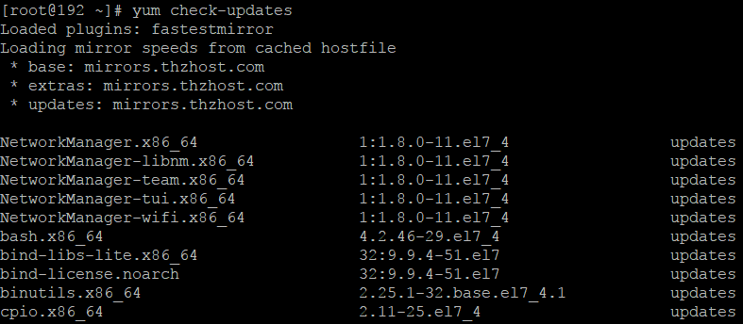
Yum
Checking for Update
To see which installed packages on your system have updates available, use the following command:
yum check-updates

Slide 204
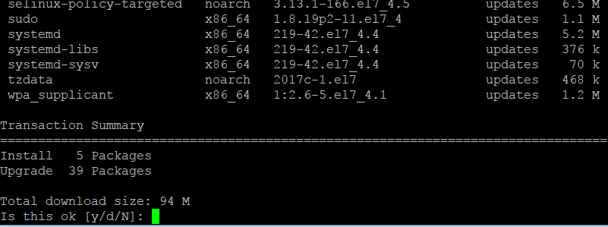
Yum
Updating Packages
To update all packages and their dependencies, enter yum update (without any arguments):

Slide 205
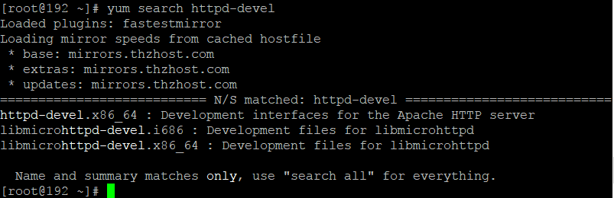
Yum
Searching Packages
You can search all RPM package names, descriptions and summaries by using the following command:
yum search term…

Slide 206
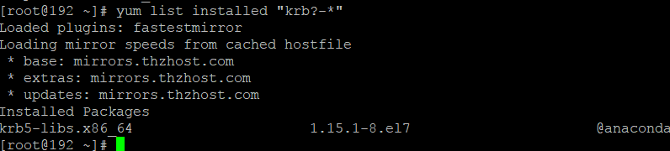
Yum
Packages and Package Groups
Listing Packages
yum list and related commands provide information about packages, package groups, and repositories.
yum list glob_expression…
yum list all
Lists all installed and available packages.
yum list installed
Lists all packages installed on your system.

Slide 207
Yum
Installing Packages
Installing individual packages
To install a single package and all of its non-installed dependencies, enter a command in the following form:
yum install package_name
Example:
[root@localhost ~]# yum install net-tools
…
Total download size: 305 k
Installed size: 917 k
Is this ok [y/d/N]: y (พิมพ์ y แล้ว Enter)

Slide 208
Yum
Installing Packages
Installing multiple packages
To install a single package and all of its non-installed dependencies, enter a command in the following form:
yum install package_name package_name ...
Example:
[root@localhost ~]# yum install httpd httpd-devel
…
Total download size: 16 M
Installed size: 53 M
Is this ok [y/d/N]: y (พิมพ์ y แล้ว Enter)

Slide 209
Yum
Removing Packages
Removing Individual Packages
To uninstall a particular package, as well as any packages that depend on it, run the following command as root:
yum remove package_name…
For Example:
[root@localhost ~]# yum remove httpd
...
Remove 1 Package (+1 Dependent package)
Installed size: 10 M
Is this ok [y/N]:

Slide 210
RPM
What is RPM?
The RPM Package Manager ( RPM ) is an open packaging system that runs on Red Hat Enterprise Linux as well as other Linux and UNIX systems.
There are several applications, such as Yum or PackageKit , that can make working with packages in the RPM format even easier.

Slide 211
RPM
Using RPM
Installing and Upgrading Packages
The rpm -U package.rpm command is therefore able to either upgrade or install , depending on the presence of an older version of package.rpm on the system.
[root@localhost ~]# rpm -Uvh tree-1.6.0-10.el7.x86_64.rpm
Replacing Already Installed Packages
If a package of the same name and version is already installed, the following output is displayed:
Preparing... ###########################################
[100%]
package tree-1.6.0-10.el7.x86_64 is already installed
To install the package anyway, use the --replacepkgs option, which tells RPM to ignore the error:
[root@localhost ~]# rpm -Uvh --replacepkgs tree-1.6.0-10.el7.x86_64.rpm

Slide 212
RPM
Using RPM
Replacing Already Installed Packages
If a package of the same name and version is already installed, the following output is displayed:
Preparing... ###########################################
[100%]
package tree-1.6.0-10.el7.x86_64 is already installed
To install the package anyway, use the --replacepkgs option, which tells RPM to ignore the error:
[root@localhost ~]# rpm -Uvh --replacepkgs tree-1.6.0-10.el7.x86_64.rpm

Slide 213
RPM
Using RPM
Resolving File Conflicts
If you attempt to install a package that contains a file that has already been installed by another package, a conflict message is displayed. To make RPM ignore this error, use the --replacefiles option:
rpm -Uvh --replacefiles package.rpm

Slide 214
RPM
Using RPM
Satisfying Unresolved Dependencies
RPM packages sometimes depend on other packages, which means that they require other packages to be installed to run properly. If you try to install a package that has an unresolved dependency, a message about a failed dependency is displayed.
To determine which package contains the required file, use the --whatprovides option:
rpm -q --whatprovides " required_file “
Example:
[root@localhost ~]# rpm -q --whatprovides /etc/passwd
setup-2.8.71-7.el7.noarch

Slide 215
RPM
Using RPM
Querying Packages
The RPM database stores information about all RPM packages installed on the system. It is stored in the /var/lib/rpm/ directory. To query this database, use the rpm command with the -q (or --query ) option:
rpm -q package_name
For example:
[root@localhost ~]# rpm -q httpd
httpd-2.4.6-67.el7.centos.6.x86_64

Slide 216
RPM
Using RPM
Querying Packages
To find information about a (non-installed) package file, use the following command:
rpm –qip package.rpm
To list files contained in a package, use:
rpm -qlp package.rpm
For installed package using,
rpm –qi package_name and
rpm –ql package_name

Slide 217
RPM
Using RPM
Querying Packages
To determine which package owns a file, enter:
rpm -qf file
For example:
[root@localhost ~]# which ls
alias ls='ls --color=auto'
/usr/bin/ls
[root@localhost ~]# rpm -qf /usr/bin/ls
coreutils-8.22-18.el7.x86_64

Slide 218
References
History of Linux, https://www.slideshare.net/anand09/history-of-linux?qid=b78819a6-7ee1-4adb-8bae-ccd0a5dcbb8c&v=&b=&from_search=1
History of Linux, https://www.slideshare.net/shiwangkalkhanda/history-of-linux-17262597?qid=b78819a6-7ee1-4adb-8bae-ccd0a5dcbb8c&v=&b=&from_search=5
What is Linux, https://www.linux.com/what-is-linux
Top 10 Linux Distros for Desktop / Laptop, https://www.linuxtechi.com/top-10-linux-distros-for-desktop-laptop/
Why is VirtualBox only showing 32 bit guest versions on my 64 bit host OS?, http://www.fixedbyvonnie.com/2014/11/virtualbox-showing-32-bit-guest-versions-64-bit-host-os/#.WfFaO4ilZPZ
The Definition Guide to CentOS by Peter Membrey, Tim Verhoven and Ralph Angenendt
VirtualBox 5.1.28, http://download.virtualbox.org/virtualbox/5.1.28/VirtualBox-5.1.28-117968-Win.exe
CentOS 7, http://mirror1.ku.ac.th/centos/7/isos/x86_64/CentOS-7-x86_64-Minimal-1708.iso

Slide 219
References
Linux fundamentals by Paul Cobbaut, http://linux-training.be/linuxfun.pdf
File Compression and Archiving, https://access.redhat.com/documentation/en-US/Red_Hat_Enterprise_Linux/4/html/Step_by_Step_Guide/s1-managing-compressing-archiving.html
A collection of 75+ free Linux tutorials, https://alvinalexander.com/linux/unix-linux-command-tutorials-collection
Yum, https://access.redhat.com/documentation/en-US/Red_Hat_Enterprise_Linux/6/html/Deployment_Guide/ch-yum.html

